Slide 1
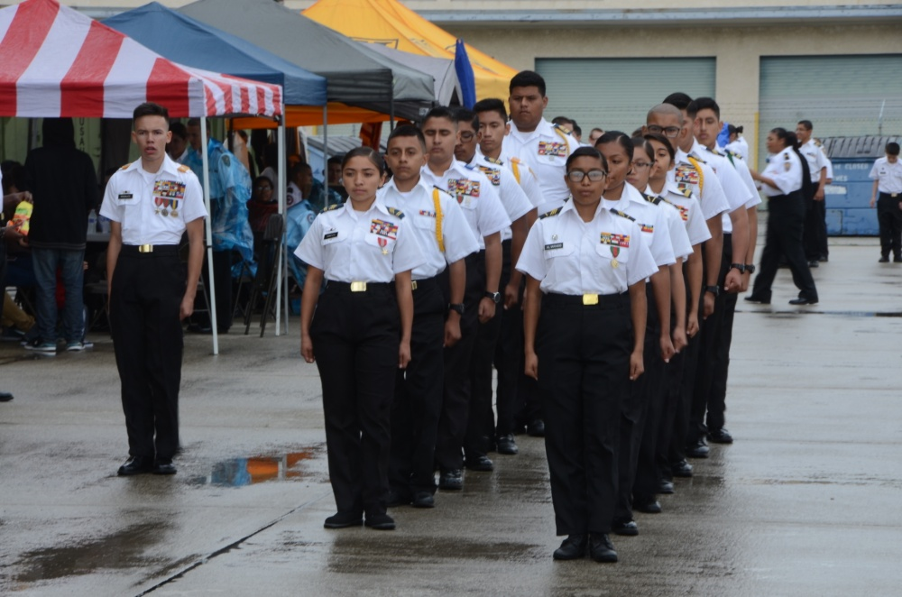
California Cadet Corps Curriculum on Military Basics
“Individual Drill with sharpness, precision and snap”
M3/A: Individual Drill with Weapons

Slide 2
Individual Drill with Weapons
Suggested Supplies:
Replica (3-4 pound) rifles or
Props that can substitute for drill rifles

Slide 3
Individual Drill With
Weapons Agenda
B1. Basic Procedures
B2. Order Arms
B3. Rest Positions
B4. Port Arms
B5. Present Arms
B6. Inspection Arms
B7. Right Shoulder Arms
B8. Left Shoulder Arms
B9. Changing Positions

Slide 4
basic Procedures
1. Identify the basic rules that govern the Manual of Arms.

Slide 5
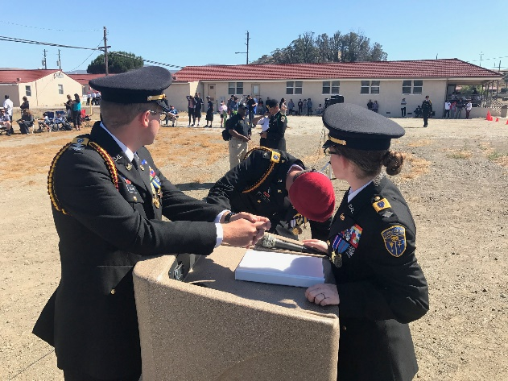
Basic Procedures
Objectives
90% of Unit Cadets can properly execute the manual of arms using a replica (3-4 pound) rifle with sharpness, precision, and snap when given proper commands.
Identify the basic rules that govern the Manual of Arms.
Identify the parts of a rifle used in the Manual of Arms.
Essential Question:
When can you execute facing movements?

Slide 6
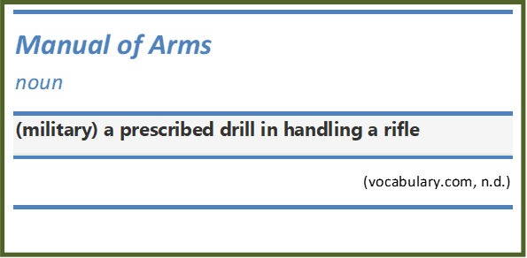
Basic Rules Governing the Manual of Arms
References:
TC 3-21.5. Drill and Ceremonies (US Army). https://cacadets.org/Regulations Chapter 5 and Appendix D
Fort Jackson Army Individual Drill Videos: https://vimeo.com/channels/524805

Slide 7
Basic Rules Governing the Manual of Arms
The Army Drill and Ceremonies Manual, TC3-21.5, (Chap. 5) covers the Manual of Arms for M-16 series rifle
Other weapon types covered in Appendices B – F
CACC usually uses replicas of the M1903 Springfield, M1 Rifle
Standards set in TC3-21.5, Appendix D
Some basic rules are taken from TC3-21.5, Chp. 5

Slide 8
Basic Rules Governing the Manual of Arms
At the halt, all movements are initiated from Order Arms or Sling Arms, which are the Positions of Attention with the rifle.
All precision movements are executed in quick time cadence.
The command Port, ARMS must be given before the command for Double Time.

Slide 9
Basic Rules Governing the Manual of Arms
Facings, alignments, and short-distance marching movements are executed at Order Arms or Sling Arms.
When these movements are commanded while at Order Arms, the Cadet automatically raises the rifle about one inch (1”) off the ground on the command of execution.
When the movement has been completed, the Cadet automatically returns the rifle to Order Arms.

Slide 10
Basic Rules (continued)
Facing movements are executed from Order Arms or Sling Arms.
When executing Right, Face and Forward, March, the facing movement is executed before the command for the manual of arms.
After a marching movement has been completed, Order, Arms or Sling, Arms is commanded before the command for the facing movement.
*You cannot execute facing movements when the rifle is at any position other than order arms or sling arms*

Slide 11
Basic Rules (continued)
Ready, Port, ARMS must be commanded following Inspection Arms and before any other movements can be commanded.
Port Arms is the key position assumed in most manual of arms movements from one position to another except Right Shoulder Arms from Order Arms and Order Arms from Right Shoulder Arms.
Manual of arms movements are a combination of the Position of Attention and the procedures for the prescribed movement.
Most manual of arms movements are executed with the head, eyes, and body stationary as in the Position of Attention.

Slide 12
Parts of the Rifle
2. Identify the parts of a rifle used in the Manual of Arms.

Slide 13
Basic Procedures
Objectives
90% of Unit Cadets can properly execute the manual of arms using a replica (3-4 pound) rifle with sharpness, precision, and snap when given proper commands.
Identify the basic rules that govern the Manual of Arms.
Identify the parts of a rifle used in the Manual of Arms.
Essential Question:
What are the 10 parts of a rifle you should know?

Slide 14
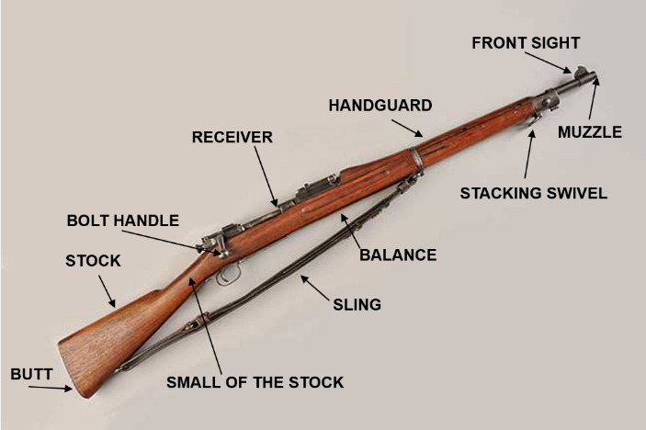
Parts of the Rifle
The parts of the M1903 or similar rifle that you should know are:
Butt | Stock
Sling | Bolt Handle
Balance | Receiver Group
Handguards | Stacking Swivel
Front Sight | Muzzle

Slide 15
Check on Learning
All movements are initiated from _______ or _________.
T/F? The command Port, ARMS must be given before the command for Double Time.
When a Cadet has completed a movement, the Cadet does what?
Most manual of arms movements are executed with the head, eyes, and body _____________.
A Cadet cannot execute facing movements when the rifle is at any position other than ______ or _________.

Slide 16
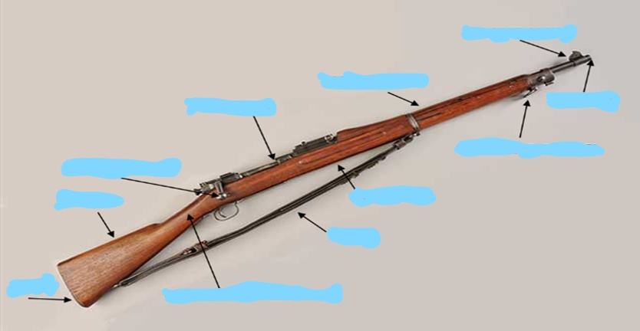
Check on Learning
Practicum: If you have access to a drill rifle, use it in the identification of the 10 rifle parts you should know. Otherwise, use the picture below for this exercise.
Name the parts of the rifle:

Slide 17
Order Arms
3. Properly execute Order Arms with a rifle.

Slide 18
Order Arms
Objectives
90% of Unit Cadets can properly execute the manual of arms using a replica (3-4 pound) rifle with sharpness, precision, and snap when given proper commands.
3. Properly execute Order Arms with a rifle.
Essential Question:
What position does a Cadet assume with the command of Order Arms ?

Slide 19
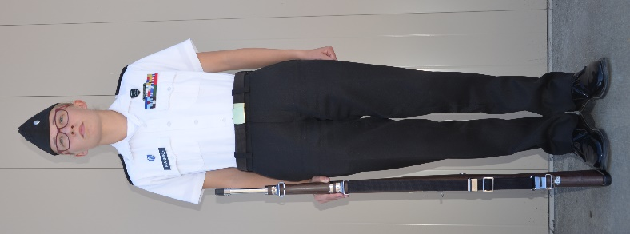
Order Arms
Assume Order Arms on the command FALL IN or from Parade Rest on the command of execution ATTENTION.
At Order Arms, maintain the Position of Attention with the rifle.
Place the butt of the rifle on the marching surface with sights to the rear and touching the right foot.
Secure the rifle with the right hand in a “U” formed by the fingers and thumb.
Keep the right arm as in the Position of Attention and hold the rifle with the right thumb and fingers.
Keep the right hand and arm behind the rifle.

Slide 20
Check on Learning
Assume ____________ on the command FALL In.
T/F - The butt of the rifle is placed on the marching surface and touching the left foot?
Keep the _______ and arm behind the rifle

Slide 21
Practicum
In the classroom, gym, or outside:
Practice Order of Arms with a replica rifle or prop

Slide 22
Rest Positions
4. Properly execute the Rest Positions with a rifle.

Slide 23
Rest Positions with a Rifle
Objectives
90% of Unit Cadets can properly execute the manual of arms using a replica (3-4 pound) rifle with sharpness, precision, and snap when given proper commands.
4. Properly execute the Rest Positions with a rifle.
Essential Question:
How are the rifle rest positions executed?

Slide 24
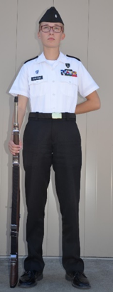
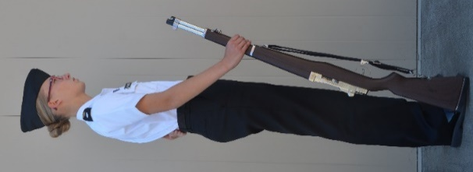
Rest Positions
The rifle Rest positions are commanded and executed the same as individual drill with the following additions:
On the command of execution REST of Parade, REST, thrust the muzzle forward keeping the toe of the butt on line with the front of the right foot and the right arm straight.
Execute Stand at Ease with the rifle in the same manner as Parade Rest.
On the command AT EASE or REST, keep the butt of the rifle in place as in Parade Rest.

Slide 25
Check on Learning
When executing Stand at Ease with the rifle where should you turn your head and eyes?
T/F – On the command of REST of Parade, REST your arm should be bent.
On the command AT EASE or REST, does the butt of the rifle remain in place as in Parade Rest or move forward?

Slide 26
Practicum
In the classroom, gym, or outside:
Practice Rest Positions with a replica rifle or prop

Slide 27
Port Arms
5. Properly execute Port Arms with a rifle.

Slide 28
Port Arms with a Rifle
Objectives
90% of Unit Cadets can properly execute the manual of arms using a replica (3-4 pound) rifle with sharpness, precision, and snap when given proper commands.
5. Properly execute Port Arms with a rifle.
Essential Questions:
What count is the Port Arms movement?

Slide 29
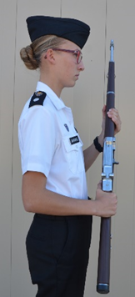
Port Arms
Port Arms from Order Arms is a two-count movement. The command is Port, ARMS.
On the command of execution ARMS, grasp the rifle with the right hand and raise the rifle diagonally across the body, keeping the right elbow down alongside the rifle (without strain).
With the left hand, simultaneously grasp the rifle at the balance (grasping the wood stock right above the receiver) so that the rifle is about 4 inches (a fist) from the body.
On count two, grasp the rifle at the small of the stock with the right hand. Hold the rifle diagonally across the body, about 4 inches from the body, the right forearm horizontal, and the elbows close to the sides.

Slide 30
Order Arms from Port Arms
Order Arms from Port Arms is executed in three counts. The command is Order, ARMS.
On the command of execution ARMS, move the right hand up and across the body and firmly grasp the rifle on the upper stock (handguard) without moving the rifle, and keep the right elbow aligned alongside the rifle.
On count two, move the left hand from the balance and lower the rifle to the right side until it is about one inch (1”) from the marching surface next to the right foot.
(CONTINUED ON NEXT SLIDE)

Slide 31
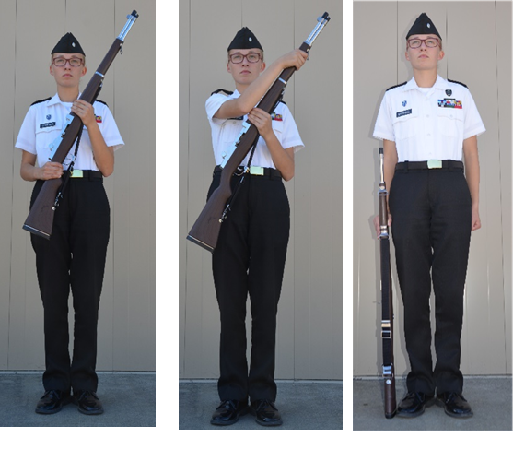
Order Arms from Port Arms
Guide the rifle to the side by placing the Order Arms from Port Arms index finger of the left hand at the top of the rifle near the stacking swivel, fingers and thumb extended and joined, palm to the rear.
On count three, move the left hand sharply to the left side, gently lower the rifle to the ground next to the right foot, and resume the position of Order Arms.

Slide 32
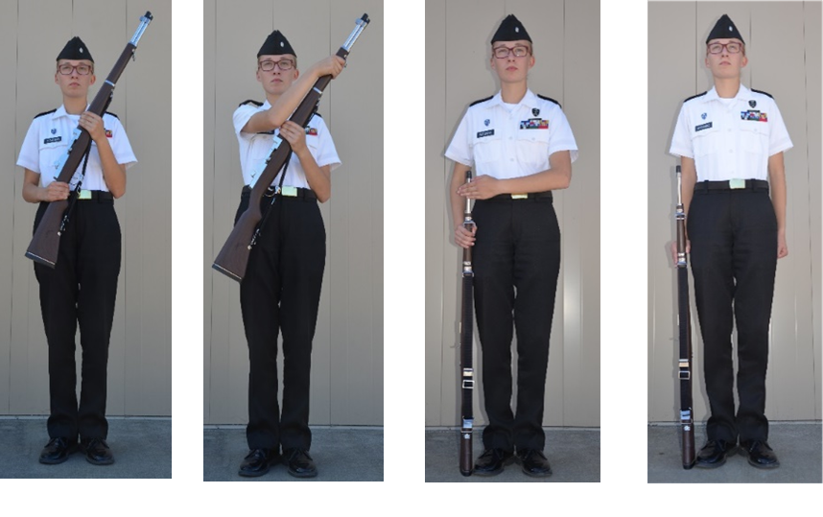
Order Arms from Port Arms

Slide 33
Check on Learning
Order Arms from Port Arms is a _________ count move.
The command of execution for Port Arms is .
T/F – On count three, the rifle should be lowered to the ground next to the left foot.

Slide 34
Practicum
In the classroom, gym, or outside:
Practice Port Arms and Order Arms with a replica rifle or prop

Slide 35
Present Arms
6. Properly execute Present Arms with a rifle.

Slide 36
Present Arms with a Rifle
Objectives
90% of Unit Cadets can properly execute the manual of arms using a replica (3-4 pound) rifle with sharpness, precision, and snap when given proper commands.
6. Properly execute Present Arms with a rifle.
Essential Question:
What is the correct final position of the rifle when Presenting Arms?

Slide 37
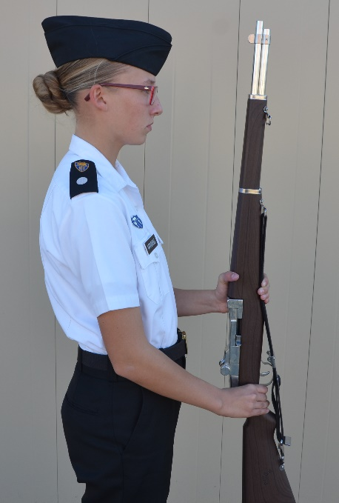
Present Arms
Present Arms from Order Arms is a three-count movement. The command is Present, ARMS.
On the command of execution ARMS, execute Port Arms in two counts.
On count three, twist the rifle with the right hand so that the sights are to the rear, and move the rifle to a vertical position about four inches (4”) in front of and centered on the body.
Lower the rifle until the left forearm is horizontal.
Keep the elbows in at the sides.
Keep the left thumb wrapped around the rifle and touching the right side of the handguard right above the receiver.
NOTE: Incline the barrel slightly backward to ensure that the weapon is vertical.

Slide 38
Order Arms from Present Arms
Order Arms from Present Arms is a four-count movement. The command is Order, ARMS.
On the command of execution ARMS, return the rifle to Port Arms.
Counts two, three, and four are the same as Order Arms from Port Arms.

Slide 39
Additional Notes
Port Arms is assumed en route to or from Present Arms when going to or from Right Shoulder or Left Shoulder Arms. Present Arms from or to Port Arms is a one-count movement.
When rendering reports or courtesy to an individual from Order Arms:
Execute Present Arms and turn the head and eyes toward the individual addressed.
Order Arms is executed automatically upon acknowledgment of the Salute.

Slide 40
Check on Learning
What is the command of execution for the movement Order Arms from Present Arms?
T/F – Port Arms is assumed en route to or from Present Arms when going to Right Shoulder Arms.
T/F - When rendering reports or courtesy to an individual from Order Arms, execute Present Arms and turn the head and eyes toward the individual addressed.

Slide 41
Practicum
In the classroom, gym, or outside:
Practice Present Arms with a replica rifle or prop

Slide 42
Inspection Arms
7. Properly execute Inspection Arms (if you have a M1903 Rifle).

Slide 43
Inspection Arms with a Rifle
Objectives
90% of Unit Cadets can properly execute the manual of arms using a replica (3-4 pound) rifle with sharpness, precision, and snap when given proper commands.
Properly execute Inspection Arms (if you have a M1903 Rifle).
Essential Question:
Should Cadets use replica rifles for inspection?

Slide 44
Replica Rifles vs Demilitarized Rifles
Many replica rifles used in the CA Cadet Corps do not have functioning bolts
Those that do are often cheap and easily broken
It is not recommended that Cadets practice Inspection Arms unless they have access to actual (demilitarized) rifles.
In that case, follow the instructions in TC 3-21.5, Appendix D.

Slide 45
Check on Learning
Are replica rifles mandatory for inspection practice?
T/F - Cadets should not practice Inspection Arms with demilitarized rifles.

Slide 46
Right Shoulder Arms
8. Properly execute Right Shoulder Arms with a rifle.

Slide 47
Right Shoulder Arms
Objectives
90% of Unit Cadets can properly execute the manual of arms using a replica (3-4 pound) rifle with sharpness, precision, and snap when given proper commands.
8. Properly execute Right Shoulder Arms with a rifle.
Essential Question:
How do the hands move in the movement Right Shoulder, Arms?

Slide 48
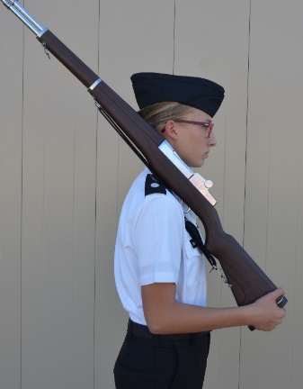
Right Shoulder Arms
Right Shoulder Arms from Order Arms is a four-count movement. The command is Right Shoulder, ARMS.
Execute count one, the command of execution ARMS.
On count two, release the grasp of the right hand and grasp the heel of the butt between the first two fingers with the thumb and forefinger touching.
(NOTE: Do NOT put the right hand on the small of the stock as in Port Arms. Move the right hand directly from the handguard to the butt of the rifle.)

Slide 49
Right Shoulder Arms (continued)
On count three (without moving the head), release the grasp of the left hand, twist the rifle so that the sights are up, and place the weapon onto the right shoulder, moving the left hand to the small of the stock to guide the rifle to the shoulder.
Keep the fingers and thumb (left hand) extended and joined with the palm turned toward the body.
Keep the left elbow down, and keep the right forearm horizontal (parallel to the ground) with the right upper arm touching the body and elbow on line with the back.
On count four, sharply move the left hand back to the left side as in the Position of Attention.
**The next slide shows Right Shoulder Arms from Order Arms**

Slide 50
Right Shoulder Arms from Order Arms
Note: Left elbow should be down. Photo shows incorrect position of elbow.

Slide 51
Holding the Butt of the Rifle
NOTE: It is very specific how one is to hold the butt of the rifle at Right and Left Shoulder Arms. Touch the tip of the index finger to the tip of the thumb, forming an oblong. The thumb and index finger go on the front of the rifle. The other three fingers go on the bottom of the rifle butt.

Slide 52
Order Arms from Right Shoulder Arms
Order Arms from Right Shoulder Arms is a four-count movement. The command is Order, ARMS.
On the command of execution ARMS, without moving the head and without changing the grasp of the right hand, press down quickly and firmly on the butt of the rifle with the right hand and twist the weapon (with the sights up), guiding it diagonally across the body and about four inches (4”) from the waist.
Grasp the rifle with the left hand at the balance.
On count two, move the right hand up and across the body and firmly grasp the rifle just forward of the lower band without moving the rifle; keep the right elbow down without strain.
Counts three and four are the same as from Port Arms to Order Arms.

Slide 53
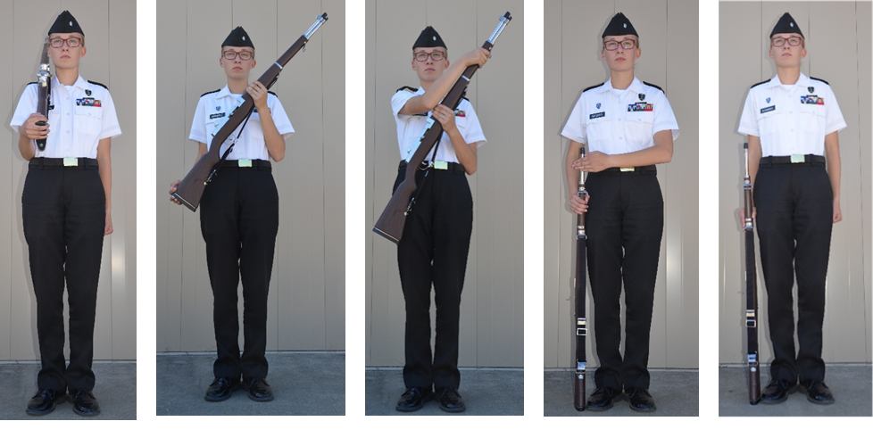
Order Arms from Right Shoulder Arms

Slide 54
Check on Learning
What is the command of execution in Right Shoulder, Arms?
T/F - On count two, the Cadet releases the grasp of the right hand and grasps the heel of the butt between the first two fingers with the thumb and forefinger touching.
On count three, release the grasp of the _____ hand, twist the rifle so that the sights are up, and place the weapon onto the right shoulder.

Slide 55
Practicum
In the classroom, gym, or outside:
Practice Right Shoulder Arms with a replica rifle or prop
Ensure the butt of the rifle is being held correctly.

Slide 56
Left Shoulder Arms
9. Properly execute Left Shoulder Arms with a rifle.

Slide 57
Left Shoulder Arms
Objectives
90% of Unit Cadets can properly execute the manual of arms using a replica (3-4 pound) rifle with sharpness, precision, and snap when given proper commands.
9. Properly execute Left Shoulder Arms with a rifle.
Essential Question:
What is the placement of the left arm at the end of the Left Shoulder Arms movement?

Slide 58
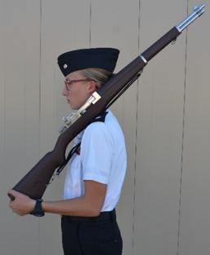
Left Shoulder Arms
Left Shoulder Arms from Order Arms is a four-count movement. The command is Left Shoulder, ARMS.
On the command of execution ARMS, execute Port Arms in two counts.
On count three, release the grasp of the left hand and (without moving the head) place the rifle on the left shoulder with the right hand (with the sights up), keeping the right elbow down.

Slide 59
Left Shoulder Arms (continued)
At the same time, grasp the rifle with the left hand with the heel of the butt between the first two fingers and with the thumb and forefinger touching.
The left forearm is horizontal (parallel to the ground), and the left upper arm is against the side and on line with the back.
On count four, move the right hand sharply to the right side as in the Position of Attention.

Slide 60
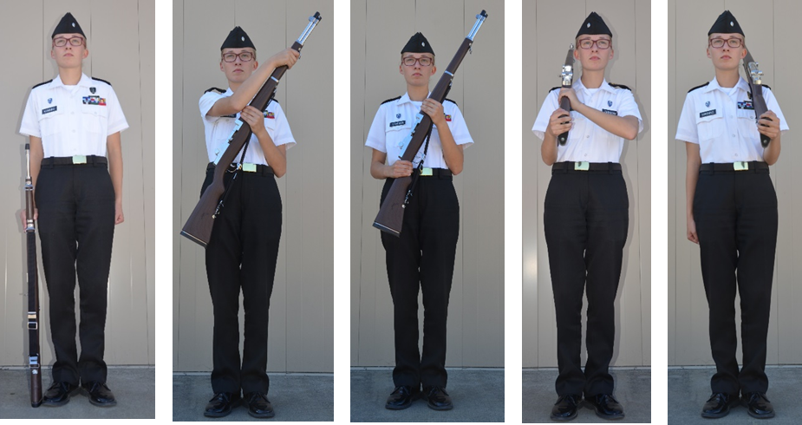
Left Shoulder Arms from Order Arms

Slide 61
Order Arms from Left Shoulder Arms
Order Arms from Left Shoulder Arms is a five-count movement. The command is Order, ARMS.
On the command of execution ARMS, move the right hand up and across the body and grasp the small of the stock, keeping the right elbow down.
On count two (without moving the head), release the grasp of the left hand and with the right hand move the rifle diagonally across the body (sights up) about four inches (4”) from the body.
At the same time, grasp the rifle at the balance with the left hand, and resume Port Arms.
Counts three, four, and five are the same as Order Arms from Port Arms.

Slide 62
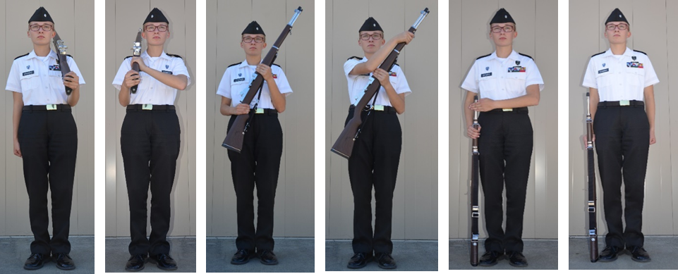
Order Arms from Left Shoulder Arms

Slide 63
Check on Learning
What is the command of execution in Left Shoulder, Arms?
At the end of the Left Shoulder Arms movement, the left forearm is to the ground and the left upper arm is the side and on line with the .

Slide 64
Practicum
In the classroom, gym, or outside:
Practice Left Shoulder Arms with a replica rifle or prop

Slide 65
Changing positions
10. Properly change from each of the positions in the Manual of Arms to any other position.
11. Properly execute 15-Count Manual of Arms with a rifle.

Slide 66
Changing Positions
Objectives
90% of Unit Cadets can properly execute the manual of arms using a replica (3-4 pound) rifle with sharpness, precision, and snap when given proper commands.
10. Properly change from each of the positions in the Manual of Arms to any other position.
11. Experienced Cadets properly execute 15-Count Manual of Arms with a rifle.
Essential Question:
What is the 15-count Manual of Arms?

Slide 67
Changing Positions Right Shoulder Arms from Port Arms
Right Shoulder Arms from Port Arms is a three-count movement. The command is Right Shoulder, ARMS.
On the command of execution ARMS, release the grasp of the right hand and grasp the rifle with the heel of the butt between the first two fingers, with the thumb and forefinger touching.
Counts two and three are the same as counts three and four from Order Arms.
When marching, the command is given as the right foot strikes the ground; the right hand moves to the butt of the rifle when the left foot strikes the ground, immediately after the command.

Slide 68
Changing Positions Port Arms from Right Shoulder Arms
Port Arms from Right Shoulder Arms is a two-count movement. The command is Right Shoulder, ARMS.
On the command of execution ARMS, execute count one of Order Arms from Right Shoulder Arms.
On count two, release the grasp of the right hand and grasp the rifle at the small of the stock and come to Port Arms.
When marching, the command is given as the right foot strikes the ground; the first movement, taking the rifle off the shoulder, happens the next time the left foot strikes the ground.

Slide 69
Changing Positions Left Shoulder Arms from Port Arms
Left Shoulder Arms from Port Arms is a two-count movement. The command is Left Shoulder, ARMS.
On the command of execution ARMS, execute Left Shoulder Arms in the same manner as counts three and four from Order Arms.
When marching, the command is given as the left foot strikes the ground.

Slide 70
Changing Positions Port Arms from Left Shoulder Arms
Port Arms from Left Shoulder Arms is a two-count movement. The command is Port, ARMS.
On the command of execution ARMS, execute the first two counts of Order Arms from Left Shoulder Arms.
When marching, the command is given as the left foot strikes the ground; the first movement, putting the rifle onto the left shoulder, takes place when the left foot strikes the ground, so the Cadet skips a beat after the command is given.

Slide 71
Changing Positions Left Shoulder Arms from Right Shoulder Arms
Left Shoulder Arms from Right Shoulder Arms is a four-count movement. The command is Left Shoulder, ARMS.
On the command of execution ARMS, execute the first count the same as executing Order Arms.
On count two, remove the right hand from the butt of the rifle and grasp the small of the stock (Port Arms).
Counts three and four are the same movements as from Port Arms.
When marching, the command is given as the left foot strikes the ground; the first movement, taking the rifle off the right shoulder, happens when the left foot strikes the ground - skipping a beat after the command.

Slide 72
Changing Positions Right Shoulder Arms from Left Shoulder Arms
Right Shoulder Arms from Left Shoulder Arms is a five-count movement. The command is Right Shoulder, ARMS.
On the command of execution ARMS, execute Port Arms in two counts.
Counts three, four, and five are the same as from Port Arms.
When marching, the command is given as the right foot strikes the ground; the first movement, putting the right hand on the small of the stock, happens when the left foot strikes the ground, immediately after the command.

Slide 73
Changing Positions Present Arms from Right Shoulder Arms or Left Shoulder Arms
Present Arms from Right Shoulder Arms or Left Shoulder Arms, while in formation, is executed from the Halt only, NOT while marching. The command is Present, ARMS.
On the command of execution ARMS, come to Port Arms from either shoulder and then execute Present Arms (in one count) from Port Arms.
Cadets who might salute during Eyes Right while marching in a ceremony (Platoon Leaders and above), if carrying rifles, rifles should be at Sling Arms.

Slide 74
Changing Positions
To resume Right (Left) Shoulder Arms from Present Arms, the command is Right (Left) Shoulder, ARMS.
On the command of execution ARMS, execute Port Arms in one count and then execute the counts as prescribed from Port Arms.

Slide 75
15-Count Manual of Arms
Experienced Cadets should be able to execute the 15-count manual of arms in unison from Order, to Right Shoulder, to Left Shoulder, to Present, to Order Arms.
The command is Fifteen-Count Manual, ARMS.

Slide 76
Check on Learning
When marching, the command given for Right Shoulder, Arms to Port, Arms is given when which foot strikes the ground?
What is the 15-Count Manual of Arms?

Slide 77
Practicum
In the classroom, gym, or outside:
Practice changing positions with a replica rifle or prop
Experienced Cadets: practice executing the 15-count manual of arms in unison.

