Slide 1
California Cadet Corps Curriculum on Basics
ESSAYONS
“Principles”

Slide 2
Agenda
C1. Leadership Principles
C2. Leadership Indicators
C3. Leader’s Code

Slide 3
LEADERSHIP PRINCIPLES
C1. Identify the Leadership Principles

Slide 4
What are Leadership Principles?
The definition of principle is:
a fundamental truth or proposition that serves as the foundation for a system of belief or behavior
a standard of moral or ethical decision-making
a rule or belief governing one's personal behavior

Slide 5
Leadership Principles….
Are requirements for good leaders
Are standards for our behavior
Help leaders be effective
Are an important source for accomplishing the mission

Slide 6
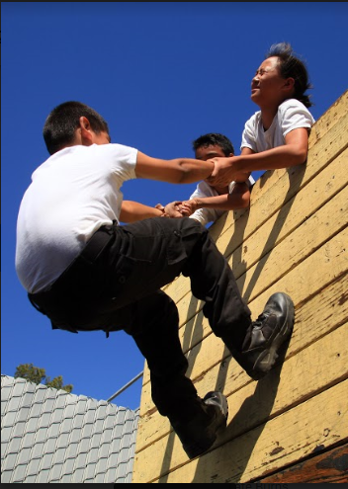
Principle 1: Know Yourself and Seek Self-Improvement
Know your strengths and your weaknesses
Strive to be a better person today than you were yesterday
Learn something new everyday

Slide 7
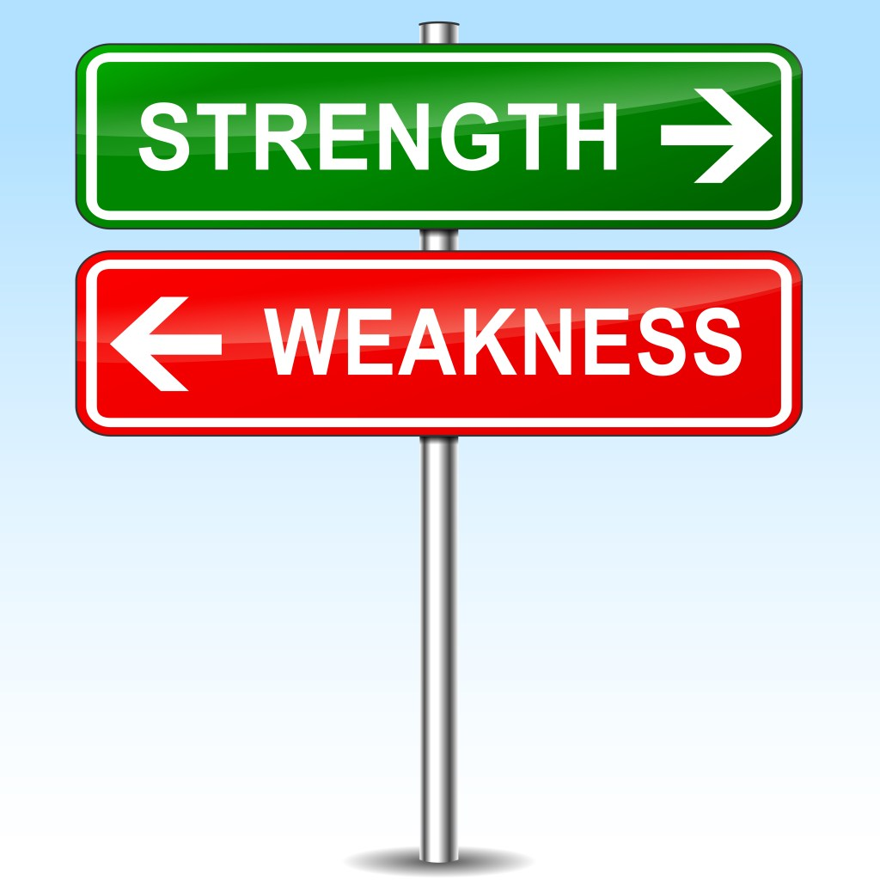
Strengths and Weaknesses
Capitalize on your strengths
Strengthen your weaknesses

Slide 8
Principle 2: Be Technically and Tactically Proficient
Proficiency - being skilled at something
Technical proficiency - knowing important info about your job
Tactical proficiency - implementing your job well

Slide 9
Technical and Tactical Proficiency
Good leaders will gain knowledge
Good leaders use knowledge to accomplish the mission
Good leaders are competent

Slide 10
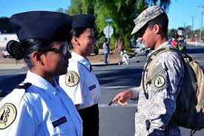
Principle 3: Develop a Sense of Responsibility Among Your Subordinates
Teach those whom you lead to share in the responsibility to accomplish the mission
Create a sense of “ownership” over getting the job done

Slide 11
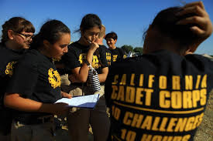
Responsibility
Teamwork and accountability
Leaders share blame if it does not go well
and share credit if it goes well
Leaders have a stake in making sure the project is successful

Slide 12
Principle 4: Make Sound and Timely Decisions
SOUND DECISIONS- good decisions based on common sense; decisions which help accomplish the mission & maintain the welfare of Cadets
TIMELY DECISIONS - made quickly and communicated with confidence to the other Cadets

Slide 13
Principle 5: Train your Cadets as a Team
Cadets should see themselves as a group rather than as individuals
Working collaboratively will accomplish more than working as individuals

Slide 14
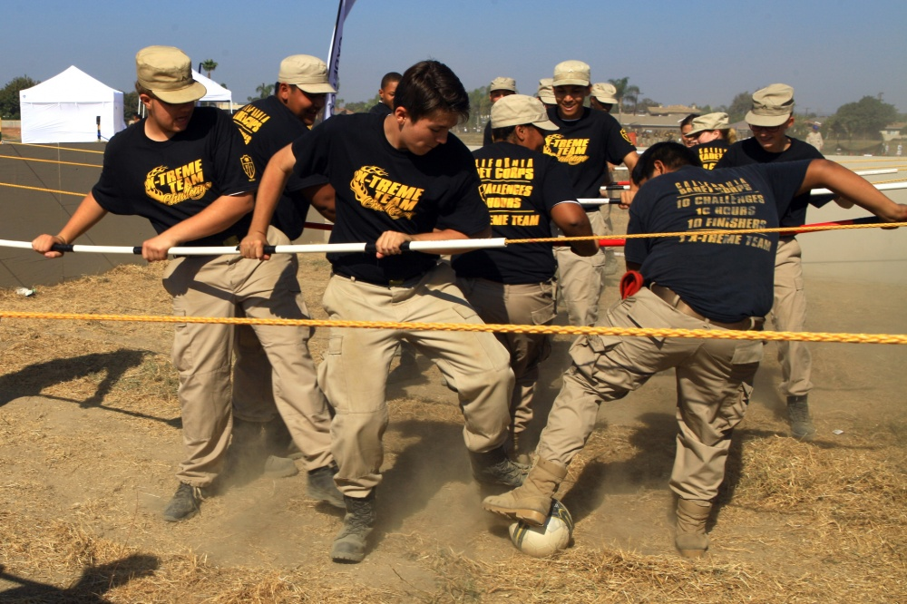
Teams…
Work toward a common goal
The more you practice, the better the team
Give people a sense of belonging

Slide 15
Principle 6: Set the Example
In the way you act
In the way you dress
In the words you speak
In the attitude you display
In the way you treat other people

Slide 16
An Example, Good or Bad
…is emulated or copied by the people who witness it
If Cadets see you looking and acting professionally, they will take you seriously
If Cadets see you acting foolishly or dressed sloppily, they will not listen to you

Slide 17
Principle 7: Train your Cadets in Accordance with Their Capabilities
Remember the story of Goldilocks – the soup being too hot, too cold, then just right?
Training should not be too hard, or too easy. It needs to be JUST RIGHT

Slide 18
Training that is “Just Right”
Takes into consideration the abilities & experiences of persons being trained
Helps the people being trained to:
make connections to what they already know
see how they will use the training in the future
People need to see a reason to pay attention in training!

Slide 19
More about Training
Effective training makes sure the “Message Given” is “Message Received”
Constantly check to see the Cadets understand what is being taught
Give the Cadets you are training a chance to ask questions

Slide 20
Principle 8: Ensure the task is U-S-A
UNDERSTOOD - do they know what you want them to do?
SUPERVISED - make sure they are doing it right!
ACCOMPLISHED - make sure the job gets done

Slide 21
Leaders who don’t U-S-A…
End up with Cadets who do:
Not accomplish assigned tasks
Assigned tasks incorrectly
End up having to:
Re-do a lot of work because it was not done correctly the first time
Do a lot of work themselves because their subordinates do not accomplish it

Slide 22
Principle 9: Know your Cadets and Look out for their Welfare
Know their strengths
Know their weaknesses
Look out for their safety and well-being at all times

Slide 23
Cadet Welfare…
Are Cadets too cold, too hot, or just right?
Are Cadets tired or hungry?
Are they doing things that are unsafe that might get them hurt?
Are they happy and motivated?
Did they all eat before you eat?

Slide 24
REMEMBER: Your cadets come first. Do not expect them to do anything you yourself would not be willing to do. Take care of their needs BEFORE you take care of your own needs.

Slide 25
Principle 10: Keep Your Cadets Informed
What’s going on at your unit, at the Brigade, in the state
Be sure they understand the reasons behind decisions
Communicate with them regularly to tell them “the scoop” on everything you know about official CACC business (not gossip)

Slide 26
Ways to Inform:
Newsletters
Daily briefings
Bulletin boards
Chalkboards/white boards with “announcements” sections
Facebook/Instagram/Twitter
Can you think of others?

Slide 27
Principle 11: Seek Responsibility and Take Responsibility for Your Actions
Always want to advance in rank and positions of leadership
In order to be a better and more effective leader
When you make decisions or choose to do/not do something, always accept the blame when it is wrong

Slide 28
Review: The 11 Leadership Principles
Know yourself and seek self-improvement.
Be technically and tactically proficient.
Develop a sense of responsibility among your subordinates.
Make sound and timely decisions.
Train your Cadets as a team.
Set the example.
Train your Cadets in accordance with their capabilities.
Ensure the task is understood, supervised, and accomplished.
Know your Cadets and look out for their welfare.
Keep your Cadets informed.
Seek responsibility and take responsibility for your actions.

Slide 29
Check on Learning
In your own words explain what it means to “Train your Cadets in accordance with their capabilities” (Principle 7)
What does the acronym “U-S-A” stand for in Principle 8? How is it applied in leadership?
T/F: Principle 3: Develop a sense of responsibility among your subordinates includes the idea that suboardinate Cadets should feel a sense of “ownership” in getting the job done.

Slide 30
LEADERSHIP INDICATORS
C2. Discuss the Leadership Indicators in relation to their unit.

Slide 31
INDICATORS OF LEADERSHIP
Morale
Proficiency
Discipline
Esprit de Corps

Slide 32
What is an indicator?
“Something that points toward something else”
Something that shows if good leadership is present in an organization
The 4 indicators can be used to tell:
if a leader is a good leader, and
if there is strong leadership in an organization

Slide 33
Indicator #1: Morale
Morale:
is how happy and positive people are about their jobs and the organization to which they belong
Are they generally happy to be part of the group?
Are they generally in “high spirits?”

Slide 34
Ways to Build Morale
Activities which are fun and which help people develop a sense of camaraderie or friendship with others in the group
Games
Cadences
Songs
Skits
Can you think of others?

Slide 35
Indicator #2: Proficiency
In a good organization, people know their jobs and do them well
In organizations with weak leadership, people don’t always know what they are doing and they do not accomplish the mission effectively

Slide 36
How is proficiency developed?
Through lots of high quality training activities
Ongoing training
Regular “checkups” to make sure jobs are being done right
Corrections when people are not doing something correctly

Slide 37
Indicator #3: Discipline
Discipline is “Prompt obedience to orders” AND
Taking action in the absence of orders

Slide 38
How do you know if people are disciplined in an organization?
They work hard
They follow directions without questioning their superiors’ lawful orders (obviously, if their superiors give them unlawful orders, they should not follow them)
When there are no specific instructions, they do what they think is the right thing to do even though there is no “boss” there to look over their shoulder

Slide 39
How do you develop discipline?
You can be mean to people, but that’s NOT a good way to develop discipline
It’s best to use techniques of motivation

Slide 40
Motivating people to be disciplined…
Help them:
Believe they are capable of accomplishing the mission (this is called efficacy)
See the task as possible rather than impossible (level of difficulty)
Understand what you want them to do and why
See both the benefits to them if they do it as you have asked AND the “costs” to them of not doing it as you ask (cost/benefit analysis)

Slide 41
Esprit de Corps - pride in the organization to which you belong
Developed by giving people a sense of “unit identity”
Guidons
Patches, sweatshirts, t-shirts, logos, etc
Unit cadences and songs
Mascots, cheers
Friendly unit competition

Slide 42
Effective leaders lead organizations with:
high levels of MORALE
people with high levels of job PROFICIENCY
DISCIPLINE among their members
a group spirit called ESPRIT DE CORPS

Slide 43
Check on Learning
How would describe the current morale in your Cadet unit?
In what ways are your developing proficiency in your unit?
Do Cadets take initiative in your unit when no specific instructions are provided?

Slide 44
THE LEADER’S CODE
C3. Explain the key points of the Leader’s Code

Slide 45
The Leader’s Code
I become a Cadet leader by what I do. I know my strengths and my weaknesses, and I strive constantly for self-improvement. I live by a moral code and set an example that others can follow. I know my job, and I carry out the spirit as well as the letter of the orders I receive.
I take the initiative and seek responsibility, and I face situations with boldness and confidence. I estimate the situation and make my own decisions as to the best course of action. No matter what the requirements, I stay with the job until the job is done; no matter what the results, I assume full responsibility.
I train my Cadets as a team and lead them with tact, enthusiasm and justice. I command their confidence and their loyalty: they know I would not assign to them any duty I, myself, would not perform. I make sure they understand their jobs, and I follow through energetically to ensure their duties are completed fully. I keep my Cadets informed, and I make their welfare one of my prime concerns.
These things I do selflessly in fulfillment of the obligations of leadership and for the achievement of the group goal.

Slide 46
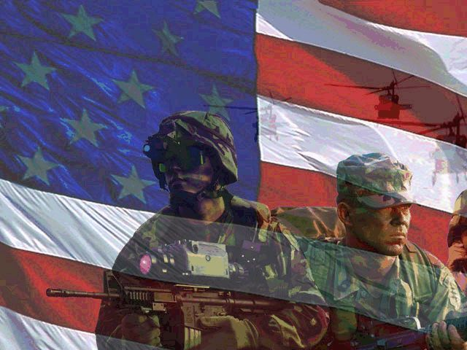
The Cadet Leader’s Code
Part One

Slide 47
I become a Cadet leader by what I do
My actions make me a leader, not the position I hold
If I act like a leader, people will want to follow me

Slide 48
I know my strengths and my weaknesses
What I am good at and what I am not good at
What I need to improve upon and what I already do very well

Slide 49
And I strive constantly for self-improvement
I am always trying to get better at the things I am not as good at
I am always showing people that I do not know everything, but I am trying to get better

Slide 50
I live by a moral code
I do not:
Lie
Cheat
Steal
Tell dirty jokes
Drink alcohol
Smoke
Do drugs
Etc

Slide 51
And set an example that others can follow
People see me and the way I act
My behavior is exemplary and other Cadets can always count on me to behave properly

Slide 52
I know my job
I am good at my assigned job(s)
I have a lot of knowledge about the Cadet Corps and everything I am responsible for

Slide 53
And I carry out the spirit as well as the letter of the orders I receive
The “letter” of orders means I follow the exact orders I am given, word for word
The “spirit” of the orders means I follow the ideas behind the orders

Slide 54
An Example of “Spirit” and “Letter” of Orders
I ask you to guard the front door of school for Open House to help guests and I tell you not to move from there, but
An older woman asks you to escort her to the office and you do so
**The “letter” of the orders says do not move, but the “spirit” says it is OK to help**

Slide 55
The Cadet Leader’s Code
Part Two

Slide 56
I take the initiative
I do what is right even if I have not been specifically instructed what to do
I figure out what is the right thing to do and I do it

Slide 57
…and seek responsibilities
I want to gain many experiences of leadership, increasing as I get better at my job
I want others to trust me with increasingly important jobs

Slide 58
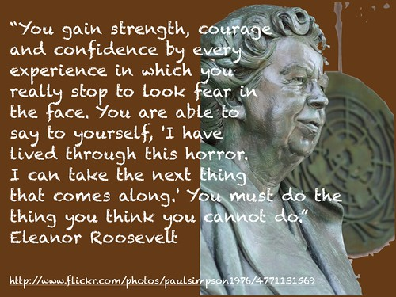
And I face situations with boldness and confidence
When faced with problems or challenges, I do not back down
I face problems head on
I am confident in my ability to tackle complicated problems
I know I am capable of problem solving and I show others my self-confidence

Slide 59
I estimate the situation
I don’t rush to judgment or action until I am first aware of the situation in which I find myself
I gather information about the task at hand before I act

Slide 60
…and make my own decision as to the best course of action
I consider all the options
I choose the best one and communicate my decision to others in a way that makes them know I mean business and I know what I am doing
I consult with others who can give me information about things I need to make decisions on, but ultimately I make the final decision and stick by that decision

Slide 61
No matter what the requirements, I stay with the job until the job is done
I do not quit in the middle of the game
When I start something, I finish it to the best of my ability
No matter how hard something may be, I am not a quitter
Even though I may be tired, I continue on

Slide 62
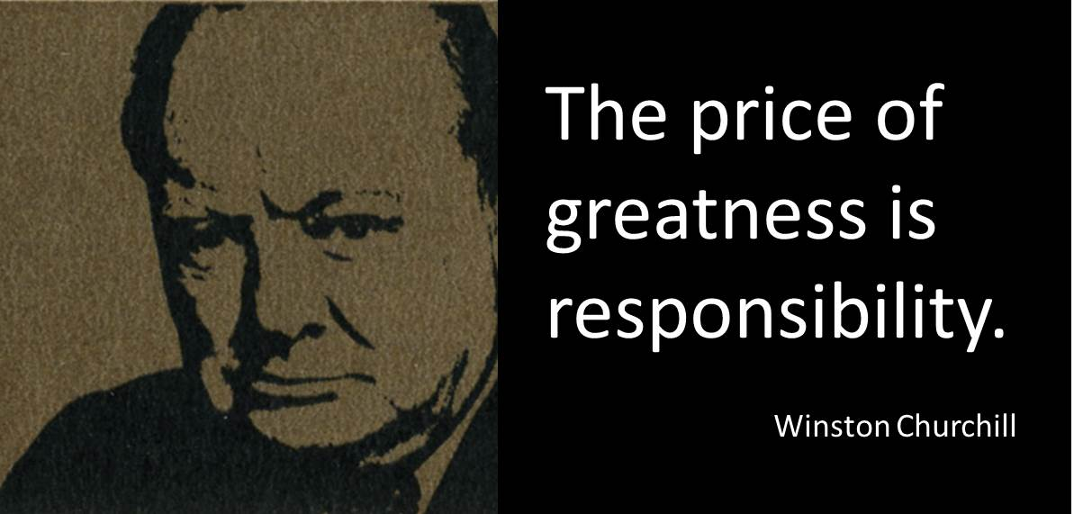
…no matter what the results, I assume full responsibility
I am the leader
I am responsible for everything that happens or fails to happen under my command
If the results are good, I share the glory with my cadets
If the results are bad, it is all my fault!

Slide 63
The Cadet Leader’s Code
Part Two

Slide 64
I train my Cadets as a team
I get them to work together so we accomplish the mission as a group
I want them to think of themselves as part of a team

Slide 65
…and lead them with tact
I treat them with respect and try not to say things that will hurt their feelings
If I have to correct them I do it fairly and with sensitivity to how they feel

Slide 66
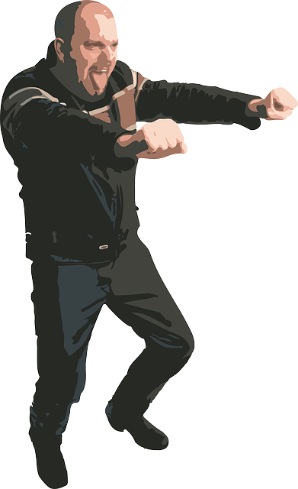
…enthusiasm
I put forth a lot of effort and my Cadets see how much energy I put into my job and into accomplishing the mission

Slide 67
…and with justice
I treat the Cadets fairly and make decisions I know are as fair as they can be

Slide 68
I command their confidence and their loyalty
They trust me to do the right thing and to take care of them
They are loyal to me and to the organization
They have confidence that I will be faithful to them, too

Slide 69
They know I would not assign them any duty I myself would not perform
I never assign my Cadets a task I would not be willing to do myself
If I tell a Cadet to clean the toilet, I must be willing to set the example and be willing to clean toilets

Slide 70
I make sure they understand their jobs
When I assign a task to a Cadet or group of Cadets, I make sure they know exactly what to do and how to do it
I answer any questions they might have about what I expect

Slide 71
And follow through to ensure their duties are completed fully
I don’t just tell cadets what to do and expect it to happen magically
I supervise them to make sure the job is done right and according to the timeline I gave them

Slide 72
I keep my cadets informed
I tell them about events the Cadets are involved in
I make sure their questions are answered about upcoming activities, etc.

Slide 73
…and I make their welfare one of my prime concerns
I am always concerned about the safety and well-being of my Cadets
I make sure they are well fed, have enough sleep, don’t get overheated, avoid sunburn, enjoy their training, etc…

Slide 74
These things I do selflessly
I put the Cadets first
My needs and wants always come second to theirs

Slide 75
…in fulfillment of the obligations of leadership
I do these things because being in charge means I am responsible for everything that happens or fails to happen in my unit

Slide 76
…and for the achievement of the group goal
The mission is the second most important thing after the safety of my Cadets
I constantly strive to accomplish the missions I have been given.

Slide 77
Check on Learning
Explain in your own words the key points of the Leader’s Code

