Slide 1
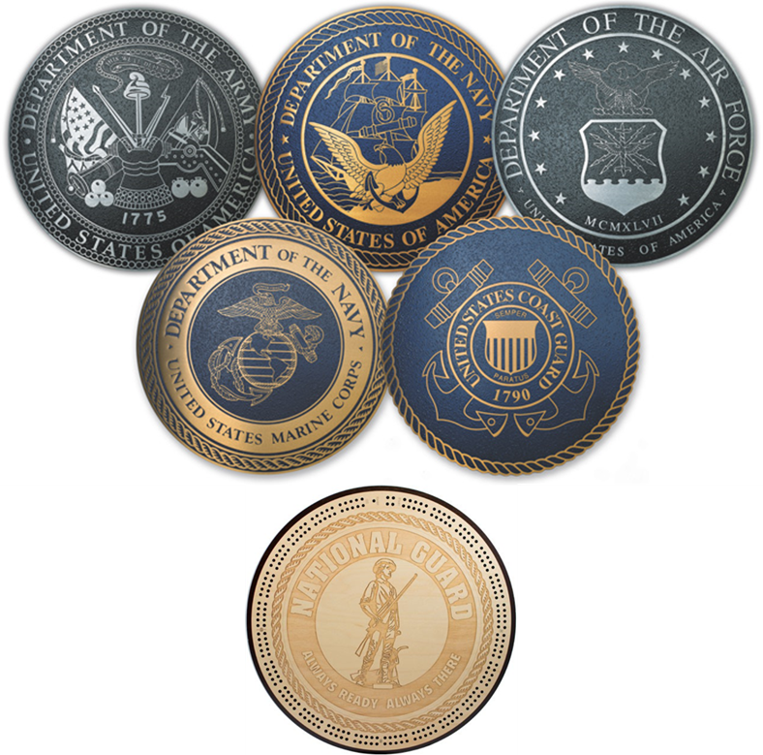
California Cadet Corps Curriculum on Military Knowledge
“To Defer War & Protect Our Freedoms”
M9/A: Purpose of the Military Branches

Slide 2
Purpose of the Military Branches
Do You Know Your Military?
This video describes the different branches of military service:
blob:https://www.dvidshub.net/35e2b001-ba8d-4127-b978-15d4c220d1cb

Slide 3
Agenda
A1. US Army Purpose
A2. US Air Force Purpose
A3. US Navy Purpose
A4. US Marine Corps Purpose
A5. US Coast Guard Purpose
A6. California National Guard Purpose

Slide 4
US Army purpose
A1. Explain the purpose of the United States Army

Slide 5
Purpose of the Military Branches
OBJECTIVES
90% of Unit Cadets will understand the purpose of the different branches of service.
Plan of Action
Explain the purpose of the United States Army
Explain the purpose of the United States Air Force
Explain the purpose of the United States Navy
Explain the purpose of the United States Marine Corps
Explain the purpose of the United States Coast Guard
Explain the purpose of the California National Guard
Essential Question: What is the US Army’s main purpose?

Slide 6
US ARMY
Mission
“To deploy, fight and win our nation's wars by providing ready, prompt, and sustained land dominance by Army forces across the full spectrum of conflict as part of the joint force.”
Army, U. (2018). US Army. Retrieved from US Army: https://www.army.mil/info/organization/

Slide 7
US ARMY
Breaking it down:
“To deploy, fight and win our Nation’s wars” –
The Army goes where they’re needed and fights wars

Slide 8
US ARMY
Breaking it down:
“Providing ready, prompt and sustained land dominance” –
The Army is in charge of the land-based part of war
It controls the land, and through that control, dominates the place where they’re fighting

Slide 9
US ARMY
Breaking it down:
“Across the full spectrum of conflict” –
Uses the elements of combat power –Maneuver, Firepower, Leadership, Protection, and Information—to overwhelm the enemy and win
Involves support units providing protection or security, logistics, and services to the fighting forces
Involves intelligence and cyber forces getting into the minds and systems of the enemy to create opportunities to exploit them

Slide 10
US ARMY
Breaking it down:
“As part of the joint force” –
Committed to working with the other military branches of services to win wars

Slide 11
US ARMY

Slide 12
US ARMY
Composed of three components:
Active Army, (aka, the Regular Army)
Soldiers and Units who work for the Army as their full-time job
Army Reserve
Soldiers and Units who work for the Army part-time,
Trained in case they’re called up to serve full-time in cases of emergency
Army National Guard
Soldiers and Units who work for their State Governor, but who train to the same standards of the Army and Reserve,
Can be called up to serve full-time in cases of emergency.
Also work for the state during emergencies

Slide 13
US air force purpose
A2. Explain the purpose of the United States Air Force

Slide 14
Purpose of the Military Branches
OBJECTIVES
90% of Unit Cadets will understand the purpose of the different branches of service.
Plan of Action
Explain the purpose of the United States Army
Explain the purpose of the United States Air Force
Explain the purpose of the United States Navy
Explain the purpose of the United States Marine Corps
Explain the purpose of the United States Coast Guard
Explain the purpose of the California National Guard
Essential Question: What is the US Air Force’s main purpose?

Slide 15
US AIR FORCE
Mission
To fly, fight and win in air, space, and cyberspace

Slide 16
US AIR FORCE
"With one hand the Air Force can deliver humanitarian assistance to the farthest reaches of the globe, while with the other hand we can destroy a target anywhere in the world."
Force, U. A. (2018). US Air Force. Retrieved from US Air Force: https://www.airforce.com/mission

Slide 17
US AIR FORCE
Breaking it down:
Air power is primary mission
It can provide lethal capabilities

Slide 18
US AIR FORCE
Breaking it down:
Space Capabilities
Provides services, facilities, & range safety control for
Department of Defense, NASA & commercial launches
satellite command & control for DOD satellites
missile warning
space control

Slide 19
US AIR FORCE
Breaking it down:
Cyberspace
Network security, data transmission, & sharing of information
Establishes, operates, maintains, & defends AF networks to ensure warfighters can maintain information advantage for US forces
Figures out countermeasures

Slide 20
US AIR FORCE
Composed of three components:
Active Air Force
Air Force Reserve
Air National Guard
Supported by the Civil Air Patrol (CAP):
Civilian Auxiliary
Perform:
Emergency services missions
Aerospace education for youth & general public
Cadet programs for teens
Other missions as requested by governmental & private agencies

Slide 21
Check on Learning
What is the Air Force’s primary mission?
What are the two other important parts of it’s mission?

Slide 22
Us navy purpose
A3. Explain the purpose of the United States Navy

Slide 23
Purpose of the Military Branches
OBJECTIVES
90% of Unit Cadets will understand the purpose of the different branches of service.
Plan of Action
Explain the purpose of the United States Army
Explain the purpose of the United States Air Force
Explain the purpose of the United States Navy
Explain the purpose of the United States Marine Corps
Explain the purpose of the United States Coast Guard
Explain the purpose of the California National Guard
Essential Question: What is the US Navy’s main purpose?

Slide 24
US NAVY
Mission
“To recruit, train, equip, and organize to deliver combat ready Naval forces to win conflicts and wars while maintaining security and deterrence through sustained forward presence.”
Navy, U. (2018). US Navy. Retrieved from US Navy: https://www.navy.com/

Slide 25
US NAVY
Breaking it down:
Military presence & dominance on the seas
Fleet of naval ships
Air component extends presence inland
Transports equipment & supplies to distant battlefields

Slide 26
US NAVY
Breaking it down:
Submarine fleet
Can launch ballistic missiles
Has played major role in deterrence for decades
Submarine-based missiles have prevented potential adversaries from starting a nuclear war with the US

Slide 27
US NAVY
Consists of two components*:
Active Navy
Navy Reserve
*The Marine Corps is part of the Navy, but we’ll look at it as a separate component

Slide 28
Check on Learning
In addition to dominance on the seas, what are the two other pieces of the US Navy’s mission?

Slide 29
Us marine corps Purpose
A4. Explain the purpose of the United States Marine Corps

Slide 30
Purpose of the Military Branches
OBJECTIVES
90% of Unit Cadets will understand the purpose of the different branches of service.
Plan of Action
Explain the purpose of the United States Army
Explain the purpose of the United States Air Force
Explain the purpose of the United States Navy
Explain the purpose of the United States Marine Corps
Explain the purpose of the United States Coast Guard
Explain the purpose of the California National Guard
Essential Question: What is the US Marine Corps’ main purpose?

Slide 31
US MARINE CORPS
Mission
To defend the people of the United States at home and abroad

Slide 32
US MARINE CORPS
Breaking it down:
Land arm of the Navy
Guard US embassies
On naval ships & bases
Quick reaction force

Slide 33
US MARINE CORPS
Contributed greatly in the Pacific Theater during WWII
Got in
Fought hard
Won
Moved on
Reputation as fighters who:
Don’t give up
Fight ferociously
Fight to win

Slide 34
US MARINE CORPS
Consists of Two Components:
Active Marine Corps
Marine Corps Reserve

Slide 35
Check on Learning
What is the Marine Corps’ purpose?

Slide 36
Us coast guard Purpose
A5. Explain the purpose of the Coast Guard

Slide 37
Purpose of the Military Branches
OBJECTIVES
90% of Unit Cadets will understand the purpose of the different branches of service.
Plan of Action
Explain the purpose of the United States Army
Explain the purpose of the United States Air Force
Explain the purpose of the United States Navy
Explain the purpose of the United States Marine Corps
Explain the purpose of the United States Coast Guard
Explain the purpose of the California National Guard
Essential Question: What is the US Coast Guard’s main purpose?

Slide 38
US COAST GUARD
Mission
“To ensure our Nation's maritime
safety, security and stewardship.”
**Stewardship is defined as the job of supervising or taking care of something, such as an organization or property**
Guard, U. C. (2018). US Coast Guard. Retrieved from US Coast Guard: https://www.work.uscg.mil/Missions/

Slide 39
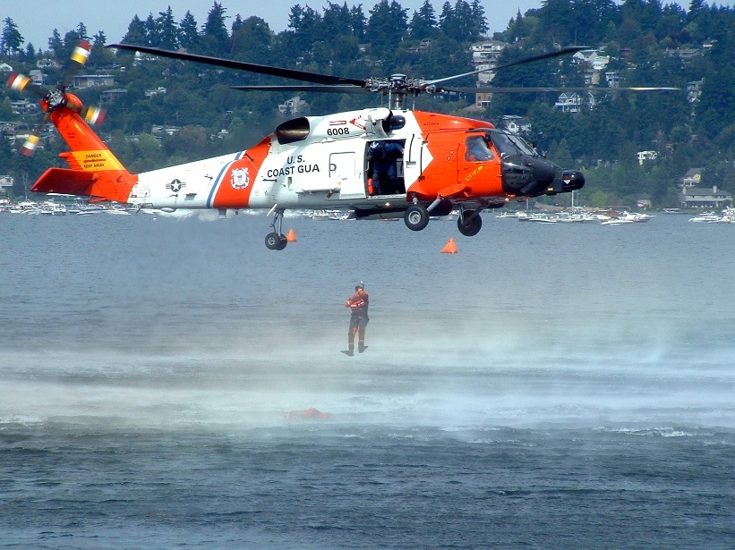
US COAST GUARD
One of the five US military services, BUT
Often falls under Department of Defense
Currently part of the Department of Homeland Security

Slide 40
US COAST GUARD
Breaking it down:
The Coast Guard is a
Military service
Law enforcement organization
Regulatory agency
First responder
Member of the intelligence community

Slide 41
US COAST GUARD
Breaking it down:
Has 3 basic roles
Maritime safety
Maritime security
Maritime stewardship
Subdivided into 11 missions

Slide 42
US COAST GUARD
Breaking it down:
The 11 missions
Homeland security missions
Non-homeland security missions
Ports, Waterway & Coastal Security
Drug Interdiction
Aids to Navigation
Search and Rescue
Living Marine Resources
Marine Safety
Defense Readiness
Migrant Interdiction
Marine Environmental Protection
Ice Operations (ice breaking)
Other Law Enforcement

Slide 43
US COAST GUARD
Consists of Two Components:
Active Coast Guard
Coast Guard Reserve

Slide 44
Check on Learning
Which of these is not a part of the US Coast Guard’s mission?
To ensure:
Maritime safety
Maritime space defense
Maritime security
Maritime stewardship

Slide 45
California national guard Purpose
A6. Explain the purpose of the California National Guard

Slide 46
Purpose of the Military Branches
OBJECTIVES
90% of Unit Cadets will understand the purpose of the different branches of service.
Plan of Action
Explain the purpose of the United States Army
Explain the purpose of the United States Air Force
Explain the purpose of the United States Navy
Explain the purpose of the United States Marine Corps
Explain the purpose of the United States Coast Guard
Explain the purpose of the California National Guard
Essential Question: What is the California National Guard’s main purpose?

Slide 47
CALIFORNIA NATIONAL GUARD

Slide 48
CALIFORNIA NATIONAL GUARD
Federally funded California military force
Part of the US National Guard
Consists of:
California Army National Guard
California Air National Guard
California State Military Reserve
California Youth and Community Programs Task Force

Slide 49
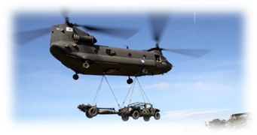
California Army National Guard
Mission
Organizes, trains, equips, and resources community based land forces

Slide 50
California Army National Guard
Mobilizes to support state and/or federal authority when ordered to do so
Performs many Army missions
Train 1 weekend a month & 2 weeks annually
May respond to disasters in the state
May be called to duty if needed for a federal mission

Slide 51
California Air National Guard
Mission
Provides support to the emergency response mission alongside the California Army National Guard and also supports
the Air Force as needed

Slide 52
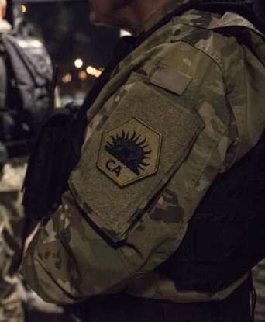
California State Military Reserve
Mission
Fills holes and provides expertise, support, and manpower as needed, especially in training situations and in state
emergencies
Photo By Crystal Housman CSMR

Slide 53
Youth and Community Programs Task Force
Mission Provides command, oversite, resources, and coordination with the California National Guard to the various youth programs run by the California Military Department

Slide 54
Youth and Community Programs Task Force
Oversees:
The Youth ChalleNGe Programs (Grizzly, Sunburst, Discovery)
STARBASE (Science and Technology Academics Reinforcing Base Aviation and Space Exploration)
The California Cadet Corps
Funded Military Institutes supported by the Military Department
California Military Institute
Oakland Military Institute
Porterville Military Academy

Slide 55
Check on Learning
In your own words, explain the purpose of the California National Guard.

