Slide 1
Curriculum on Citizenship
“California Basics”

Slide 2
California Basics Agenda
A1. California Geography
A2. California Symbols
A3. The People of California
A4. Threats in California

Slide 3
California Geography
A1. Identify the key geographic features of California.

Slide 4
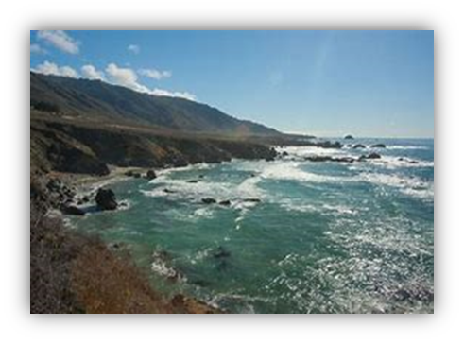
California Geography
California is 3rd largest US state
More people than any state
More diverse topography than most
Mountains
Ocean
Rivers
Desert
Glaciers
Forests
Large cities
Millions of farmland acres

Slide 5
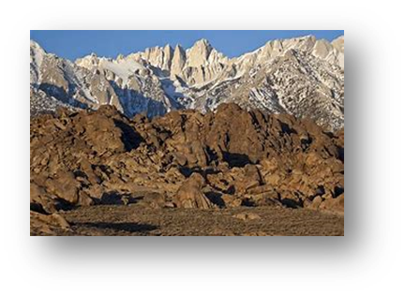
California Geography
Borders 3 states (Oregon/Nevada/Arizona)
Borders Mexico & Pacific Ocean
Approx. 800 miles long x 250 miles wide
Highest point: Mount Whitney
Lowest point: Death Valley

Slide 6
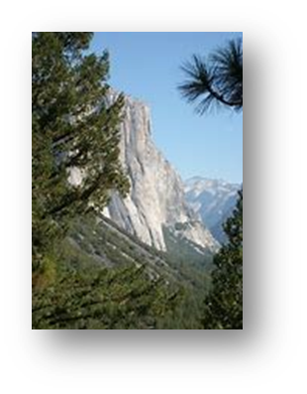
California Geography
Mountain Ranges:
Klamath Mtns: high & forested
Coastal Mtns: parallel the coast
The Sierra Nevada Mtns: border w/Nevada
The Los Angeles/Transverse Ranges: run between Santa Barbara & San Diego
San Diego/Peninsular Ranges: SD County to Baja
Basin & Range Region: Narrow ranges & flat arid valleys (deserts)

Slide 7
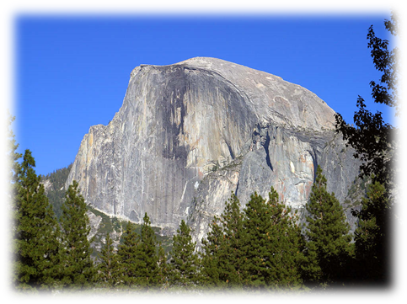
California Geography
The Central Valley
Runs along middle of California
Between Coastal Ranges & the Sierra Nevada
Sacramento & San Joaquin Valleys
Comprise large part of farmland

Slide 8
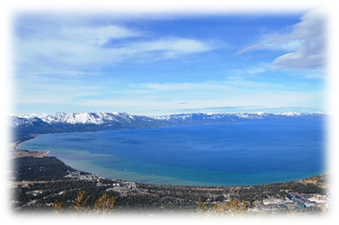
California Geography
The Central Valley (cont’d)
Major Rivers:
Sacramento
San Joaquin
Colorado
Major Lakes:
Lake Tahoe
Salton Sea
Owens Lake
Searles Lake

Slide 9
California Geography
Frequent Earthquakes
Major faults underground
Tectonic activity along coast
Historically significant:
1906 San Francisco (magnitude 7.8 – 8.2)
1971 San Fernando (mag. 6.6)
1989 Loma Prieta (mag. 6.9 – 7.1
1994 Northridge (mag. 6.7)

Slide 10
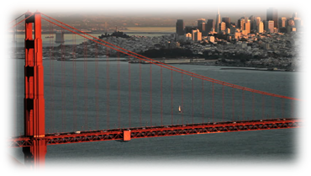
California Geography
Largest Metropolitan Areas:
Los Angeles
San/Francisco/Oakland
San Diego
Riverside/San Bernardino
Sacramento
San Jose

Slide 11
California Geography
Diverse Climate
Coastal & SoCal → Mediterranean
Moderately rainy winters
Mild, dry summers
High Sierras → Warm summer/Winter snow
Desert Areas → Hot summer/Cold winter
Northern Coast → More rain than SoCal

Slide 12
Check on Learning
What states border California?
Describe the Basin and Range Region? What topography in California falls into this category?
What are the three major rivers in California?
Name at least three key geographic features of California?

Slide 13
California Symbols
A2. Name 75% of the listed symbols of California.

Slide 14
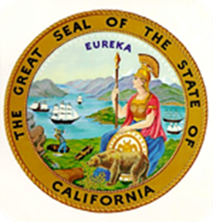
California Symbols
State Flag
State Seal
State Colors: Blue & Gold

Slide 15
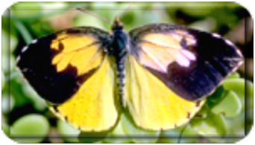
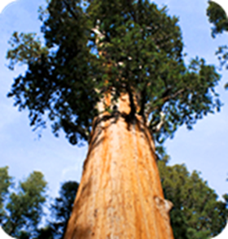
California Symbols
State Flower: The California Poppy
State Insect: The Dogface Butterfly
State Tree: The California Redwood

Slide 16
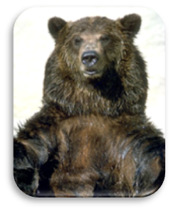
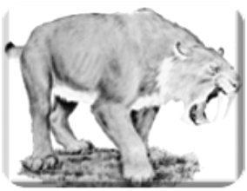
California Symbols
State Fish:
The Golden Trout
State Animal:
The Grizzly Bear
State Fossil: The Saber-Toothed Cat

Slide 17
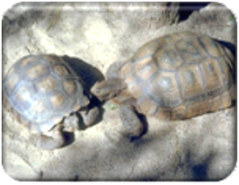
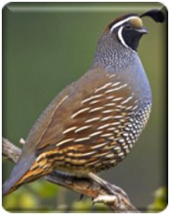
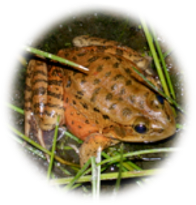
California Symbols
State Reptile: The Desert Tortoise
State Bird: The California Quail
State Amphibian:
The California Red-Legged Frog

Slide 18
California Symbols
State Motto:
Eureka!
(Greek for “I have found it”)
State Nickname: The Golden State

Slide 19
Check on Learning
What are our state colors?
What two symbols are on our flag?
What is our state motto? What does it mean in English?
What is our state animal?
What is our state flower?

Slide 20
The People of California
A3. Discuss details of the people of California, past and present.

Slide 21
The People of California
Native Americans
Tribes or bands
If cultural or linguistic connections, generally lived in small groups loosely tied together
Most: permanent location
Some: nomadic

Slide 22
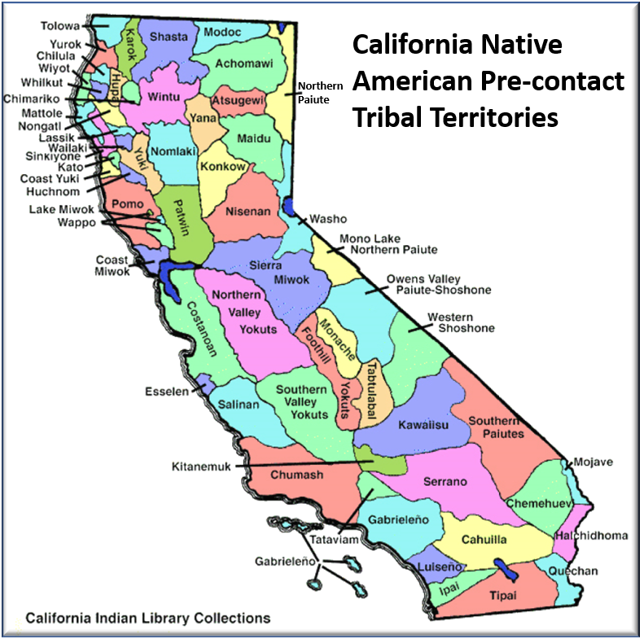
The People of California

Slide 23
The People of California
Many native bands & cultures died out
Interaction w/European settlers
Catholic missions
Est. 275,000 natives before European settlers came
Approx. 15,000 end of 19th Century

Slide 24
The People of California
1% of Californians are Native Americans
Apache/Cherokee/Choctaw/Creek/Hopi/Zuni/ Navajo/Blackfeet/Shoshone/Paiute/Pueblos/ Cahuilla/Chumash
Highest # of Native Americans than other states
More tribes, too
Live both on and off reservations
reservation a.k.a. “rancheria”

Slide 25
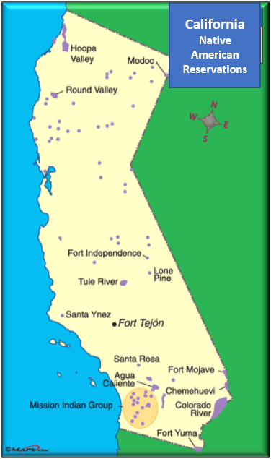
The People of California

Slide 26
The People of California
Larger population than any other state
Diverse
Majority-minority
= majority of people are ethnic minorities
Increasingly Hispanic or Latino
Large % of Whites, Asians, & Blacks
Gender approx. 50/50 male/female

Slide 27
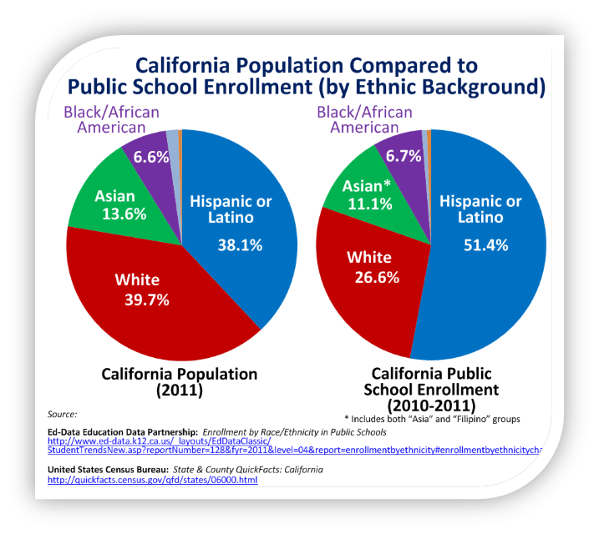
The People of California

Slide 28
The People of California
California Population as of April 2017
Population estimates, July 1, 2017, (V2017) | 39,536,653
Population estimates base, April 1, 2010, (V2017) | 37,254,518
Population, percent change – April 1, 2010 (estimates base) to July 1, 2017, (V2017) | 6.10%
Population, Census, April 1, 2010 | 37,253,956
Age and Sex
Persons under 5 years | 6.30%
Persons under 18 years | 22.90%
Persons 65 years and over | 13.90%
Female persons | 50.30%
 | 0.503
Race and Hispanic Origin
White alone | 72.40%
Black or African American alone | 6.50%
Native American and Alaska Native alone | 1.60%
Asian alone | 15.20%
Native Hawaiian and Other Pacific Islander alone | 0.05%
Two or More Races | 3.90%
Hispanic or Latino | 39.10%
White alone, not Hispanic or Latino | 37.20%
Source: US Census Bureau (Bureau, 2017)

Slide 29
Check on Learning
T/F: All native people of California lived permanently in one place year-round.
Why did many native cultures die out?
Only % of Californians today are Native Americans.
What does it mean that California is a “majority-minority”?

Slide 30
Threats in California
A4. Name the threats California faces.

Slide 31
Threats in California
Catastrophic Events
Earthquakes
Floods
Wildfires
Civil unrest

Slide 32
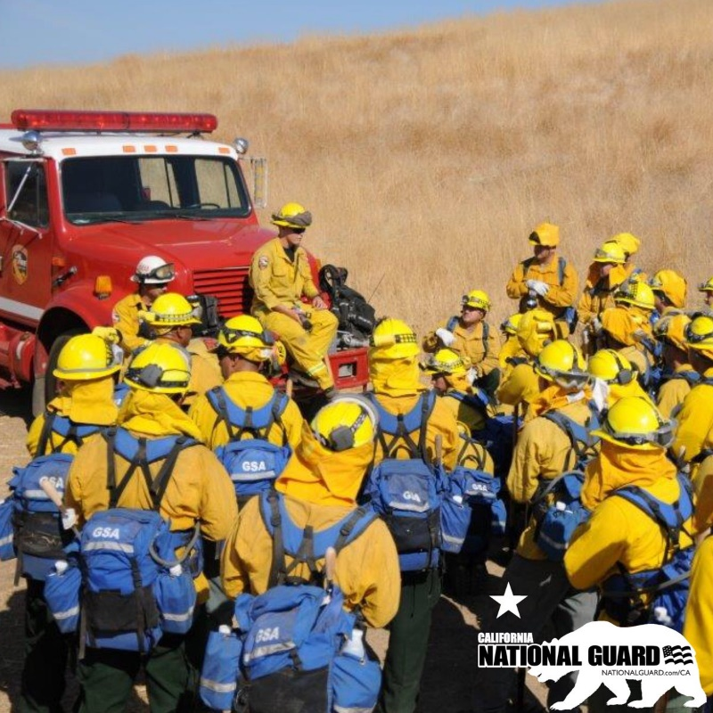
Threats in California
National Guard (CACC’s parent organization)
Helps deal with/recover from disaster
Prepares for & steps up when called is a significant mission

Slide 33
Threats in California
Why so many earthquakes?
Plate tectonics
Volcanic activity
Plate Tectonics
Pacific Plate moving north
North American Plate moving south
Plates contact = friction
Friction creates fault
Earthquakes occur at fault

Slide 34
Threats in California
San Andreas Fault
The boundary line between Pacific & North American Plates
Runs along much of length of California
100s of other smaller faults
Approx. 200 potentially dangerous
70% of population lives w/in 30 miles of a fault

Slide 35
Threats in California

Slide 36
Threats in California
Volcanic Activity (a result of plate tectonics)
Most are small
Don’t cause damage
BUT…volcanic activity = earthquakes
Mammoth Lakes region
Mount Lassen
Mount Shasta

Slide 37
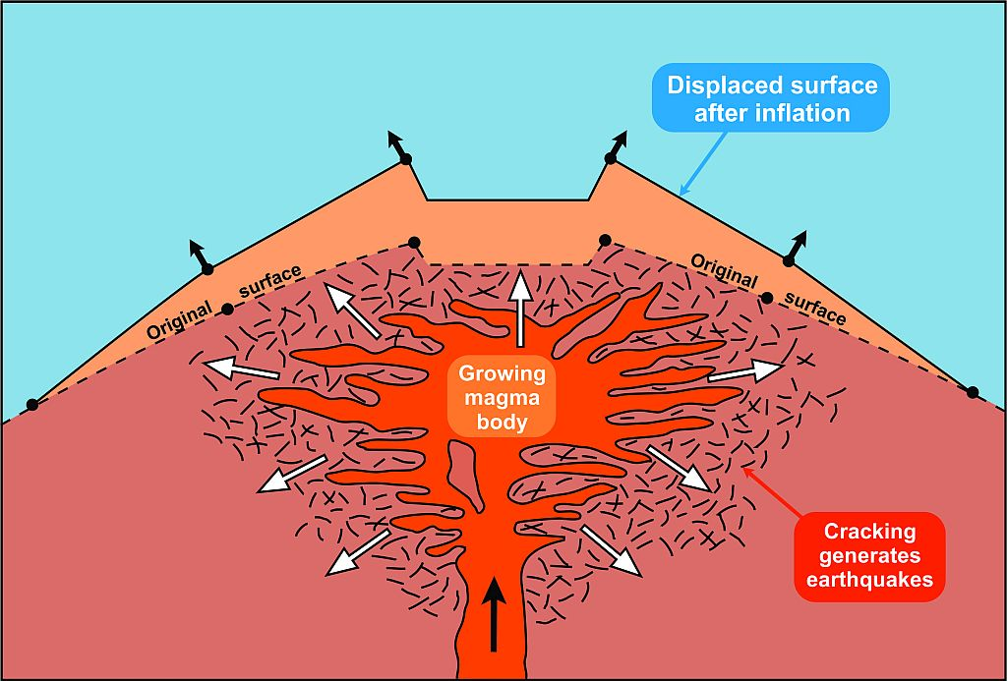
Threats in California

Slide 38
Threats in California
2 or 3 large-scale earthquakes per year
Magnitude of 5.5 or greater
Level at which moderate damage to structures can occur
Stringent building codes help prevent damage

Slide 39
Threats in California
Wildfires
Lots of forested land → lightening starts fire
Drought → susceptible to burning
Arguments by some people:
Let smaller fires burn off dead vegetation to prevent larger fires
Logging removes fuel, thus prevents fires
(But logging has been prevented in parts of California)

Slide 40
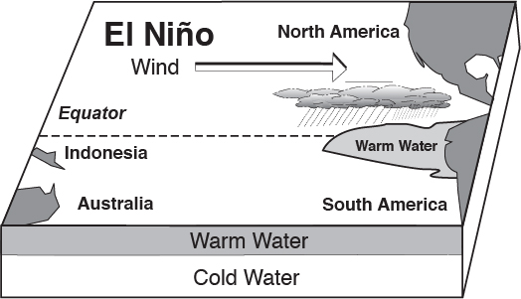
Threats in California
El Niño
Pacific Ocean temperatures ↑ off South America
Causes increased rainfall in SoCal
Eases drought situation

Slide 41
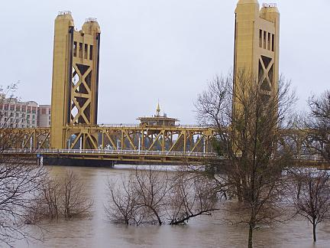
Threats in California
Too much rain or snow = flooding!
Wildfires exacerbate
Vegetation keeps soil in place → burns off
Land susceptible to mudslides/extreme runoff
Rivers → most common flood places

Slide 42
Threats in California
Manmade disasters/civil disturbances
1965 riots in Watts (Los Angeles)
1992 riots in Los Angeles (Rodney King)
San Bernardino Punk Riot of 2006
2007 MacArthur Park Rallies (regarding immigration)
2009 & 2010 BART Police Shooting of Oscar Grant in Oakland (after incident and trial)
2010 Santa Cruz May Day Riot
Black Lives Matter
Occupy Movement

Slide 43
Threats in California
Riots
People already angry about a situation
Something happens to tip anger over the top
People take to the streets
Protests
People or authorities can become violent
People hurt, property damaged, problem not solved

Slide 44
Threats in California
On a positive note…
CEOWORLD Magazine ranked California as the state w/most diversity
Diversity Measurements: culture/economic/household marital status & age groups/politics/religion/socioeconomics
And w/our diverse topography many think:
We’re a pretty great state!

Slide 45
Check on Learning
Name three threats in California.
What CACC-affiliated organization helps our state with disasters?
What causes earthquakes in California?
What is El Niño? What positive thing does it do? What negative thing may it cause?

