Slide 1
California Cadet Corps
Curriculum on Citizenship
“Make the World a Better Place: Improve Yourself!”
C2C: Improve Your State, Country, and Planet
Updated: 3 JAN 2021

Slide 2
Improve Your State, Country, and Planet
C1. What is Active Citizenship?
C2. How to be an Active Citizen
C3. Models for Active Citizenship
C4. Active Citizenship Self-Assessment

Slide 3
Improving Your State, Country, and planet: Unit Objectives
The desired outcome of this unit is that Cadets will embrace their role as Active Citizens.
Plan of Action:
Define Active Citizenship in their own words
Differentiate between the rights and responsibilities of citizenship
Identify effective ways of volunteering as an Active Citizen
Identify the four dimensions of Active Citizenship
Identify the topics that Active Citizens should have a grasp of
Identify the skills and aptitudes of an Active Citizen
Identify the characteristics of Active Citizenship
Identify tips for the Active Citizen
Explain two Active Citizenship Models
Take an Active Citizen self-assessment

Slide 4
What is Active Citizenship?
OBJECTIVES:
DESIRED OUTCOME (Leadership)
Cadets will embrace their role as Active Citizens.
Plan of Action:
Define Active Citizenship in their own words
Differentiate between the rights and responsibilities of citizenship
Identify effective ways of volunteering as an Active Citizen
Identify the four dimensions of Active Citizenship
Identify the topics that Active Citizens should have a grasp of
Identify the skills and aptitudes of an Active Citizen
Essential Question:
What is an Active Citizen?

Slide 5
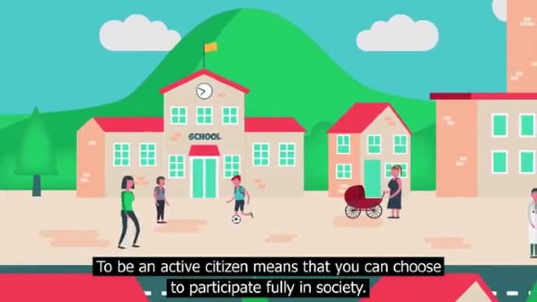
What is Active Citizenship?
Active Citizenship is the philosophy that citizens should work toward the improvement of their community, through economic participation, public volunteer work, and other such efforts to improve life for all citizens.
Democracies need active, informed and responsible citizens; citizens who are willing and able to take responsibility for themselves and their communities and contribute to the political process.
An effective Active Citizen is a person who understands the obligation and undertakes the responsibility to improve community conditions, build healthier communities and address social problems.

Slide 6
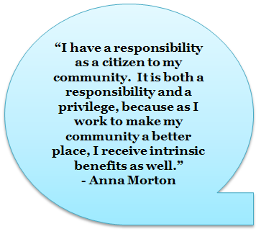
Active Citizenship
Active Citizens don’t expect the government to solve every problem
They want to engage within the government systems, with the support of governing agencies, to mutually solve problems and improve community life
Citizens have rights AND responsibilities – it’s our country too!

Slide 7
Volunteering
Help out in the community
Projects that improve life
Lend your expertise to those who can’t afford it
Many hands make light work

Slide 8
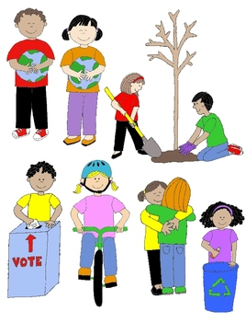
Active Citizenship
Active Citizenship brings people together
Counters the isolation of the Internet
Allows for discourse
Brings out our similarities, makes us realize our differences are minor

Slide 9
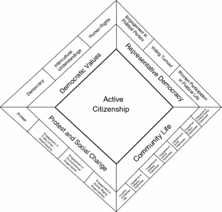
4 Dimensions of Active Citizenship
Protest and Social Change
Petitions, demonstrations, boycotts, political engagement
Human Rights & Environmental Organizations, Unions
Community Life
Religious organizations, Business, Cultural & Social Groups
Sports, PTA
Representative Democracy
Political Parties, Voting, Community-level Politics
Democratic Values
Democracy, Intercultural Understanding,
Human Rights

Slide 10
Summary of Active Citizenship
Active Citizens are those who develop the skills, knowledge and understanding to be able to make informed decisions about their communities and workplaces with the aim of improving the quality of life
An active citizen may challenge the rules and existing structures although they should generally stay within the bounds of democratic processes and not become involved in violent acts
Active Citizens value respect, courage, openness, tolerance, listening, working
Active Citizens participate in the community (involvement in a voluntary activity or engaging with local government agencies)

Slide 11
Summary of Active Citizenship
Active Citizens are empowered to play a part in the decisions and processes that affect them, particularly public policy and services
Active Citizens have knowledge and understanding of the political/social/economic context of their participation so that they can make informed decisions
Active Citizens are able to challenge policies or actions and existing structures on the basis of principles such as equality, inclusiveness, diversity and social justice
Democracies need active, informed and responsible citizens who are willing and able to take responsibility for themselves and their communities and contribute to the political process

Slide 12
Summary of Active Citizenship
Democracies depend upon citizens who are
Aware of their rights and responsibilities as citizens
Informed about the social and political world
Concerned about the welfare of others
Articulate in their opinions and arguments
Capable of having an influence on the world
Active in their communities
Responsible in how they act as citizens

Slide 13
Summary of Active Citizenship
Citizenship issues are
Real: they actually affect peoples’ lives
Topical: current today
Sometimes Sensitive: can affect people at a personal level, especially when family or friends are involved
Often controversial: people disagree and hold strong opinions about them
Ultimately moral: relate to what people think is right or wrong, good or bad, important or unimportant in society

Slide 14
Summary of Active Citizenship
Active Citizenship helps young people
to develop self-confidence and successfully deal with significant life changes and challenges such as bullying and discrimination
by giving them a voice in the life of their schools, communities, and society
to make a positive contribution by developing the expertise and experience needed to claim their rights and understand their responsibilities and preparing them for the challenges and opportunities of adult and working life

Slide 15
Citizenship Education
Essential elements of citizenship education are:
Knowledge and understanding about topics such as
laws and rules
the democratic process
the media
human rights diversity
money and the economy
sustainable development
the world as a global community
concepts such as democracy, justice, equality, freedom, authority, and the rule of law

Slide 16
Citizenship Education
Essential elements of citizenship education are:
Skills and aptitudes:
Critical thinking
Analyzing information
Expressing opinions
Taking part in discussions and debates
Negotiating
Conflict resolution
Participating in community action

Slide 17
Citizenship Education
Essential elements of citizenship education are:
Values and dispositions:
Respect for justice, democracy and the rule of law, openness, tolerance, courage to defend a point of view
Willingness to listen to, work with and stand up for others

Slide 18
Check On Understanding
Define Active Citizenship in your own words.
Which of the following are rights, and which are responsibilities?
HS Education Stand up for Equality
Voting Clean Water
Free Speech Opportunity
Which of these is NOT one of the 4 Dimensions of Active Citizenship?
Democratic Values c) Protest & Social Change
Community Life d) Democratic Process
Identify the skills of an Active Citizen from these:
Critical thinking Counseling
Debating Conflict resolution

Slide 19
How to be an Active Citizen
OBJECTIVES:
DESIRED OUTCOME (Leadership)
Cadets will embrace their role as Active Citizens.
Plan of Action:
Identify the topics that Active Citizens should have a grasp of
Identify the characteristics of Active Citizenship
Identify tips for the Active Citizen
Essential Question:
What do we do to be an Active Citizen?

Slide 20
Being an Active Citizen

Slide 21
Topics Good Citizens Know:
Laws and rules
Voting for government office
Role and influence of the media
Human rights
Cultural diversity
Money and the economy
The environment and sustainable development
Concepts such as democracy, justice, equality, freedom, authority, and the rule of law

Slide 22
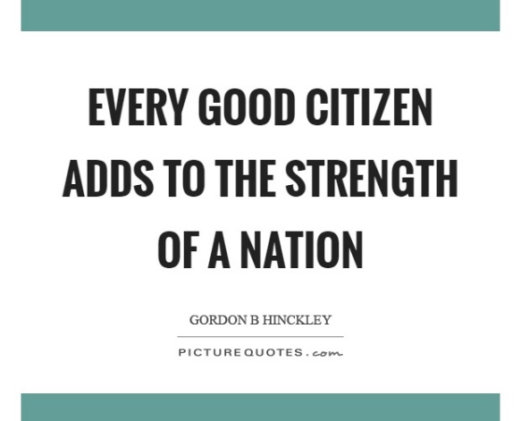
Characteristics of Active Citizenship
The Junior Chamber International (JCI) lists the following characteristics of active citizenship:
Respect
Honoring duties
Being informed
Compassion
Active Involvement
Working together
Sustainable solutions
Self-development
Safe, stable and clean environment

Slide 23
Tips for Active Citizens
Take only positive positions
Listen to all peoples’ views
Avoid stereotyping
Accept responsibility – don’t blame others for a lack of success
Be persistent
Act
Keep an ongoing assessment
Celebrate milestones along the way to maintain motivation

Slide 24
How to Create Positive Change

Slide 25
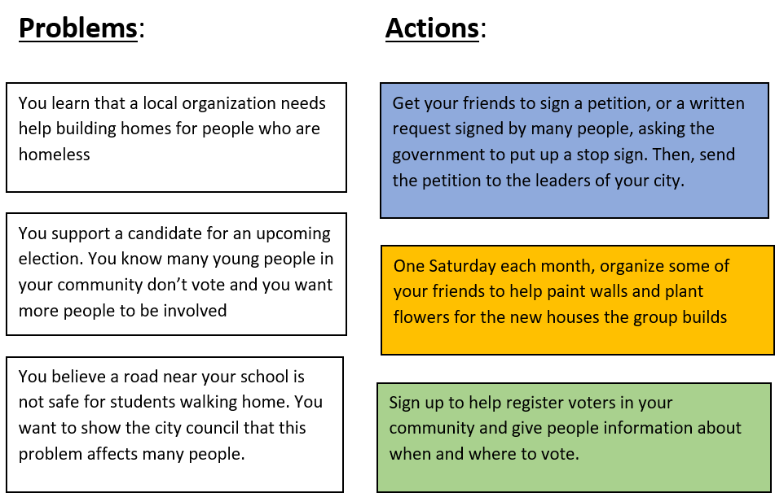
Practical Exercise
Match each problem with an action you could take in response.

Slide 26
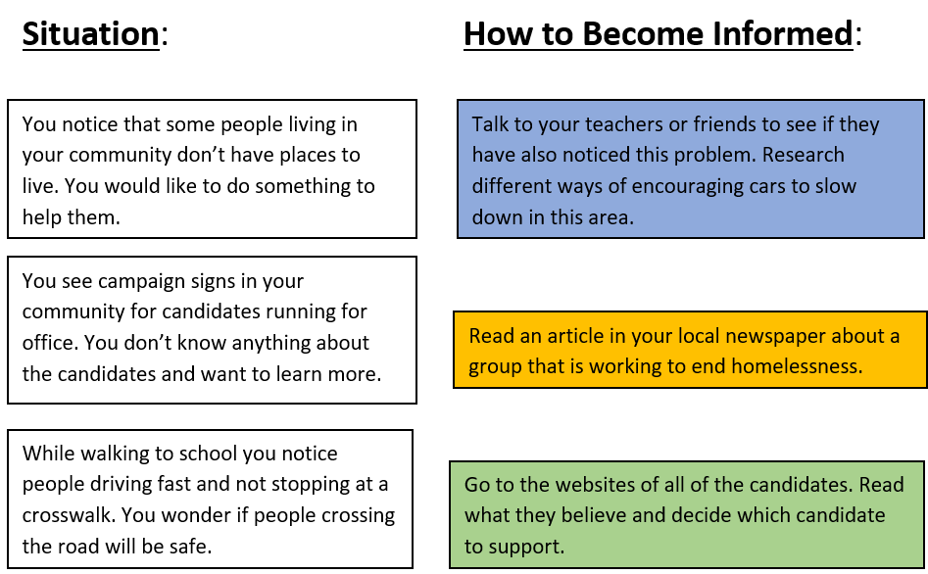
Practical Exercise
You might notice issues that you want to learn more about in your community. Imagine you are in the situations below. Match each situation with the steps you could take to become more informed.
Group Activities available in Curriculum!
Check them out!!

Slide 27
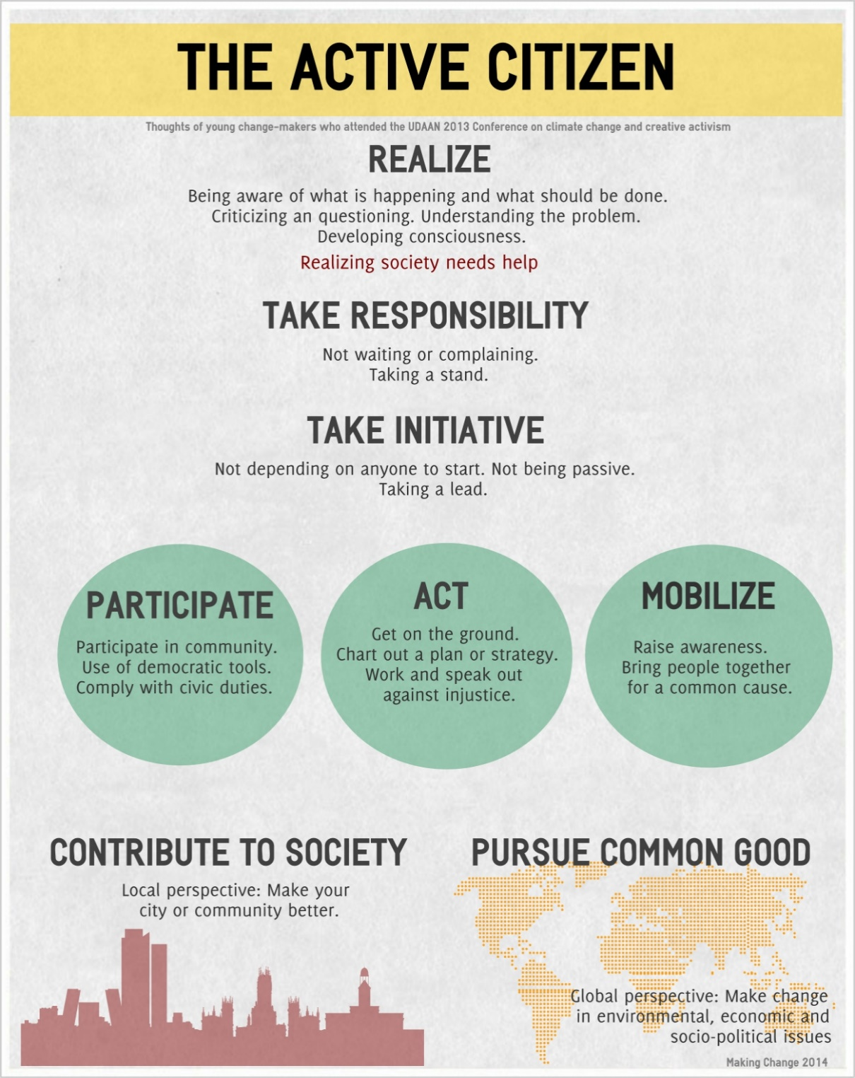

Slide 28
Check On Understanding
Which of these topics should good citizens have knowledge about?
The economy
Role of the media
Human rights
Laws & Rules
Which are characteristics of good citizens?
Respect
Nosiness
Being informed
Self-discipline
Name 3 Tips for Active Citizens

Slide 29
Models for Active Citizenship
OBJECTIVES:
DESIRED OUTCOME (Leadership)
Cadets will embrace their role as Active Citizens.
Plan of Action:
Explain two Active Citizenship Models
Essential Question:
What are the processes identified in an Active Citizenship model?

Slide 30
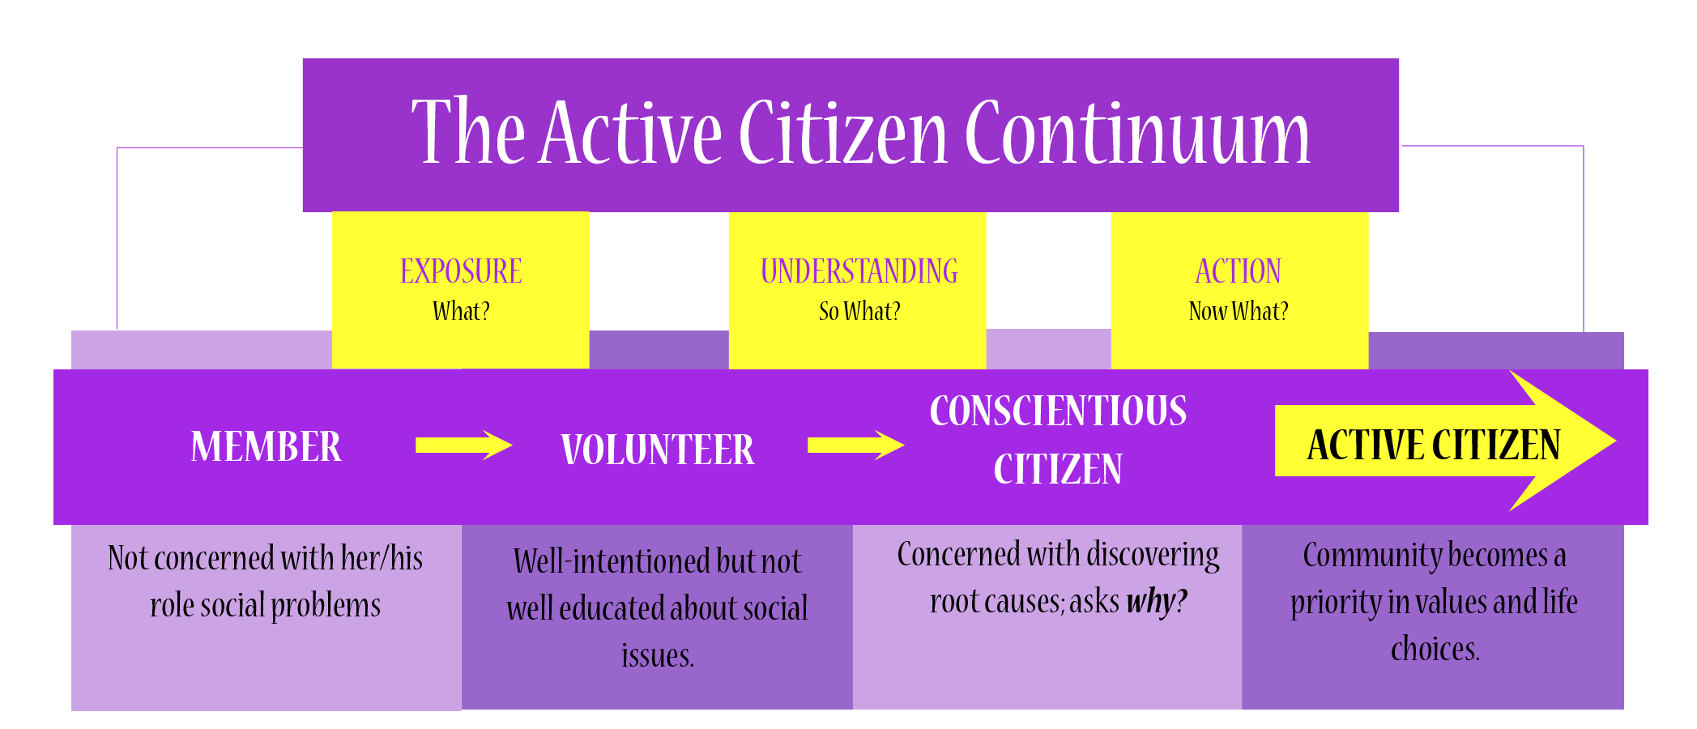
Model for Active Citizens
Where are you on this continuum?

Slide 31
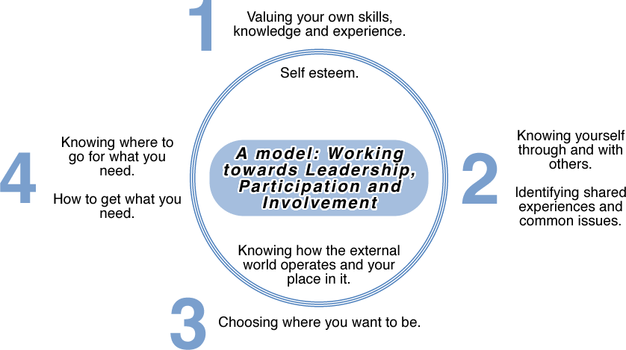
“Take Part” Model

Slide 32
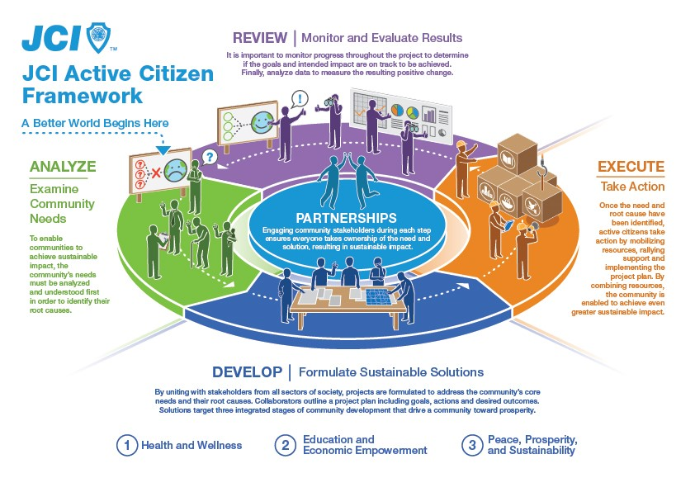
JCI Framework / Model

Slide 33
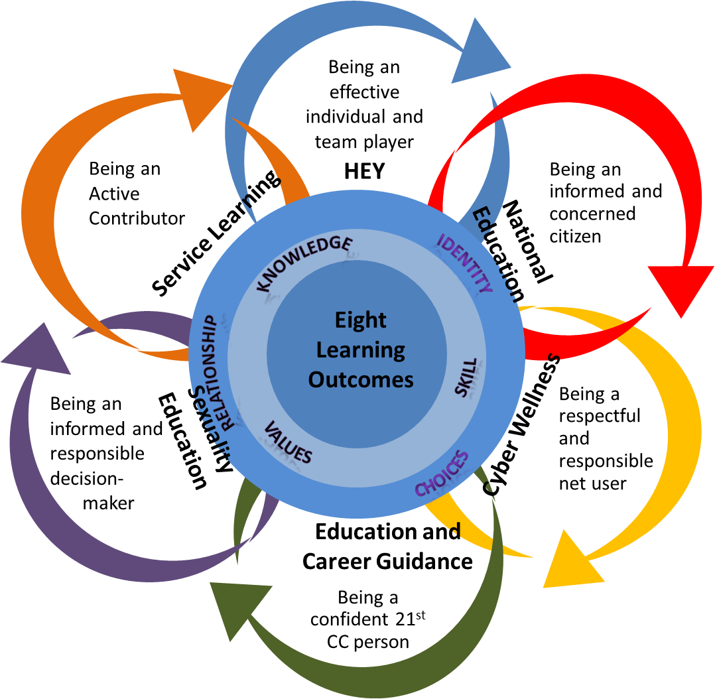
Learning Outcomes of Character & Citizenship Development Model

Slide 34
Be an Active Citizen!
Can you use the leadership skills you have learned in Cadet Corps and put them to use in other parts of your life?
These models suggest that you can.
If you want to be a contributing citizen of your community, California, the United States, and the World, you must be involved in issues that are important to you.
A leader has an impact on others; as an active citizen, you can spread that impact, potentially around the world!

Slide 35
Check On Understanding
Take any one of these models and explain it in your own words
Make up a slide (PowerPoint or just on paper) that gives bullet points for your main ideas about the model
This may be done within the class in groups (each take a different model)

Slide 36
Active Citizenship Self-Assessment
OBJECTIVES:
DESIRED OUTCOME (Leadership)
Cadets will embrace their role as Active Citizens.
Plan of Action:
Take an Active Citizen self-assessment
Essential Question:
How good of an Active Citizen am I now?

Slide 37
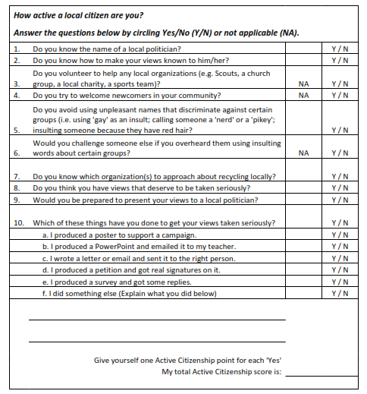
Take the Self Assessment

Slide 38
Use the Self-Assessment
What was your Active Citizen score from the Assessment?
Likely not (yet) very high
That’s okay!
How can you be a more Active Citizen?
What actions that were listed on the Assessment could you do?
Can you think of an issue to address in your school or community?
Get involved!
Earn community service points for your ribbon!

Slide 39
Check On Understanding
From the Active Citizenship Self-Assessment, what areas might you get better at?
What actions can you take to pursue an issue and get your views taken seriously?

