Slide 1
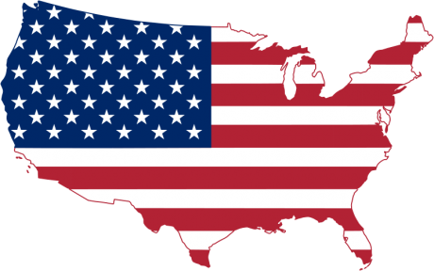
California Cadet Corps
Curriculum on Citizenship
“What We Stand For”
C8B: Great Americans
Updated 20 NOV 2020

Slide 2
Great Americans
B1. Native American Warriors
B2. Military Nurses
B3. Suffragettes
B4. Buffalo Soldiers
B5. 65th IN Regiment “Borinqueneers”
B6. Lafayette Flying Corps
B7. Doolittle Raiders
B8. Navajo Code Talkers
B9. Tuskegee Airmen
B10. African American Units in World War
B11. World War II Nisei Units

Slide 3
Native American Warriors
OBJECTIVES
DESIRED OUTCOME (Followership)
At the conclusion of this training, Cadets will be able to describe groups who have sacrificed for the benefit of the United States despite challenges and obstacles.
Plan of Action:
Define the warrior tradition and how that motivates Native Americans to serve their country today.
Describe how Native American communities support their soldiers and veterans through culture and ceremonies.
Essential Question: How have Native Americans contributed to the United States military, and how does their community support and influence their contribution?

Slide 4
The Warrior Tradition
What is the warrior tradition? Sitting Bull, of the Hunkpapa Lakota Sioux, said:
“The warrior, for us, is one who sacrifices himself for the good of others. His task is to take care of the elderly, the defenseless, those who cannot provide for themselves, and above all, the children – the future of humanity.” Being a warrior is more than about fighting it is about service to the community and protection of your homeland.
(WNED-TV & Florentine Films/Hott Productions, 2019)

Slide 5
The Warrior Tradition
Use this link to play The Warrior Tradition
https://www.pbs.org/wned/warrior-tradition/watch/

Slide 6
Check on Learning
Name a symbol of Native American tradition that you still see used in Native American culture today.
How are symbols of Native American culture used to preserve their culture today?
Who was Lori Piestewa?
Describe the Warrior Tradition in your own words.

Slide 7
Military Nurses
OBJECTIVES
DESIRED OUTCOME (Followership)
At the conclusion of this training, Cadets will be able to describe groups who have sacrificed for the benefit of the United States despite challenges and obstacles.
Plan of Action:
Describe the history of nursing in the US military.
Essential Question: How did nursing grow as a field in the US military, and what was the status of nurses throughout that history?

Slide 8
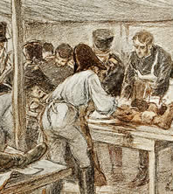
Nursing During Wars Revolution
Medicine was rather primitive
Common soldiers tended the sick and wounded, assisted by civilian doctors and volunteer ‘nurses’

Slide 9
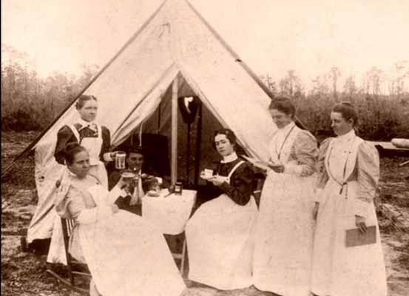
Nursing During Wars Civil War
Nursing had advanced during the Crimean War in Europe
Doctors and orderlies aided by volunteer civilian women serving as nurses
US Sanitary
Commission
Nuns
Dorothea Dix:
Superintendent

Slide 10
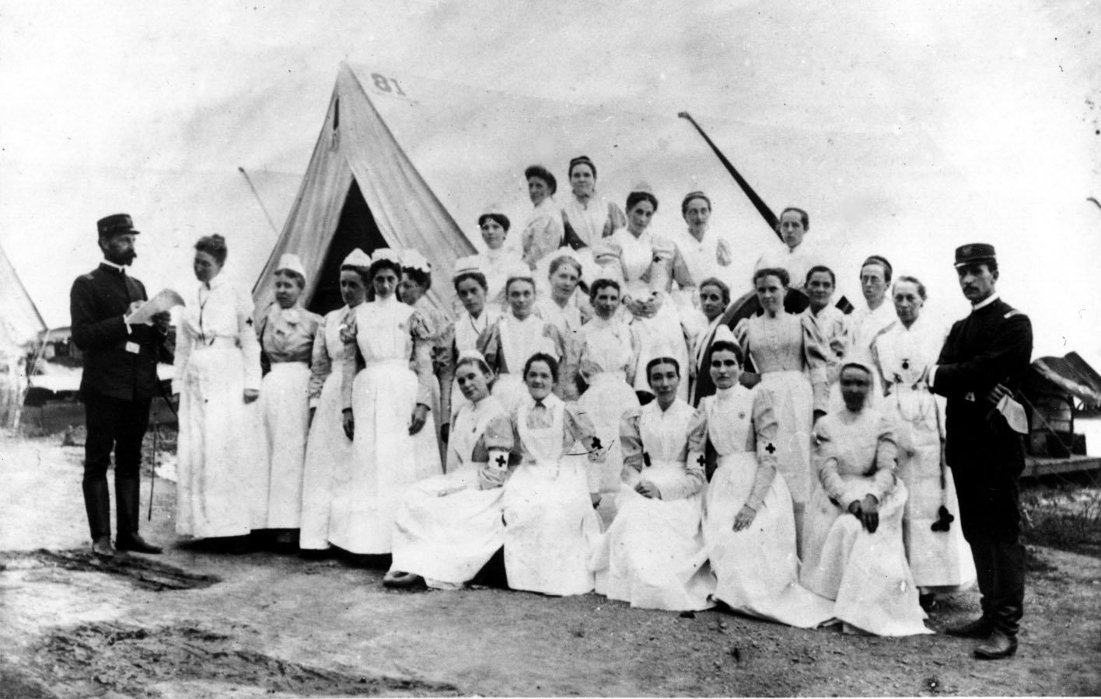
Nursing During Wars Spanish American War
US Military contracted for civilian nurses
Most served in hospitals in the US
A few went to Cuba, Philippines, Puerto Rico, and Honolulu
Of 1563 nurses,
153 died of diseases
(mostly typhoid)
Nuns

Slide 11
Army Nurse Corps
Formed officially in 1901
3-year appointments
Not actually commissioned officers until 1947
Only around 100 on active duty

Slide 12
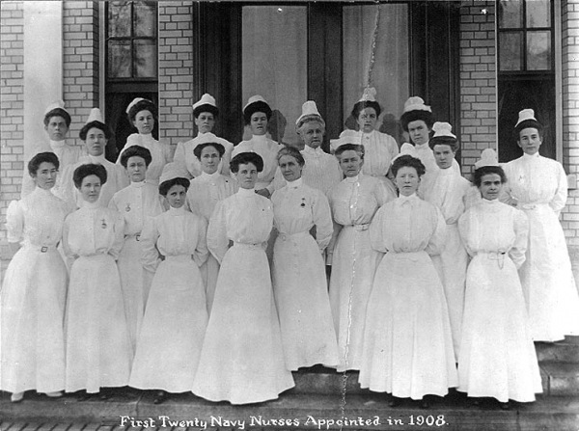
Navy Nurses

Slide 14
Check on Learning
When was the Army Nurse Corps established?
1776 c) 1860
1796 d) 1901
When did nursing become a profession ?
Late 18th Century c) Early 20th Century
Late 19th Century d) Late 20th Century
When did nurses officially hold officer rank in the US military?
1860 c) 1898
1963 d) 1947

Slide 15
Suffragettes
OBJECTIVES
DESIRED OUTCOME (Followership)
At the conclusion of this training, Cadets will be able to describe groups who have sacrificed for the benefit of the United States despite challenges and obstacles.
Plan of Action:
Describe the Declaration of Sentiments.
Describe the timeline of the women’s suffrage movement in the United States.
Essential Question: How did the Women’s Suffrage Movement come about, what did they do, and what was the result? What was the Declaration of Sentiments?

Slide 16
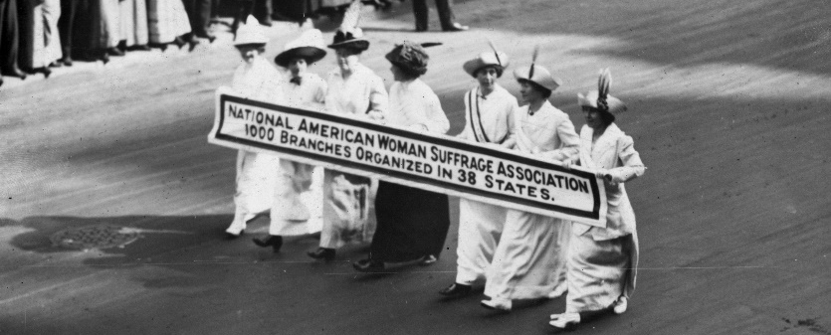
Suffrage
Suffrage is the right to vote in political elections.
Suffragettes were women advocating the right to vote through organized protest. It usually refers to women advocating for women’s suffrage.
Women’s suffrage is giving women the right to vote.
A suffragist is someone advocating for the right to vote.
(Webster, 2020)

Slide 17
History of Suffrage in the US
The Constitution did not address the right to vote. They left this to the states.
In the 18th Century, suffrage was limited to white male landowners. This excluded women and minorities.
In the early 19th Century, most new states opened voting to non-property owners
The 15th Amendment in 1870 opened voting to all races
The 19th Amendment in 1920 opened voting to women
Even today, there is effort by some to restrict people from voting – but the basic right to vote is established

Slide 18
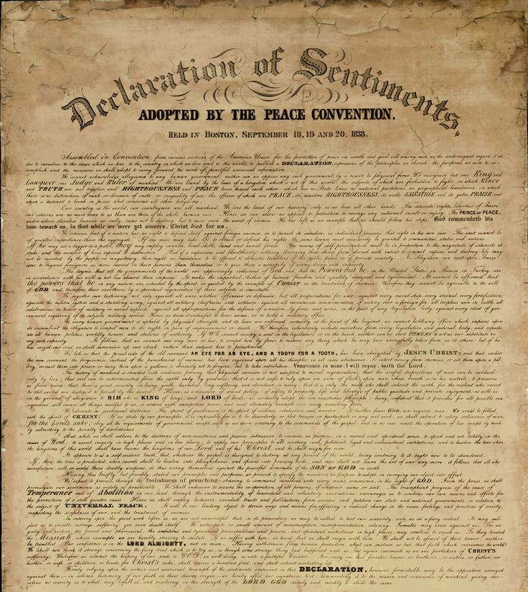
Women’s Suffrage
1848 in Seneca Falls, NY
Elizabeth Cady Stanton and Lucretia Mott hosted a conference on women’s suffrage
They published the Declaration of Sentiments
Based on the Declaration of Independence
Listed grievances on lack of women’s suffrage
Signed by 100 attendees

Slide 19
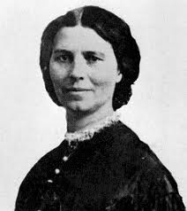
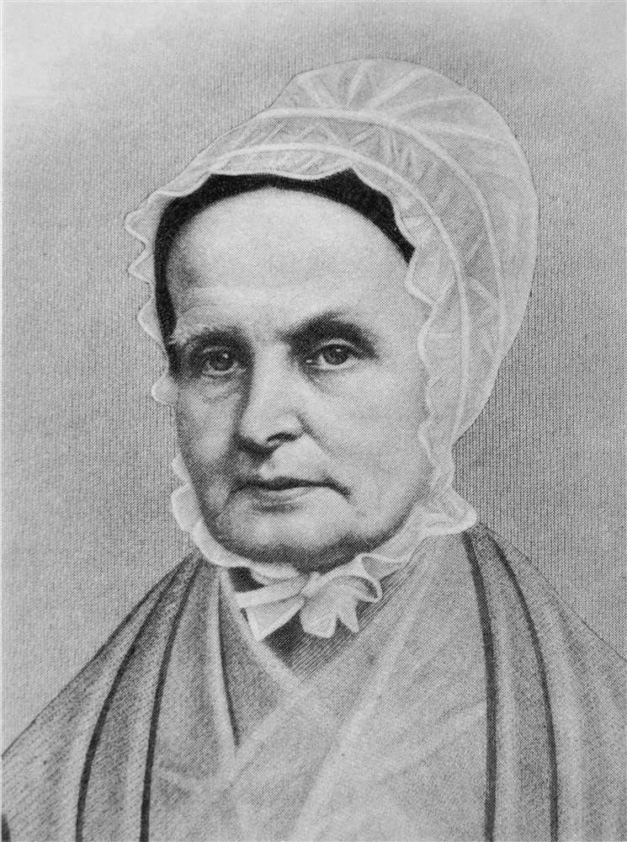
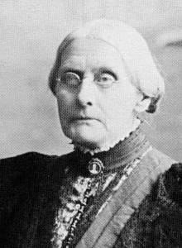
Suffragette Leaders Started Movement
Elizabeth Cady Stanton
Lucretia Mott
Susan B. Anthony

Slide 20
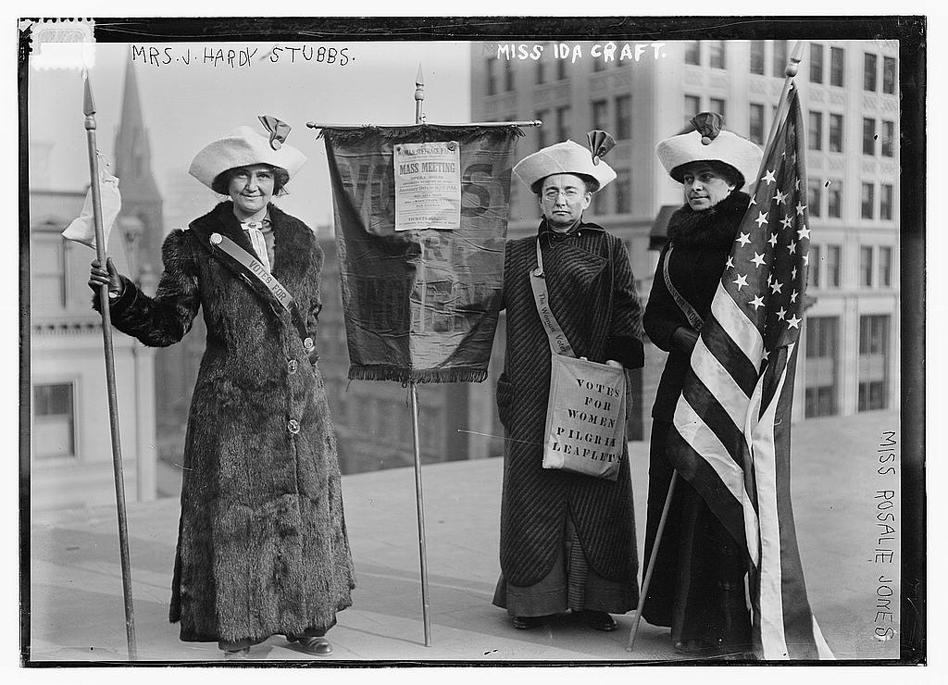
Suffrage Movement
Continued to grow throughout the last half of the 19th and first couple decades of the 20th Centuries
Not as violent in America as it was in Britain
Wars tended to detract from movement
Later wars, where women contributed to war effort more, added to support for suffrage
Early on, allied with anti-slavery and temperance movements

Slide 21
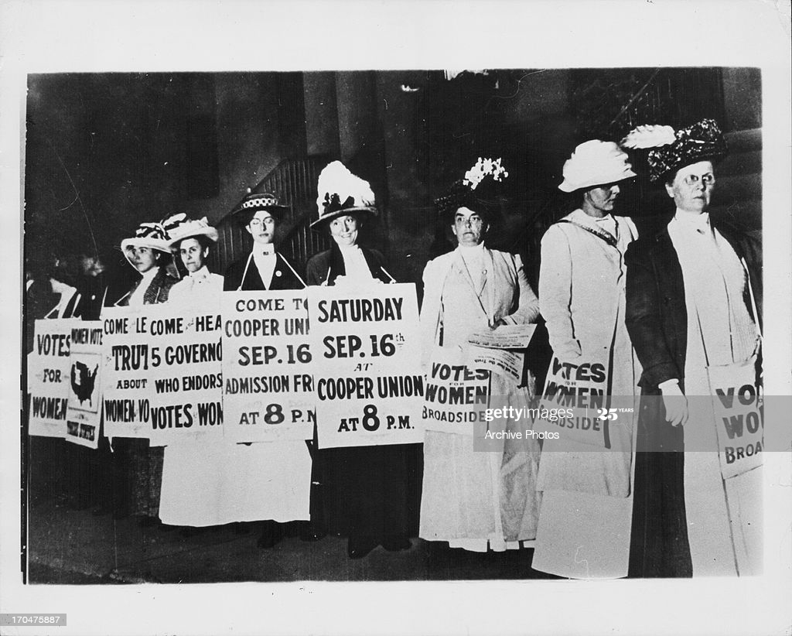
Suffragist Activities
Conferences
Lobbying politicians
Rallies / public demonstrations
Picketing
Strikes
Hunger strikes
Supporting minority voting

Slide 22
Check on Learning
T / F Picketing was a typical form of protest for suffragettes
When did women get the right to vote?
1848 c) 1920
1870 d) 1947
The Declaration of Sentiments is based on
The Constitution
The Declaration of Independence
The Declaration of Arbroath

Slide 23
Buffalo Soldiers
OBJECTIVES
DESIRED OUTCOME (Followership)
At the conclusion of this training, Cadets will be able to describe groups who have sacrificed for the benefit of the United States despite challenges and obstacles.
Plan of Action:
Describe who the Buffalo Soldiers were and what they did.
Essential Question: Who were the Buffalo Soldiers, and what did they do in support of the United States of America?

Slide 24
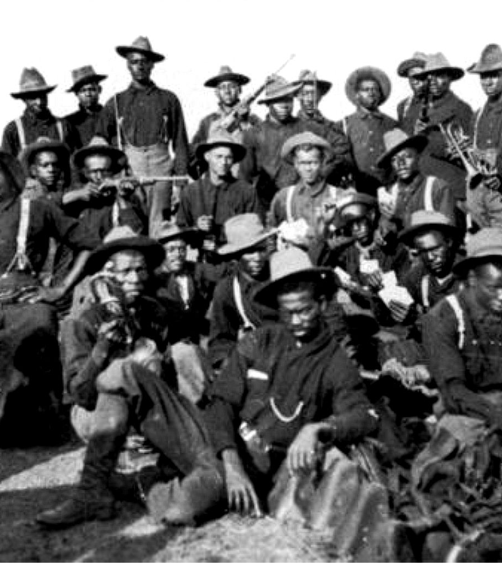
Buffalo Soldiers
Thousands of African Americans served in the US Army during the Civil War
In 1866, Congress authorized the formation of six African American segregated regiments
2 Cavalry Regiments
4 Infantry Regiments
27 Medals of Honor

Slide 25
Buffalo Soldier Missions
Control the Native Americans of the Plains
Capture cattle rustlers & thieves
Protect settlers, stagecoaches, wagon trains, & railroad crews
Build roads & Army forts
Manage national parks
Explore & map the West
String telegraph lines
Protect Native American lands from illegal settlement
Discourage illegal traders
Patrol the US/Mexican border
Fight battles where needed (i.e. Spanish-American War)

Slide 26
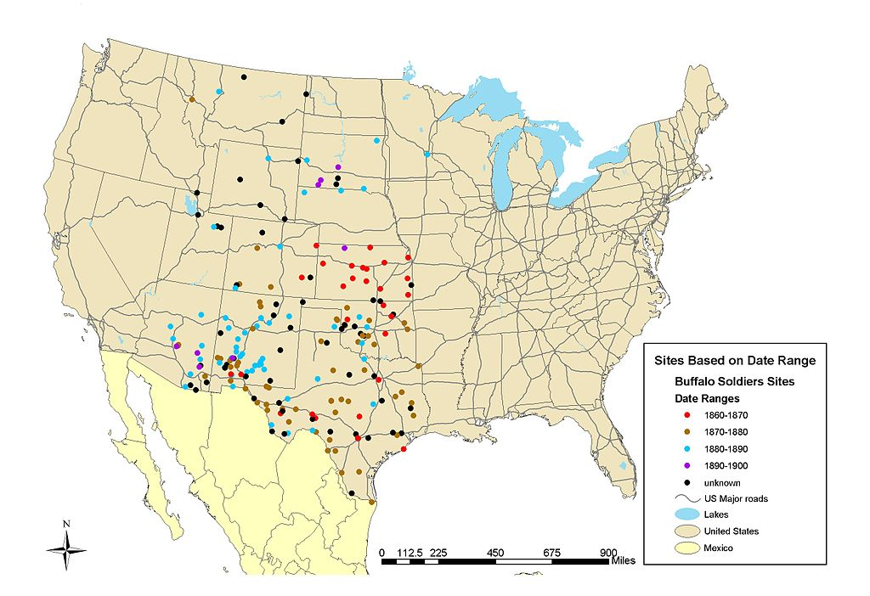
Where They Served
By NPS map - National Park Service, CRGIS Buffalo Soldiers Mapping Project at National Park Service Mapping Project, Buffalo Soldiers;
https://commons.wikimedia.org/w/index.php?curid=12730456

Slide 27
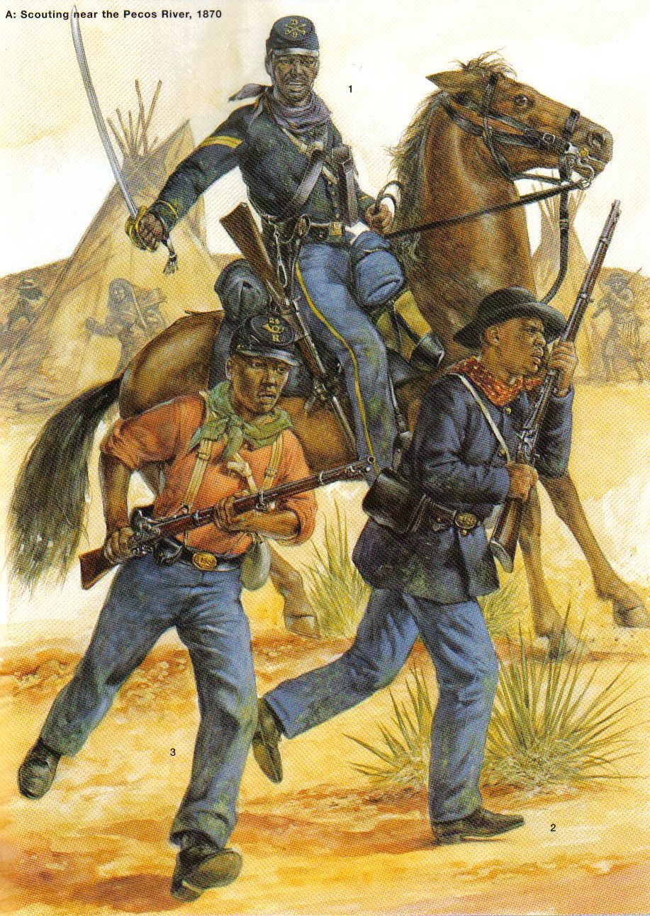
Why “Buffalo Soldier”?
We’re really not sure. Maybe:
Because of their rugged and tireless marching (like buffalo)
Their hair is like buffalo fur
They wore buffalo-hide coats
They took the name as a sign of respect from Native Americans, who revered the buffalo

Slide 28
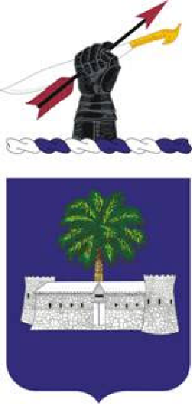
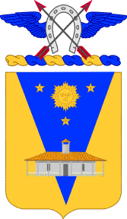
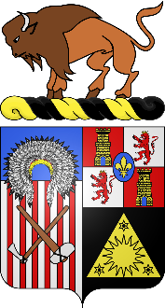
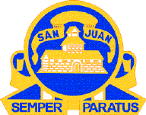
Who Were Buffalo Soldiers?
Initially just the 10th Cavalry Regiment
Later adopted by 9th Cavalry Regiment
Later adopted by 24th/25th Infantry Regiments
Later adopted to mean all Black soldiers
9th CAV 10th CAV 24th IN REGT 25th IN REGT

Slide 29
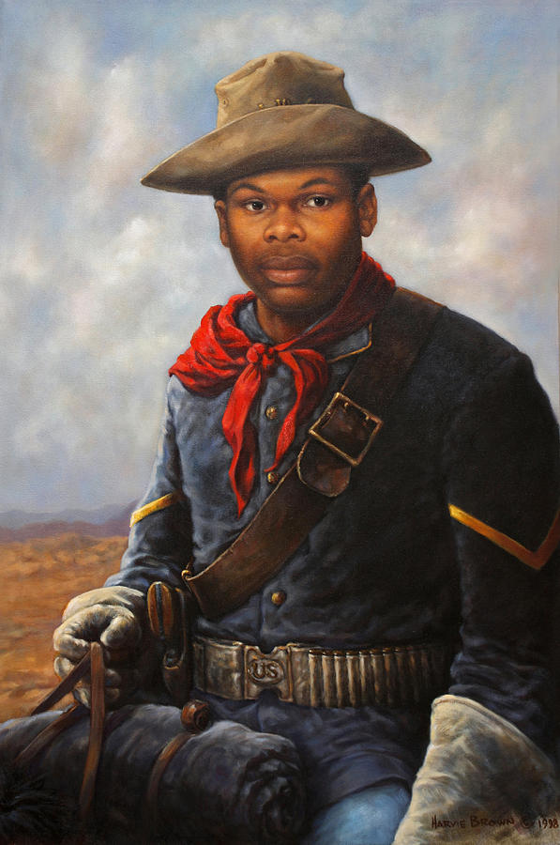
Who Were Buffalo Soldiers?
American Soldiers
Ambassadors for their race
Paved the way for future military integration
Volunteers
Significant number of Civil War veterans
Served with pride and honor
Proved their ability to fight & win despite challenges
Competitive positions in these units – they were winners
Improved the situation in the American West
Added to Army capabilities

Slide 30
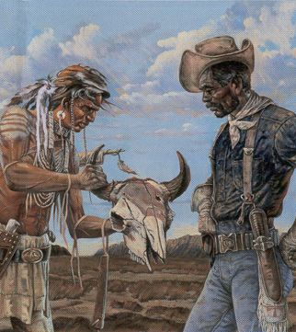
African Americans vs Native Americans
Buffalo Soldiers’ mission was to pacify Native American tribes in the West
Native Americans respected their fighting spirit
Uncomfortable fact of history
How do we reconcile it?
Do we place blame?
Do we consider the prevailing beliefs of the era?
Is there a way to make amends?
How do we learn about each others’ culture now?
How do we embrace history and move forward?
Do they share the status of victim of their time?

Slide 31
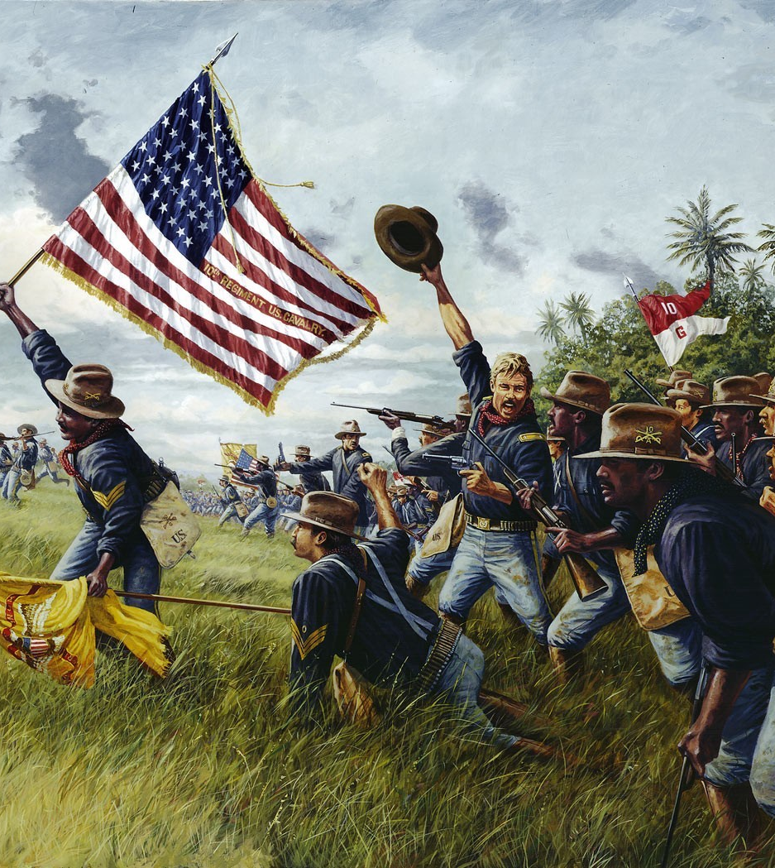
Spanish-American War
3000 Buffalo Soldiers part of expeditionary force into Cuba & Philippines
“I never saw braver men anywhere” (Rough Rider Frank Knox)
Battles: Las Guasimas, San Juan Hill, Kettle Hill, Tayacoba

Slide 32
Buffalo Soldiers

Slide 33
Check on Learning
Name four missions the Buffalo Soldiers performed
Where were they stationed?
What were the two wars that the 4 regiments of Buffalo Soldiers fought in?
Bonus: How many Medals of Honor were awarded to Buffalo Soldiers?

Slide 34
65th Infantry Regiment “Borinqueneers” and other Hispanic units
OBJECTIVES
DESIRED OUTCOME (Followership)
At the conclusion of this training, Cadets will be able to describe groups who have sacrificed for the benefit of the United States despite challenges and obstacles.
Plan of Action:
Identify the 65th Infantry Regiment, Borinqueneers, and their major successes and failures.
Essential Question: Who was the 65th Infantry Regiment, and what were their major successes and failures?

Slide 35
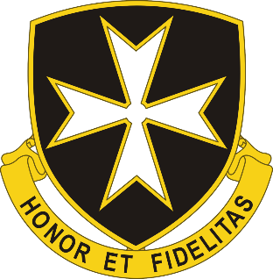
65th Infantry Regiment
Last segregated unit of Hispanic Americans to serve in the US Army
Formed right after Puerto Rico became a US Territory (1899)
Puerto Rican officers and men
White (Hispanic) and Black (African Puerto Ricans) units within the regiment
First unit to fire a shot at the enemy in World War I (1915 – before US entered the war)
Named from original name of Puerto Rico (Borinquen) when inhabited by the Taino indigenous people

Slide 36
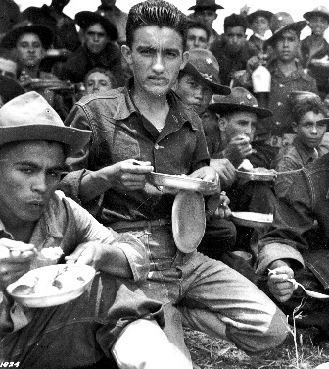
World Wars I and II
65th IN Regt activated during both wars
WWI: deployed to Panama for defense missions
WWII: deployed to Panama for defense missions, then to North Africa, Italy, France, & Germany

Slide 37
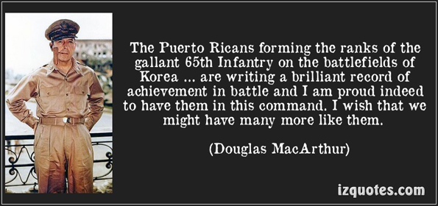
Korean War
August 1950 – November 1954
Heavily involved in fighting under 3rd Division
Many officers replaced by non-Puerto Ricans and even non-Hispanic officers
Continued rotation of new soldiers; this took experienced soldiers out of the fight
Shortage of officers and NCOs

Slide 38
Court Martials
L Company refused to fight after some poor decisions and orders led to poor morale
>100 men tried by court martial
91 found guilty
Secretary of the Army cancelled the sentences and granted clemency and pardons
Bias found in court martial process
Replacement of officers and NCOs with non-Hispanics led to breakdown of unit cohesion

Slide 39
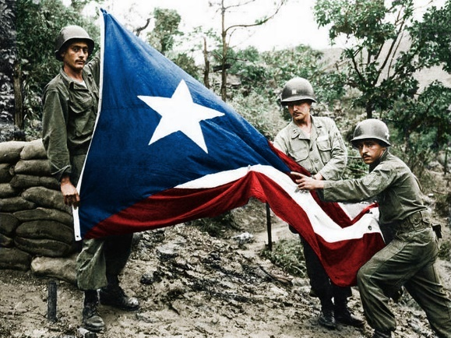
Desegregration
In 1953, the Army desegregated the 65th
Transferred thousands of Hispanic soldiers to other units
Brought in thousands of white and Black soldiers
Only a small core of 250 Puerto Ricans remained
After demobilization, only 1st Bn, 65th IN remains as part of the Puerto Rican National Guard

Slide 40
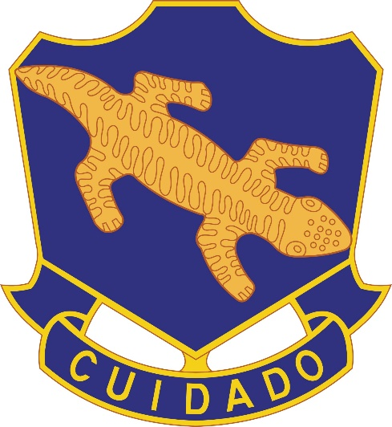
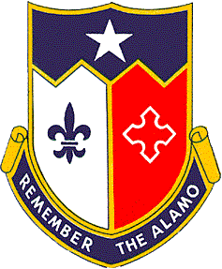
Other Mostly Hispanic Units
158th Infantry “Bushmasters” (AZ ARNG)
Mostly Mexican Americans & Native Americans
Fought in Indian Wars
Pursuit of Pancho Villa in 1915
WWI under 40th IN Division (CA ARNG)
WWII: Panama, Australia, New Guinea, Philippines, then Occupation of Japan
141st Infantry (TX ARNG)
Italy, France, Germany

Slide 41
Check on Learning
What state gave us the “Borinqueneers”?
Which of the following were segregated Hispanic units?
65th IN Regt
141st IN Regt
158th IN Regt
What happened in Korea with L Company of the 65th Infantry Regiment?

Slide 42
Lafayette Flying Corps
OBJECTIVES
DESIRED OUTCOME (Followership)
At the conclusion of this training, Cadets will be able to describe groups who have sacrificed for the benefit of the United States despite challenges and obstacles.
Plan of Action:
Describe the LaFayette Flying Corps and what they accomplished.
Essential Question: What was the LaFayette Flying Corps, what did they do, and what were their goals?

Slide 43
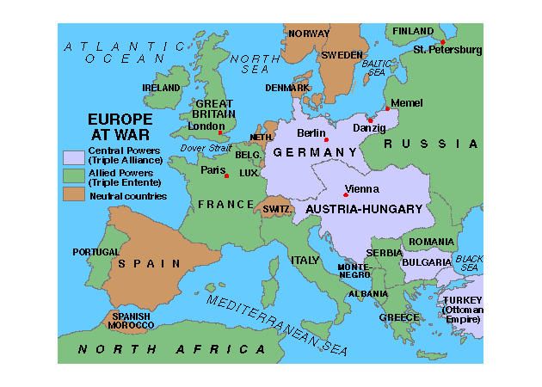
World War I
1914 – start of the First World War
Most of Europe fighting in France
United States was neutral
Many Americans wanted to contribute
American Volunteer Ambulance Services
French Foreign Legion
New unit in French Air Service formed in 1916:
Escadrille Americaine (American Squadron)
Renamed Lafayette Escadrille

Slide 44
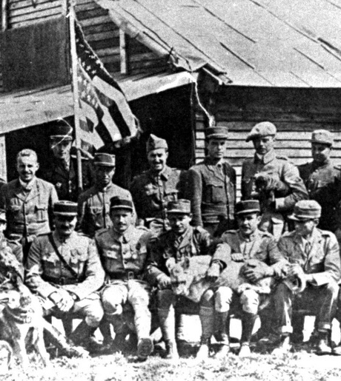
Lafayette Escadrille
Lobbied for by Norman Prince
All-American squadron in French Air Service
Give Americans an opportunity to fight/fly
Drum up support for America to enter the war
Named after the Marquis de Lafayette (French and American hero from Revolutionary War)
Approved in 1915, formed in 1916
First air combat in May 1916 at Verdun
French uniforms, French aircraft
Developed a good record

Slide 45
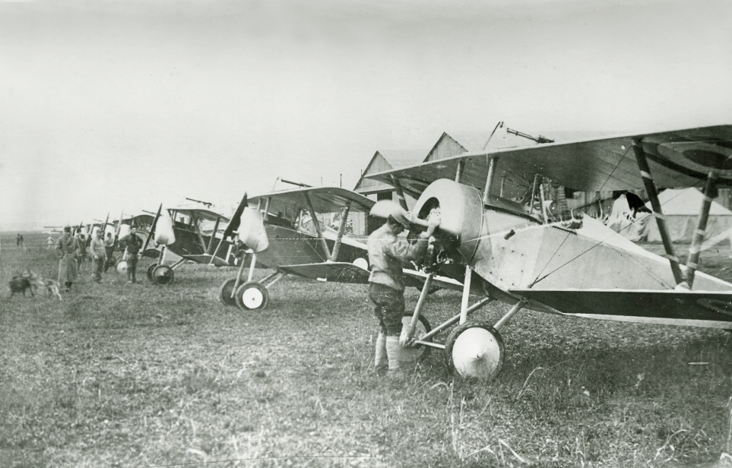
Americans in Other Units
There were so many volunteers, the French Air Service finally spread them among other French squadrons
About 200 American pilots overall
38 in Lafayette Escadrille (over 21 months)
+
=
Lafayette Escadrille Lafayette Flying Corps
Americans in FAS Units

Slide 46
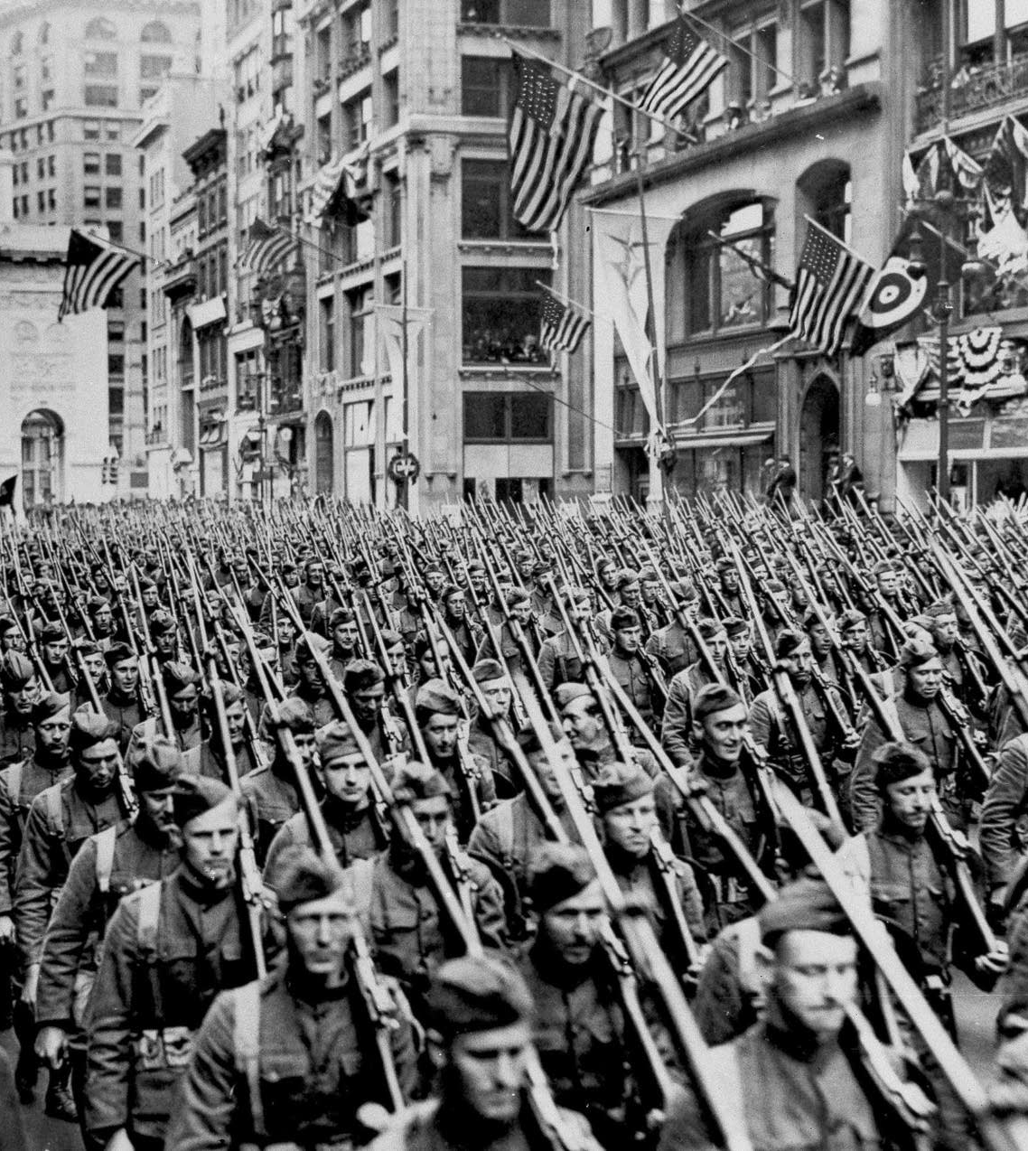
America Enters the War
America entered WWI in April 1917
Mobilized population and economy
Started drafting and training men (4 Million)
Formed many new units
American Expeditionary Force (AEF) stood up July 1915
Entered fighting war in October 1017
Continued to flow troops to France

Slide 47
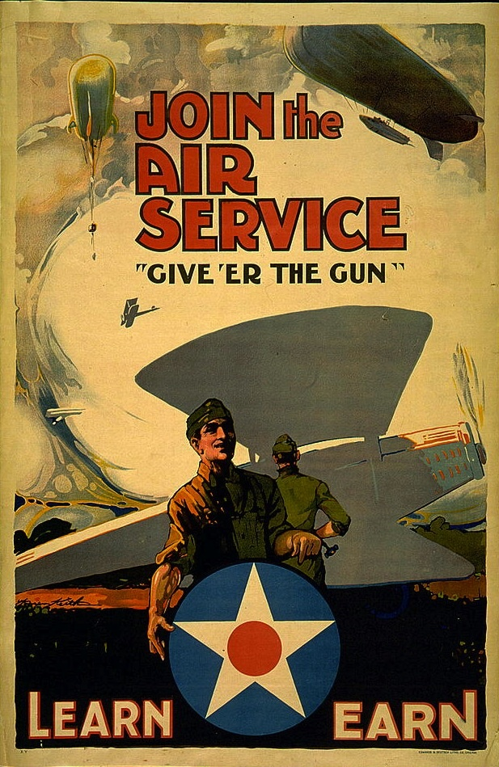
American Air Service
American Air Service had to recruit and train pilots and support
Wanted 5000 pilots and planes, and 50,000 mechanics
Had only 100 pilots, 3 airfields
Trained 11,000 pilots
Only about 1000 made it into combat
AEF ready to start flight operations in Feb 1918

Slide 48
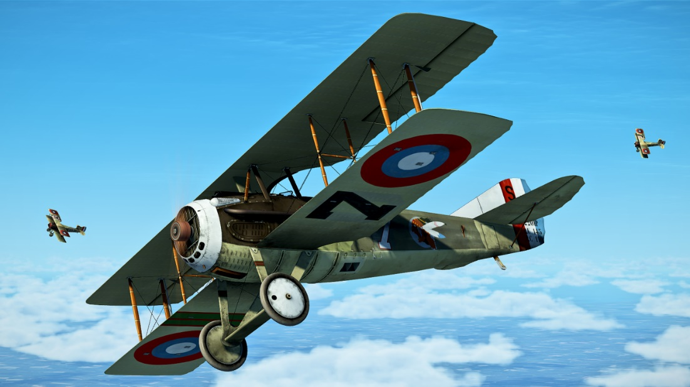
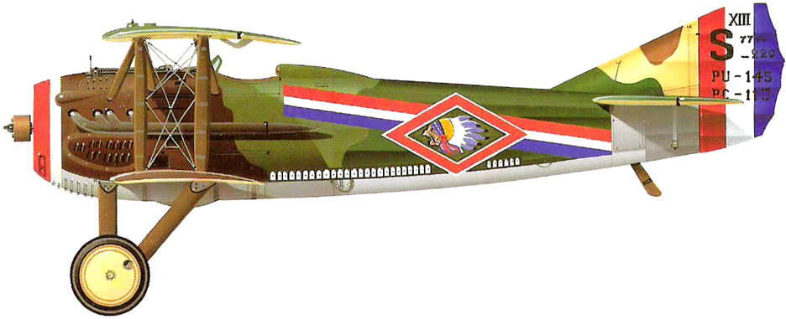
Disbanding Lafayette Escadrille
Pilots from Lafayette Flying Corps transitioned into the American Air Service in February 1918
103rd Aero Squadron
Lafayette Flying Corps pilots, due to their experience, were the core of America’s air capabilities
Continued flying missions
Served as flight instructors
Provided commanders for new units

Slide 49
Check on Learning
What was the Lafayette Escadrille?
What was the Lafayette Flying Corps?
How many pilots did America train after we entered World War I?
How many made it into combat?
What happened to the Lafayette Flying Corps in February 1917?

Slide 50
Doolittle Raiders
OBJECTIVES
DESIRED OUTCOME (Followership)
At the conclusion of this training, Cadets will be able to describe groups who have sacrificed for the benefit of the United States despite challenges and obstacles.
Plan of Action:
Describe the Doolittle Raid, when and how it occurred, and what it accomplished.
Essential Question: What was the Doolittle Raid and what did it accomplish?

Slide 51
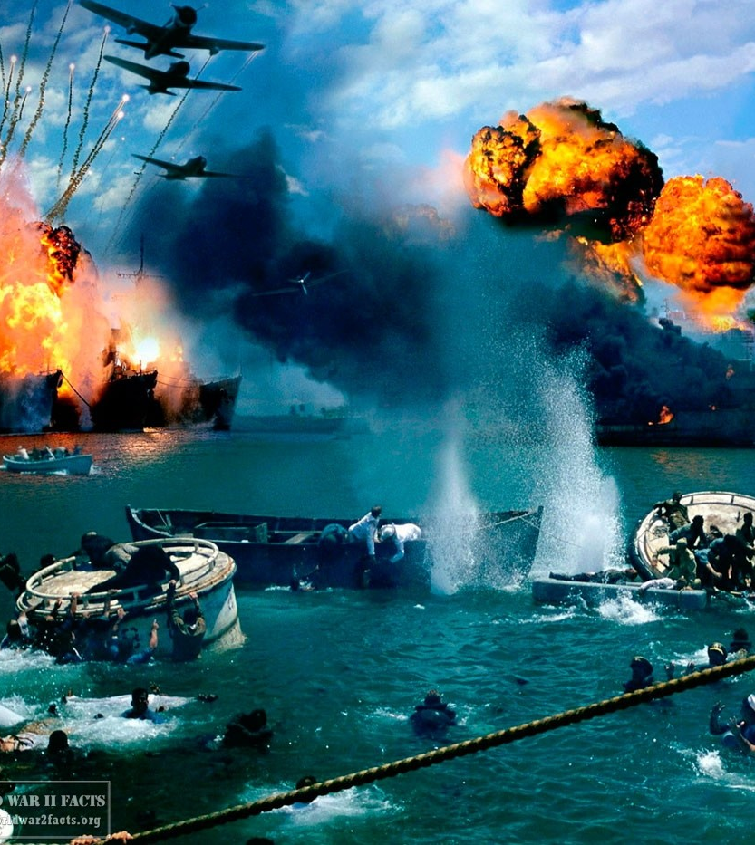
Pearl Harbor Attack
December 7, 1941
Surprise attack on naval and air bases in Hawaii by Japanese Navy
2400 people killed
1200 people wounded
5 battleships sunk
10 ships damaged
188 aircraft destroyed, 159 damaged
US Military caught unprepared
Country was shocked and devastated
Entered war with Japan

Slide 52
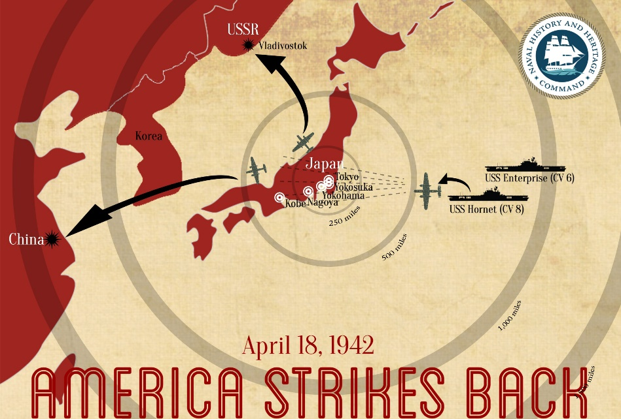
US Response
American readying for war
President asked for the military to respond
Navy developed a plan to attack Japan
Fly Air Force bombers off an aircraft carrier
Bomb targets in Japan
Land bombers in Russia or China
Lt Col James Doolittle given the mission

Slide 53
3 Goals
Cause material damage
Morale: Boost American morale and lower Japanese morale
Get Japan to expend resources to guard Japan against future attack

Slide 54
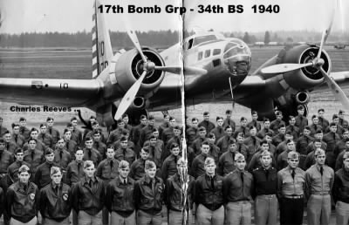
The Raiders
Commanded by LtCol Jimmy Doolittle
17th Bombardment Group
Most experienced B-25 crews in the Air Corps
100% of unit volunteered for extremely dangerous mission
24 crews trained
16 crews did the mission

Slide 55
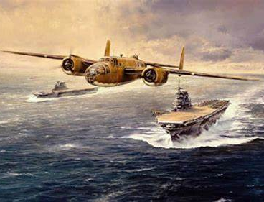
Executing the Plan
Aircraft Carrier spotted 650 miles east of Japan
Launched raid early
Japanese still taken by surprise
Some targets hit, some not
All planes left Japanese airspace intact
15 to China, 1 to Russia (not in plan)

Slide 56
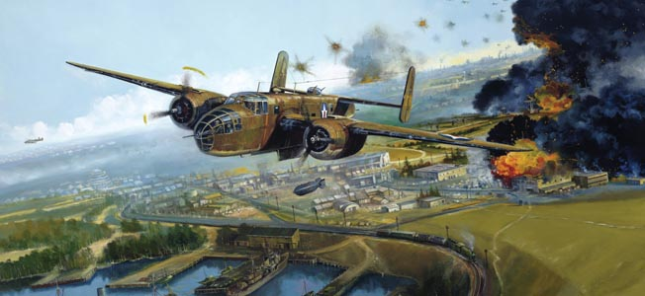
The Targets
Tokyo
Yokosuka
Yokohama
Kobe
Nagoya
Targets included an arsenal, factories, refineries, a dock yard, ship, steel works, and residential areas
One plane was slightly damaged by anti-aircraft fire. No others received battle damage.
No lasting significant damage was done by the raids

Slide 57
The Get-Away Plan
Planes headed to friendly China occupied by Japanese forces
Either land, refuel, get to Chongqing* or
Crash/bail out, get to Chongqing
One plane, low on fuel, went to Russia
(Russia had neutrality pact with Japan, had refused request for all planes to land there)
From Chongqing, they could be extracted
Crews were saved by Chinese civilians
* Chongqing was the capital of Nationalist China

Slide 58
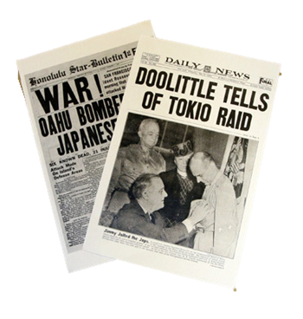
The Results
Raid considered a great success
Little actual damage
Huge American morale boost
Stunned Japanese people – no one had thought they could be attacked in Japan
Caused Japan to bring some combat forces home to defend homeland
Pushed Japan into the Battle of Midway (big defeat)
Japanese Army went after Chinese who had helped crews. Decimated the area. 250,000 Chinese killed in retaliation.

Slide 59
The Results
2 Crews captured by Japanese
8 airmen captured; 3 executed; 1 died in captivity; 4 survived the war as prisoners of war
13 Crews eventually evacuated from China
1 Crew interned in Russia; ‘escaped’ in 1943
Most of the airmen went on to fight in WW2
Doolittle promoted to Brigadier General, awarded Congressional Medal of Honor
All others promoted, awarded Distinguished Flying Cross & Chinese award
2015: Congressional Gold Medal awarded

Slide 60
Videos
Doolittle Raiders: A China Story:
https://vimeo.com/266803924

Slide 61
Check on Learning
The plan was to attack _______ from an _______ _______ and land in ________.
The Commander of the Raid was _______.
The raiders crash landed or bailed out and were helped to safety by _____________.

Slide 62
Navajo Code Talkers
OBJECTIVES
DESIRED OUTCOME (Followership)
At the conclusion of this training, Cadets will be able to describe groups who have sacrificed for the benefit of the United States despite challenges and obstacles.
Plan of Action:
Describe the Navajo Code Talkers, what they accomplished, and how.
Essential Question: Who were the Navajo Code Talkers, what did they accomplish, and how did they do it?

Slide 63
Video
Go to:
https://navajocodetalkers.org/story-of-the-navajo-code-talkers/

Slide 64
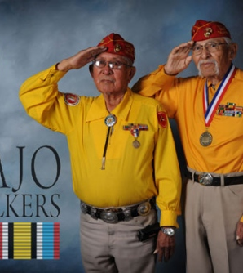
Context
Early in World War II
Marines looking for ways to quickly encrypt and decrypt messages on the battlefield
Philip Johnston recommended Navajos
He grew up on reservation speaking Navajo
Native American languages had been used in WW1
He designed a way to encode the language
Pitched it to the Marines
They approved it

Slide 65
President Bush’s Speech Congressional Gold Medal

Slide 66
Navajo Code Talkers
Program started with 29 Navajos
Trained as Marines
Developed and learned code
About 400 Navajos eventually served
Participated in every major battle in the Pacific
13 were killed in action
The code was never broken by the Japanese

Slide 67
Practical Exercise
Get the code at https://www.history.navy.mil/research/library/online-reading-room/title-list-alphabetically/n/navajo-code-talker-dictionary.html
YIL-TAS SEIS BE-DELH-NEED. BA-GOSHI BE-LA-SANA BE DZEH D-AH KLESH YAH-TAY-GO-E-ELAH BILH(W) BAH-HAS-TKIH!
A Navajo Code-Talker could decode this in seconds!

Slide 68
The Code
Two Parts:
Common military words
Alphabet
The designers translated military words that aren’t in the Navajo language, or used descriptive words
Dive Bomber: GINI (Chicken Hawk)
Observation Plane: NE-AS-JAH (Owl)

Slide 69
Alphabet Code
Each letter represented by a word starting with that letter in English
A: WOL-LA-CHEE (Ant)
B: NA-HASH-CHID (Badger)
C: TLA-GIN (Coal)
Most letter had multiple options (A: Ant, Apple, Axe) so repeated used wouldn’t allow code-breakers to figure out what the letters were

Slide 70
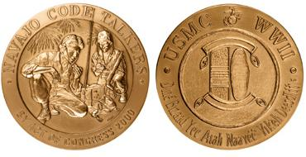
The Code
The final code had over 400 words that each Code Talker memorized
After the war, the code was considered a secret, so Code Talkers got no credit until 1969
2001 – Congress issued a Gold Medal

Slide 71
Check on Learning
Which war did the Navajo Code Talkers make their contributions in?
About how many Navajo Code Talkers were there?
Which service did they enlist in?
Did the enemy ever break the code?

Slide 72
Tuskegee Airmen
OBJECTIVES
DESIRED OUTCOME (Followership)
At the conclusion of this training, Cadets will be able to describe groups who have sacrificed for the benefit of the United States despite challenges and obstacles.
Plan of Action:
Describe the Tuskegee Airmen and what they accomplished.
Essential Question: Who were the Tuskegee Airmen, and what did they accomplish?

Slide 73
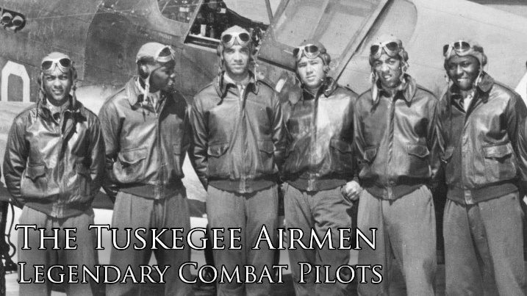
Training Pilots in Tuskegee
Prior to World War II, the Army didn’t allow African Americans to serve as pilots, or train in the aviation support specialties
Black lobbyists and newspapers pushed for African American inclusion in a new program to train civilian pilots
The Tuskegee Institute in Alabama stood up the program in January 1941

Slide 74
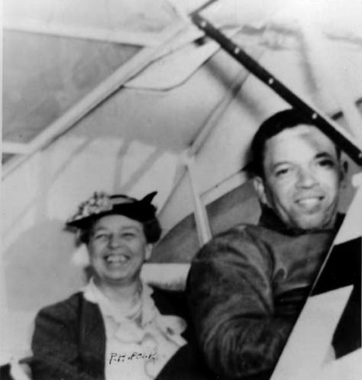
First Lady Helps Out
First Lady Eleanor Roosevelt gave a huge boost to the program when she visited in March 1941. After tours and briefings, she went flying with instructor C. Alfred Anderson. The publicity is partly credited for keeping the program on track.

Slide 75
Who Were the Tuskegee Pilots
High quality applicants
Highly motivated to succeed
For themselves and their race
CPT Benjamin O. Davis, Jr. in first class
Only the 4th African American West Point graduate
He and his father (BG Davis) were the only Black officers in the Army except some chaplains
First Commander of the 99th Pursuit Squadron

Slide 76
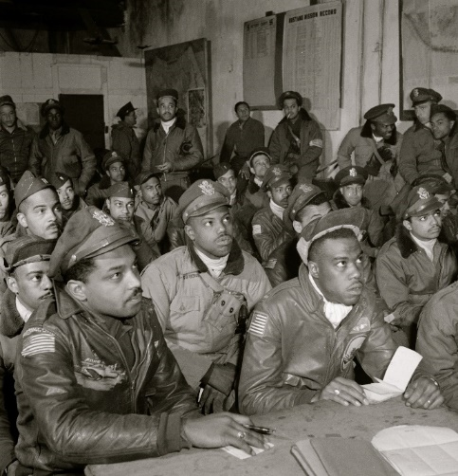
99th Pursuit Squadron
First Black flying squadron
Trained for a year
Deployed to North Africa in April 1942
Eventually joined by other Black squadrons
Became part of 332nd Fighter Group
Flew in North Africa, Sicily, Italy, Germany
Great record protecting bombers

Slide 77
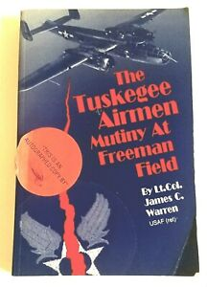
Freeman Field Mutiny
Pilots reacting to segregation, discrimination, and unequal treatment
Put in old rundown segregated facilities
Freeman Field, Indiana
Two Officers’ Clubs – one White, one Black
Names changed to clubs for Instructors, Trainees (saying only Whites were instructors)
Black officers started entering the White club

Slide 78
Freeman Field Mutiny, con’t
Over several days, over 60 Black officers were arrested, and the club was closed
Required all officers to sign a statement acknowledging new regulation; 101 Black officers refused to sign
Tried them for refusing to obey a direct order
Army Chief of Staff Marshall ordered the officers released. They got Letters of Reprimand instead of trial for mutiny

Slide 79
Freeman Field Mutiny, con’t
Three officers, accused of shoving the Officer of the Day and disobeying a lawful order during one of the protests, were court-martialed.
Two were acquitted
One was acquitted of disobeying an order, but found guilty of assault for jostling the officer
$150 fine (paid by his fellow officers)
Dishonorable Discharge
In 1995 he received a full pardon, restoration of rank, and refund of the fine

Slide 80
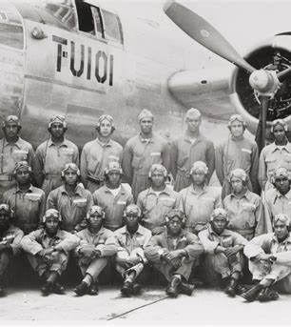
477th Bombardment Group
Four Bombardment squadrons
Equipped and trained
Never deployed to war
After Freeman Mutiny, 2 squadrons inactivated
Group command changed to Col Ben Davis, 99th Pursuit Squadron transferred to 477th, and Group was redesignated a “composite group”
Inactivated in 1947

Slide 81
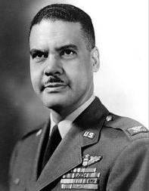
Col Benjamen O. Davis, Jr.
West Point Class of 1932
Son of BG Benjamin O. Davis, Sr
1st Black Brigadier General
First class of Tuskegee Airmen
Commanded 99th Pursuit Sqdn
Commanded 332nd Fighter Gp
Commanded 447th Bomb Group
Commanded 51st Fighter-Interceptor Wing in Korea
Vice-Commander, 13th Air Force
Chief of Staff UN Command and US Forces in Korea
Commander 13th Air Force
4-Star General upon retirement

Slide 82
Tuskegee Airmen
Trained 992 pilots 1941-1946
335 deployed overseas
66 killed in action
12 killed in training
32 captured as prisoners of war
Fought against systematic racial injustice
Influenced later desegregation of the military

Slide 83
Check on Learning
Where is the Tuskegee Institute?
Who visited the program and helped it along through the publicity of her support?
What was the Freeman Field Mutiny about?
Which of these units fought in Europe?
477th Bombardment Group
332nd Fighter Group
99th Pursuit Squadron

Slide 84
African American Units in WWII
OBJECTIVES
DESIRED OUTCOME (Followership)
At the conclusion of this training, Cadets will be able to describe groups who have sacrificed for the benefit of the United States despite challenges and obstacles.
Plan of Action:
Discuss the African American segregated units during World War II, name two of the most significant what they did, and what their challenges were.
Essential Question: What were the major segregated African American units in World War II, what did they accomplish, and what were the major challenges they faced?

Slide 85
Segregated Units
Prior to 1948, the Army segregated African Americans in their own units, sometimes with white officers
Black units were often given unequal treatment, and suffered from discrimination
African Americans wanted to serve their country, and this was the only way they were allowed, so they did
Sometimes when numbers were small, Blacks were integrated into training or units with Whites. There was usually a lot of discrimination.

Slide 86
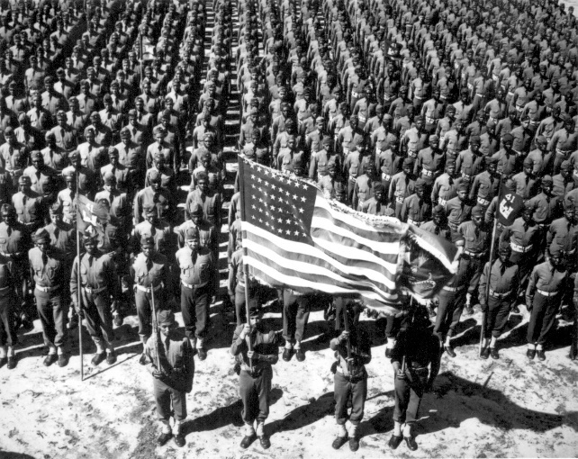
World War II
The US needed all Americans to serve
We’ve studied the Tuskegee Airmen; here are some other successful segregated units:
92nd Infantry Division
93rd Infantry Division
Red Ball Express
761st Tank Battalion
Support Units

Slide 87
Teamwork Wins

Slide 88
92nd Division
Active in World War I – Buffalo Soldier Division
Activated for World War II in 1942
Deployed to Europe SEP 1944
Fought in Italy
Poor reputation as a unit
Likely due to racism
2 Medals of Honor awarded (upgraded in 1997) for heroism in Italian Campaign

Slide 89
93rd Infantry Division
Activated for World War I but HQ never deployed. IN Regiments fought under French
Activated for World War II in 1942
Deployed to South Pacific in 1944
Guadalcanal, New Guinea, Bougainville, Bismarck Archipelago
Mostly used for combat support missions
Poor reputation as a unit
Mostly due to racism – not given missions to fight

Slide 90
Red Ball Express
Truck convoy system
Supplied Allied forces moving through Europe from D-Day beaches
One-way roads to the front, return routes
24/7 resupply operation
75% African Americans
We couldn’t have won the war without this effort

Slide 91
761st Tank Battalion
Patton’s Third Army
Outstanding performance in battle
Segregated Black unit with Black and White officers
4 campaigns
1 Medal of Honor, 11 Silver, 69 Bronze Stars
Presidential Unit Citation

Slide 92
WACS and WAVES
Around 4000 African American women served in the Women’s Army Corps during World War II
Like white women, they served in support roles
Postal units, nurses, clerical
Black women served in the WAVES (Navy Women’s Reserve) too (not on ships)

Slide 93
Blacks in the Navy
Navy leaders didn’t want to integrate
President Roosevelt overruled them and demanded they open jobs to Blacks
Mostly trained as quartermasters, machinists, electricians, and mess attendants
Finally opened a small path to officer commissions, but weren’t allowed to serve in significant leadership roles

Slide 94
Port Chicago 50
Deadliest stateside disaster of WW2
Port Chicago – just east of San Francisco
Base where ammo/explosives loaded onto ships
Hard, dangerous work
Mostly African American sailors
Little training or emphasis on safety
Two ships and the dock between them blew up
Killed 320 men

Slide 95
Port Chicago 50
After rubble was cleared, sailors ordered back to work
No change in conditions or safety improvements
250 men refused to return to the docks
Navy labeled it a mutiny, arrested the sailors
208 sailors then went back to work
50 were prosecuted for mutiny, conspiring to undermine the authority of officers, disobeying orders
All 50 found guilty, sentenced to 8-15 years prison and dishonorable discharge

Slide 96
Port Chicago 50
2 white divisions sent to work at Port Chicago alongside the Blacks
This effectively integrated the mission
Integration increased around the Navy
This helped pave the way for integration among the US military in 1948
The convicted sailors were quietly released after 18 months in federal prison. Most were shipped out to serve in the Pacific after the war ended
Last living survivor pardoned by President Clinton

Slide 97
Check on Learning
There were two Black Army Divisions in World War II. What were their designation?
What did the men of the Red Ball Express accomplish in the months after D-Day?
What famous commanding general did the 761st Tank Battalion work for?
What were the Chicago 50 court-martialed for doing?

Slide 98
Nisei in WWII
OBJECTIVES
DESIRED OUTCOME (Followership)
At the conclusion of this training, Cadets will be able to describe groups who have sacrificed for the benefit of the United States despite challenges and obstacles.
Plan of Action:
Describe the history of the 442nd Regimental Combat Team / 100th Infantry Battalion, how they were formed and what they’re known for.
Describe the role played by Nisei who served in the Army during World War II in the Pacific Theater.
Essential Question: How were Nisei units formed in the US Army during World War II, what did they accomplish, and how?

Slide 99
What’s a Nisei?
Nisei is the Japanese term for second-generation immigrant, the children of Japanese who immigrated to America from Japan
First Generation Immigrants (those who moved here) = Issei
Second Generation (children of Issei) = Nisei
Third Generation (grandchildren of Issei) = Sansei

Slide 100
Pearl Harbor Aftermath
Dec 7, 1941: Japanese Navy attacked Pearl Harbor
Increased the fear and hatred of Japanese Americans; some feared many Japanese Americans would be spies or saboteurs
125,000 Japanese Americans lived in the continental US, mostly on the west coast
63% were children or grandchildren of immigrants (born in US, American citizens)

Slide 101
Internment
Feb 1942: President Roosevelt issued Executive Order 9066, forcibly interning anyone of Japanese ancestry who lived in CA or parts of OR, WA, or Southern AZ
No evidence of spying or sabotage
Fear and racism combined to declare all people of Japanese ancestry suspect
The vast majority were loyal American citizens
Those living in Hawaii were not interned

Slide 102
Japanese in the Army
Before WW2, few Japanese served in the Army
No segregated Japanese American units
Some served in Hawaii National Guard
Draft in 1940 drafted many Nisei, especially in Hawaii (1/3 population of HI was of Japanese ancestry)
They were motivated to excel and prove themselves, and they did

Slide 103
1st Segregated Japanese Unit
May 1942: Army transferred all Japanese Americans from HI National Guard’s 298th and 299th Infantry Regiments, and formed the 100th Infantry Battalion
Families, community supported the men doing their best – prove their loyalty
“Do not bring shame unto the family”
“Fight hard for your country, even if it means sacrificing your life”

Slide 104
100th Infantry Battalion
Deployed to North Africa in mid-1943
Fought at Salerno, Cassino, and Anzio
Pushed the Germans north of Rome
June 1944: Moved under the command of the new 442nd Regimental Combat Team
442nd was all-Nisei unit of Hawaiians and volunteers from internment camps

Slide 105
442d Regimental Combat Team
Due partly to the great performance of the 100th IN Battalion, the Army formed the 442nd
It consisted of :
Two more Infantry Battalions
522nd Field Artillery Battalion
232nd Combat Engineer Company
Supposed to be 2/3 from internment camps, 1/3 from Hawaii volunteers
Not enough volunteers from camps
Huge number of volunteers from Hawaii (10K)
The Army took 2/3 from HI, 1/3 from camps

Slide 106
100th/442nd RCT
100th had done so well, the Army let it keep its name, instead of becoming 1st Bn, 442nd IN
Fought in:
Mediterranean Theater of Operations
Naples-Foggia Campaign (100th)
Rome-Arno Campaign (100th/442nd)
European Theater of Operations
Rhineland Campaign – Vosges
Rhineland Campaign – Maritime Alps
Mediterranean Theater of Operations
Northern Apennines Campaign (442nd less 522nd FAB)
Po Valley Campaign (442nd less 522nd FAB)
Other Campaigns
Southern France Campaign (Anti-Tank Co, 442^{nd)}
Central Europe Campaign (522nd FA)

Slide 107
442nd Reputation
Ferocious, dedicated fighters
Disciplined unit
Will accomplish the mission, whatever it takes
Rescued the Lost Battalion (141 Infantry)
211 men rescued
800 casualties in 442nd
5 days fighting

Slide 108
Legacy
Most decorated unit of its size in American history
They proved their loyalty and abilities
Purple Hearts: 9500
Bronze Star Medals: 5200
Silver Stars: 588
Distinguished Service Crosses: 52
Distinguished Unit Citations: 7
Presidential Unit Citations: 8
Congressional Medals of Honor: 21
The 4000 men initially making up the 100th/ 442nd had to be replaced 2.5 times. About 14,000 men served

Slide 109
Video

Slide 110
Video

Slide 111
Video

Slide 112
Other Nisei Heroes
The 100th/442nd weren’t the only Nisei serving during World War II
6000 Nisei served as translators or interrogators in the Military Intelligence Service (MIS)
MIS Language School trained over 5000 soldiers to speak Japanese
Post WW2, MISLS became Army Language School in Monterey, CA

Slide 113
MIS Linguists
Assigned to Merrill’s Marauders (proto-Ranger unit in Pacific)
Over 5000 MI linguists served in the occupation of Japan after the war
Helped liberate prisoner of war camps
Translated for military leaders
Supported war crimes trials
Translated thousands of documents
Kept their secrets for 30 years after the war

Slide 114
Those Who Served

Slide 115
Congressional Gold Medal

Slide 116
Check on Learning
Which Japanese Americans were interned by Exec Order 9066?
Why is the unit known as the 100th/442nd Regimental Combat Team? Why both numbers?
Where did the 100th/442nd fight in WW2?
Where, other than the 100th/442nd, did Nisei serve in WW2?
What is the 100th/442nd most known for?

