Slide 1
Wellness 4B: Nutrition for the Cadet
Nutrition for the Cadet
Caloric Requirements
Disciplined Eating Patterns
Reading Food Labels
Fad Diets
PT Tests
Hydration
Supplements
Preservatives
Competitions
Fitness Tests
Healthy Eating Patterns

Slide 2
Health & Wellness Agenda
B1. Caloric Requirements For Moderately Active Lifestyle
B2. Healthy Eating Patterns For A Cadet Requirement
B3. Reading Nutrition Labels
B4. Fad Diets, Supplements, Preservatives
B5. Nutrition For PT Tests, Competitions, And Fitness Tests
B6. Hydration

Slide 3
Nutrition FOR THE CADET: Unit Objectives
The desired outcome of this unit is for students to learn various nutritional facts, proper diets of nutrition, and planning for specific activities in a student cadet's life.
Plan of Action:
Define energy balance, caloric intake, and caloric expenditure
Define a Kcal and compare Kcal to cal
Explain and expand on each individual tier of the Physical Activity Pyramid
List the 3 stages in the slogan of the CDC for establishing healthy eating habits.
Define each of the 3 stages of the Reflect, Replace and Enforce model
Understand that the USDA has tools for aiding in improving healthy eating
Define discipline in the matter of healthy eating
List the main concepts of The Definite Dozen with explanations
Understand the Principle of Reinforcement, cognitive theory and self-determination theory
Define each indicator found on labels and what information each of the 6 indicators holds

Slide 4
Nutrition FOR THE CADET: Unit Objectives
Define fad diets, compare them to healthy balanced diets
Understand what dietary supplements are and what is in them
Define and understand performance enhancing drugs such as anabolic steroids, peptide hormones, and diuretics; explain the health risks of all
Understand Carbo-loading and High Protein diets, explain their effectiveness or ineffectiveness
Understand the anatomical importance of factors relating to hydration, dehydration, and hyponatremia.
Explain the similarities and differences between heat stroke and heat exhaustion.

Slide 5
Nutrition FOR THE CADET: Caloric Requirements For A moderately active lifestyle
Objectives: Cadets will be able to
Define energy balance, caloric intake, and caloric expenditure
Define a Kcal and compare Kcal to cal
Explain and expand on each individual tier of the Physical Activity Pyramid
Essential Question:
How do you utilize caloric intake to cater to exercise expectations?

Slide 6
Caloric Requirements For A cadet
Energy balance, which is a combination of two factors
caloric intake: energy in/food
caloric expenditure: calories used/burned during physical activity or workouts
Calorie: the amount of energy in food products
Kilo-calorie (Kcal): a unit of energy or heat.
Weight management is always calories in vs Kcals burned. In order to balance caloric intake of 3,500 calories, in order to not gain weight the individual must burn 3,500 kcals in the same amount of time. The number 3,500 is significant because 3,500 is equal to one pound of fat.

Slide 7
Caloric Requirements For moderate active lifestyle

Slide 8
Caloric Requirements For moderate active lifestyle
Physical Activity Pyramid has five tiers to achieve the ideal balance. From the base to the top of the model is moderate physical activity, vigorous aerobics, vigorous sport and recreation, muscle fitness exercise, and flexibility exercises.
Moderate physical activity is utilized in the long term of controlling fat accumulation
Vigorous aerobics is more intense than moderate activities, it is continuous leading to a slightly higher caloric expenditure
Vigorous sport and recreation is even more intensity of activity and allows for more calories to be burned due to the increase in time spent on it
Muscle fitness exercises see more caloric burn due to the type of exercise; it is a dense workout and even after a workout continues to help burn calories due to the body needing to rebuild the muscles, using energy to do so
Flexibility exercises are not a high-calorie burner type exercise, but they burn more calories than just resting and are a necessary need for overall fitness

Slide 9
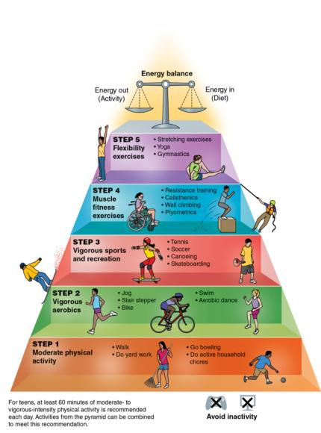
Physical Activity Pyramid

Slide 10
Check On Understanding
____________ is the stage of the physical activity pyramid that burns the most calories.
A calorie and a Kcal are the same thing? (T/F)
It’s safe to say that the more you weigh, the more calories you burn during exercises and activities? (Yes or No)

Slide 11
Nutrition FOR THE CADET: Healthy eating patterns for a Cadet
Objectives:
Cadets will be able to
List & define the 3 stages in the Slogan of the CDC for establishing healthy eating habits; Reflect, Replace & Reinforce.
Use the USDA has tools for aiding in improving healthy eating
Define discipline in the matter of healthy eating
List the main concepts of The Definite Dozen with explanations
Understand the Principle of Reinforcement
Essential Question:
How do we master a healthier eating habit?

Slide 12
Reflect, Replace, and Reinforce
The CDC has a three-stage slogan of Reflect, Replace, and Reinforce.
Stage One: Reflect
Make a list of eating/snacking habits like a food diary
Annotate habits such as eating too quickly, eating when not hungry, dessert intake, and skipping meals
Identify the unhealthy habits
Create a list of cues of when you may be triggered to eat, (examples: opening the refrigerator or cabinet when not hungry, seeing food on a counter and partaking, feeling bored or tired and just grabbing food)
Ask questions according to your cue list about avoiding bad food and seeking healthy food

Slide 13
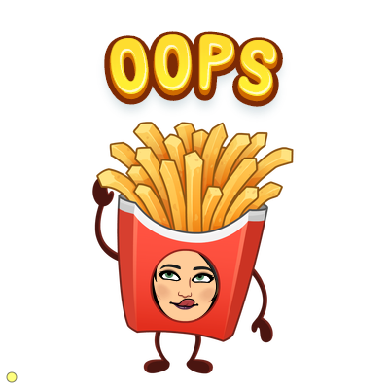
Reflect, Replace, and Reinforce
Stage Two: Replace
Replace unhealthy habits with healthier ones
Eat slower
Eat only when hungry
Plan well-balanced meals.
Stage Three: Reinforce
The mental health and integrity portion of the guidance
Be patient with oneself, the change isn’t instantaneous
Forgive oneself if missteps take place
Take it one day at a time towards progress

Slide 14
www.ChooseMyPlate.gov
www.ChooseMyPlate.gov
Free online digital planner
Information on healthy eating
Takes the individual's information and creates a ChooseMyPlate meal plan
Generates a PDF of how many calories and what category intake amounts are needed with spots a person can fill in if they reached the target or not

Slide 15
ChooseMyPlate Website
https://www.choosemyplate.gov/resources/MyPlatePlan

Slide 16
Discipline to Establish Patterns
To establish a pattern in healthy/healthier eating, an individual must create a sense of discipline.
Discipline is learning to be obedient, training oneself to improve on a skill or regimen and stick to it
Research how to safely, effectively, and realistically achieve their desired goal.

Slide 17
Definite Dozen
To establish any change in behavior is heavily rooted in psychology. The Definite Dozen, developed by Pat Summitt, is a competitive principle mostly related to sports performance but can be utilized as productive steps to developing a disciplined eating habit pattern.
Respect yourself and others- an individual cannot have self-respect without giving respect to others.
Take full responsibility- be candid as possible in accountability, there are no shortcuts to success
Develop and demonstrate loyalty- be loyal to yourself and don’t cheat. i.e. in your food journals or diaries. Seek out quality people to be around to support you

Slide 18
Definite Dozen
Learn to be a good communicator- listen to input and give honest feedback when it comes to the topics of accolades, discipline, downfalls, struggles, and other accountable factors to a supportive person or group
Discipline yourself, so no one has to- if you have an accountability partner or group be truthful with yourself and them
Make hard work your passion- do the hard stuff first, plan your work & work your plan, do not eat dessert first.
Don’t just work hard, work smart- Focus on your strengths to minimize your weaknesses
Put the team before you- in group success there is individual success. Your team can be family, friends, and champions for you in your life

Slide 19
Definite Dozen
Make winning an attitude- positive attitude is a choice
Be a competitor- be the best you that you can be daily. Win!
Change is a must- Push yourself to places you haven’t’ been before
Handle success like you handle failure – you can’t always control what happens, but you can control how you handle it. Learn from failure. Continue to seek new goals

Slide 20
Reinforcement
The why to institute positive eating patterns is following the principles of reinforcement
The principle of reinforcement is rooted in rewards and punishments for doing an action correctly. If you achieve a goal, give yourself a (non-food) reward to celebrate. If you fail to achieve a goal, continue working until you eventually reach it. This is called positive and negative reinforcement.
Punishment is related to reinforcement. You might punish yourself by denying a pleasurable event when you fail to reach your goal

Slide 21
Check On Understanding
Name the CDC three-stage slogan
Changing pattern of eating healthy is an easy task for everyone (T/F)
ChooseMyPlate is a costly resource for changing eating patterns (Yes/No)
What trait is key to establishing patterns in healthier eating?

Slide 22
Nutrition FOR THE CADET: Reading Nutrition Labels
Objectives:
Cadets will be able to
Define each indicator found on labels and what information each of the 6 indicators holds
Essential Question:
How to read food labels correctly to plan accordingly

Slide 23
Reading Nutrition Labels
Nutrition labels in common terms are food labels, nutritional information that appears in the food that is packaged that is regulated by the United States of Department of Agriculture (USDA).
Servings are the number of servings that the serving size is and how many servings per container.
Calories category breaks down how many calories the serving is and usually how many calories are from fat.
Nutrients that should be limited section are comprised of written in percentages of the daily value, these usually include total fat, saturated fat, trans-fat, cholesterol, and sodium percentages.
Carbohydrate and protein sections guided by the daily percentages values include fiber, sugars, proteins, and total carbohydrate quantities.
Micronutrients specify the percentages of vitamins and minerals.
Footnote gives the variance of the difference of percentages based on a 2,000 calorie and 2,500 calorie diets to try to give as much information and specification as possible

Slide 24
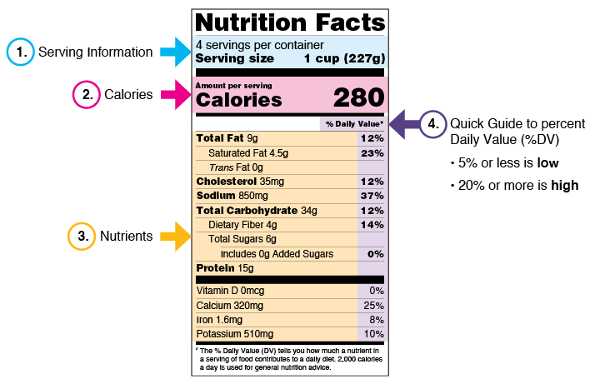
Reading Nutrition Labels

Slide 25
Serving Information
Number of Servings
Size of servings

Slide 26
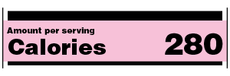
Calories
How many calories per serving
Learn your estimated calorie requirements at:
https://www.choosemyplate.gov/resources/MyPlatePlan

Slide 27
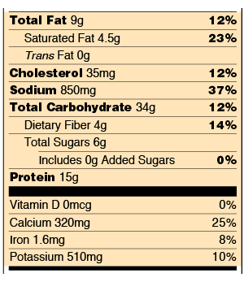
Nutrition
Nutrients to get less of:
Saturated Fat
Sodium
Added Sugars
Nutrients to get more of
Dietary Fiber
Vitamin D
Calcium
Iron
Potassium

Slide 28
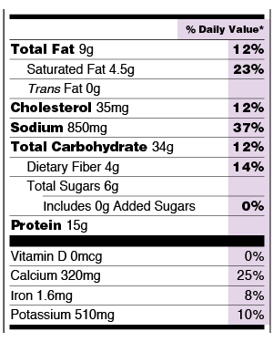
Percent Daily Value
Percentage of the Daily Value for each nutrient in a serving of the food
Expressed in grams, milligrams or micrograms
For ‘good’ nutrients, you want a high %
For ‘bad’ nutrients, you want a low %

Slide 29
Check On Understanding
1. If a bag of chips contains 3 servings and a serving is 160 calories, how many calories are you eating if you eat the whole bag?
2. Who regulates food labels?
3. Is saturated fat healthy for you? How about dietary fiber? How can you tell from the nutrition label?

Slide 30
Nutrition FOR THE CADET: Fad Diets, Supplements and Preservatives
Objectives:
Cadets will be able to
Define Fad diets, compare them to healthy balanced diets
Understand what dietary supplements are and what is in them
Define and understand performance enhancing drugs such as anabolic steroids, peptide hormones, and diuretics; explain the health risks of all.
Essential Question:
What are the surface facts on fad diets, supplements and performance enhancing drugs?

Slide 31
Fad Diets
Fad Diets:
Popular diets
Not always rooted in scientific evidence
Widespread in North America
Purport to shed excess pounds, easily
Dietary restrictions
Often not nutritionally sound
May cause health issues or long-term problems.

Slide 32
Fad Diets
Examples of Fad Diets:
South Beach Diet a low-carb diet,
Gluten-Free is a wheat, barley or rye free diet
Macrobiotic diet which is rooted in the philosophy of Yin and Yang in Buddhist culture and is very low-calorie it poses a risk to starvation

Slide 33
Dietary Supplements
Dietary supplements are manufactured products intended to supplement the diet when taken by mouth.
Supplements include vitamins, minerals, amino acids, botanical products, and herbs, as well as additives such as enzymes, glandulars, organ tissues, and metabolics.
These types of substances can be pills, capsules, tablets, powders, and liquids
they are labeled as a food type/supplement, and cannot be labeled as drugs
they are regulated under the Dietary Supplement Health and Education Act (DSHE) of 1994.
There are literally thousands of dietary supplements for various reasons: to build stronger bones, regulate blood sugar, and maintain bowel reliability, etc.

Slide 34
Performance Enhancing Drugs
Performance enhancing drugs sometimes sold under the guise of food supplements, but they can have serious side effects
Mostly used to improve physical appearance
Anabolic Steroids have a slew of health complications including liver and kidney problems, enlarged heart, high blood pressure, risk of stroke and heart attack, hair loss, acne, and mood swings and aggression
Peptide Hormones/ Growth Hormones (GH), the side effect are serious and are long term or irreversible, such as myocardial ischemia (artery disease, plaque buildup in the artery), myocardial infarction (complete blockage in the artery, heart attack) and angina (chest pain) due to use.
Diuretics will cause a suppressed immune system, causes thermal regulation to be out of balance, bone loss, electrolyte imbalance, and fatigue. Can lead to malnutrition, stunted growth, and hyperthermia.

Slide 35
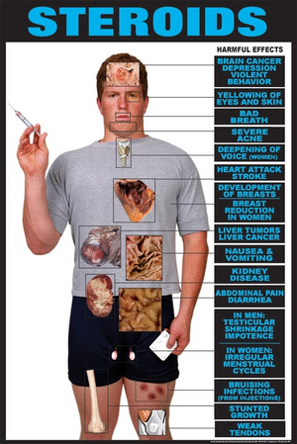

Slide 36
Peptide Hormones
Peptides include the hormone oxytocin, glutathione (stimulates tissue growth), melittin (honeybee venom), the pancreatic hormone insulin, and glucagon (a hyperglycemic factor).
Peptides build muscle mass and reduce body fat
Body builders use them to bulk up. They don’t have as many side-effects as anabolic steroids
They are illegal without a doctor’s prescription, but widely abused

Slide 37
Preservatives
Preservatives are non-nutrients
May be harmful: toxins, cholesterols, and additives that are dyed
Can be beneficial: antioxidants
Manufacturers of foods have to add preservatives to food to give them a shelf life and prevent items from spoiling too quickly
Often-used preservatives are sodium (salt) and sugars

Slide 38
Check On Understanding
Fad diets are highly effective and safe (T/F)
Anabolic steroids are usually used to improve ________ __________.
Diet pills, laxatives, and enemas are all d____________________.

Slide 39
Nutrition FOR THE CADET: Nutrition For PT Tests, Competitions, And Fitness Tests
Objectives:
Cadets will be able to
Understand Carbo-loading and High Protein diets, explain their effectiveness or ineffectiveness.
Essential Question:
How do you select the correct nutrition plan for the correct exercise plan in order to improve performance in fitness tests?

Slide 40
Nutrition For PT Tests, Competitions, And Fitness Tests
Glycogen loading or Carbohydrate loading:
increase carbohydrate intake to store the energy in the body before a prolonged, endurance, or high-performance activity. This practice is widely used by distance runners, cyclists, and for exercises that take several hours
Protein diets do not ultimately increase performance or endurance
Fat- loading is the same principle of carbo-loading, but with fat substances. It doesn’t work.

Slide 41
Check On Understanding
Carbohydrate loading is also known as ______________ ____________.
High Protein diets are more beneficial than carbo-loading before exercise. (T/F)
Explain why carbohydrate loading works.

Slide 42
Nutrition FOR THE CADET: Hydration
Objectives:
Cadets will be able to
Understand the anatomical importance of factors relating to hydration, dehydration, and hyponatremia
Explain the similarities and differences between heat stroke and heat exhaustion
Essential Question:
In what ways is hydration a basic necessity for health and function of the body?

Slide 43
Hydration
Antidiuretic hormone (ADH), also known as arginine vasopressin, is a hormone secreted from the pituitary glands in the brain
ADH function is to regulate water and electrolyte balance in the blood by controlling how much water is excreted in urine
Hydration is completely controlled by ADH, ensuring the blood is not saturated or dehydrated with water. It also conserves water.
It is important to maintain hydration levels but when there is an endurance exercise, activity, or high-performance challenge an individual should prepare for this by regularly drinking water days before, during, and after the event

Slide 44
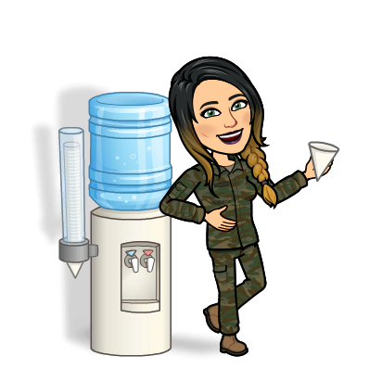
Hydration
Hydration is the balance of water fluids in the blood and body
Dehydration is water loss in the body or a harmful reduction in the amount of water in the body
The output of water through basic body functions is completed through evaporation from the skin, respiratory tract, kidneys, and large intestines
During exercise, the amount of water being expelled is determined by environmental temperature, body size, and metabolic rate
Hyponatremia is when the blood sodium levels drop below normal ranges of 136 to 143 millimoles per liter

Slide 45
Heat Exhaustion
Lack of replenishing water to balance the body can lead to heat exhaustion
Symptoms are fatigue and weakness, excessive sweating, nausea or vomiting, a rapid, weak pulse, and heat cramps
Treatment is to get to a cooler place, drink water if fully conscious, take a cool shower or use a cool compress

Slide 46
Heat Stroke
Heatstroke is a very serious medical condition
The body completely fails to maintain body temperature
Symptoms are high fever (>103 degrees), headache, cessation of sweating, nausea or vomiting, a rapid, strong pulse, confusion, unconsciousness. Can lead to death.
Treatment: Call 911/seek medical care, reduce body temperature any way you can

Slide 47
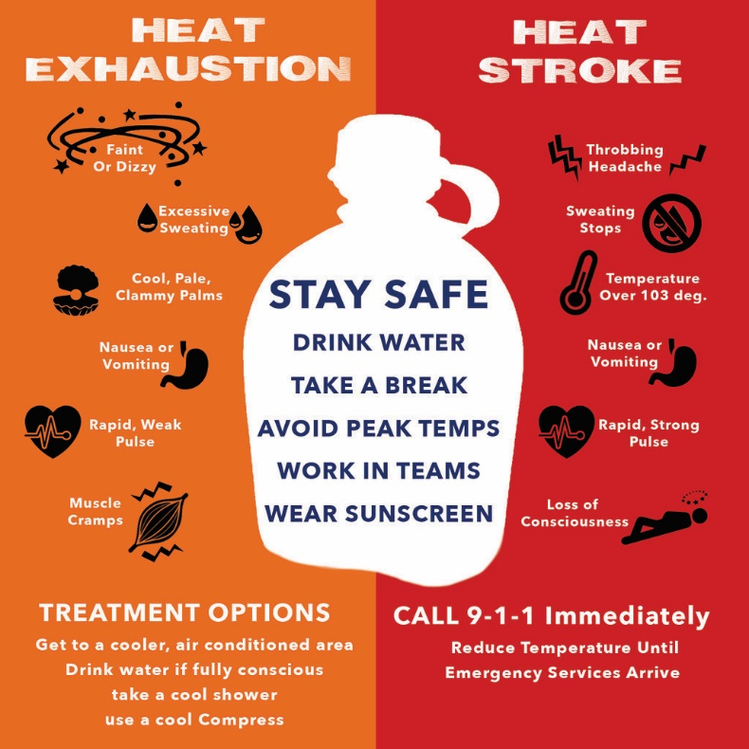

Slide 48
Check On Understanding
Explain the differences between Heat Exhaustion and Heatstroke.
What does ADH stand for?
Define dehydration.

