Slide 1
California Cadet Corps Curriculum on Leadership
L3/C: Leadership and Management

Slide 2
Agenda
C1. Management vs Leadership
C2. Delegation: Authority, Responsibility, & Accountability
C3. Leadership Counseling

Slide 3
MANAGEMENT VS LEADERSHIP
C1. Explain the differences between Management and Leadership, and how manage and lead successfully.

Slide 4
Management vs Leadership
OBJECTIVES
Cadets who complete this section of the Leadership Roles Strand will be better prepared to work within the structure of the CACC Brigade and 10th Corps, and to serve successfully in leadership positions within the California Cadet Corps.
Plan of Action
1. Explain the differences between Management and Leadership, and how to manage and lead successfully.
Essential Question: What are the differences between Management and Leadership, and how do you use both to be a good leader?

Slide 5
Definitions: Leadership
Leadership is the process of influencing and directing people by providing purpose, direction, and motivation while operating to accomplish the mission and improving the organization.
to influence, motivate, and enable others to contribute toward the effectiveness and success of the organization
Leadership is getting people to want to do what you want them to do

Slide 6
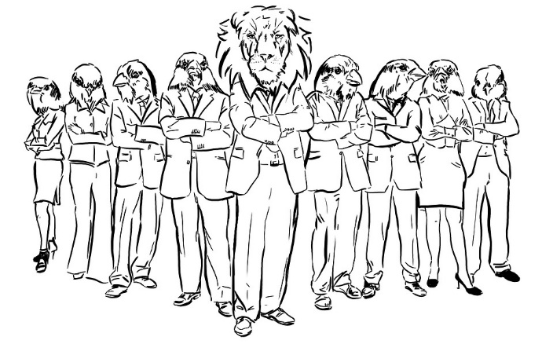
Definitions: Leadership
influencing people to change direction
showing the way for others, either by example or by promoting a new direction
Leadership is the art of motivating a group of people to act towards achieving a common goal
Pixabay.com

Slide 7
Definitions: Management
Efforts to direct resources (human, financial, material, intellectual and intangible) to assist in the accomplishment of the mission and betterment of the organization
Directing and controlling a group of one or more people or entities for the purpose of coordinating and harmonizing that group towards accomplishing a goal
Achieving goals in a way that makes the best use of all resources

Slide 8
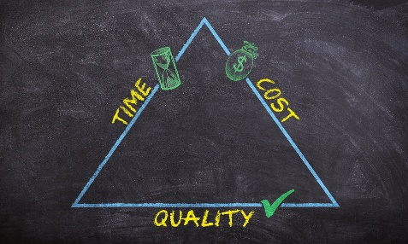
Definitions: Management
Management gets things done in a manner that makes best use of all available resources
Management is a process with a social element. It requires the efficient use of resources combined with the guidance of people in order to reach a specific organizational objective. It involves responsibility to achieve the objectives and to fulfill specific organizational purposes through economical and effective planning and regulation. It’s about taking charge and ensuring focus is placed on the things and aspects of the business that help achieve the vision and the goals

Slide 9
Definitions: Management
Management is the practice of setting and achieving goals by exercising related functions: planning, organizing, leading, and controlling, through the use of resources (people, information, money, or materials).

Slide 10
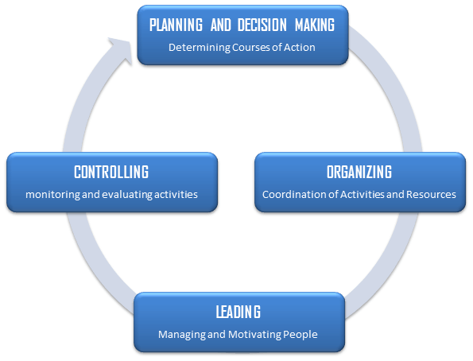
4 Functions of Management

Slide 11
Comparisons
Leadership
Management
Personality Styles: Are often called brilliant and mercurial, with great charisma. Yet, they are also often seen as loners and private people. They are comfortable taking risks, sometimes seemingly wild and crazy risks. Almost all leaders have high levels of imagination
Orientation: People-oriented
Focus: Leading people
Outcomes: Achievements
Personality Styles: Tend to be rational, under control problem solvers. They often focus on goals, structures, personnel, and availability of resources. Managers’ personalities lean toward persistence, strong will, analysis, and intelligence.
Orientation: Task-oriented
Focus: Managing work
Outcomes: Results

Slide 12
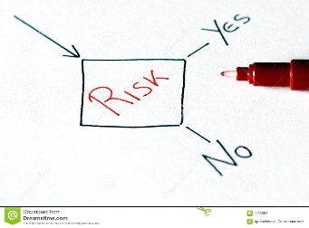
Comparisons
Leadership
Management
Approach to Tasks: Simply look at problems and devise new, creative solutions. Using their charisma and commitment, they excite, motivate, and focus others to solve problems and excel.
Approach to Risk: Risk-taking
Role in Decision-Making: Facilitative
Approach to Tasks: Create strategies, policies, and methods to create teams and ideas that combine to operate smoothly. They empower people by soliciting their views, values, and principles. They believe that this combination reduces inherent risk and generates success
Approach to Risk: Risk-averse
Role in Decision-Making: Involved

Slide 13
Comparisons
Leadership
Management
Styles: Transformational, Consultative & Participative
Power Through: Charisma & Influence
Organization: Leaders have followers
Appeal to: Heart
Styles: Dictatorial, Authoritative, Transactional, Autocratic, Consultative & Democratic
Power Through: Formal authority & Position
Organization: Managers have subordinates
Appeal to: Head

Slide 14
Combination
Leadership is one facet of Management (the others are Planning/Decision-Making, Organizing, & Controlling).
Managers must lead
Leaders don’t have to manage, but they won’t accomplish goals if they don’t
Dreamstime.com

Slide 15
People naturally and willingly follow leaders due to their charisma and personality traits, whereas a manager is obeyed due to the formal authority vested in him/her. As a result, people tend to be more loyal towards leaders rather than managers.
Reality is that almost all leaders perform management functions, and all managers perform leadership functions.
Clker.com

Slide 16
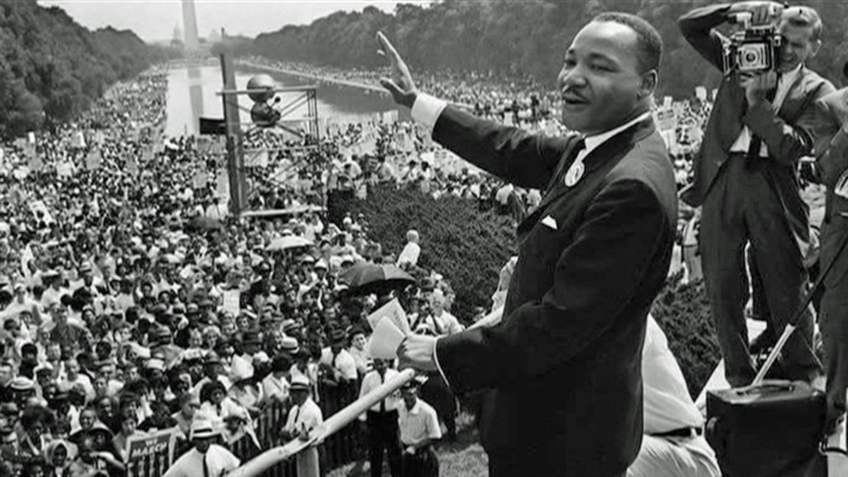
Relationships
Leader
Manager
Betterworldinternational.org
Wordpress.com
Followers
Subordinate

Slide 17
Some Differences
Subject | Leader | Manager
Essence | Change | Stability
Seeks | Vision | Objectives
Approach | Sets direction | Plans detail
Decision | Facilitates | Makes
Power | Personal charisma | Formal authority
Culture | Shapes | Enacts
Persuasion | Sell | Tell
Style | Transformational | Transactional
Exchange | Excitement for work | Money for work
Wants | Achievement | Results
Risk | Takes | Minimizes
Rules | Breaks | Makes
Conflict | Uses | Avoids
Direction | New roads | Existing roads
ChangingMinds.org

Slide 18
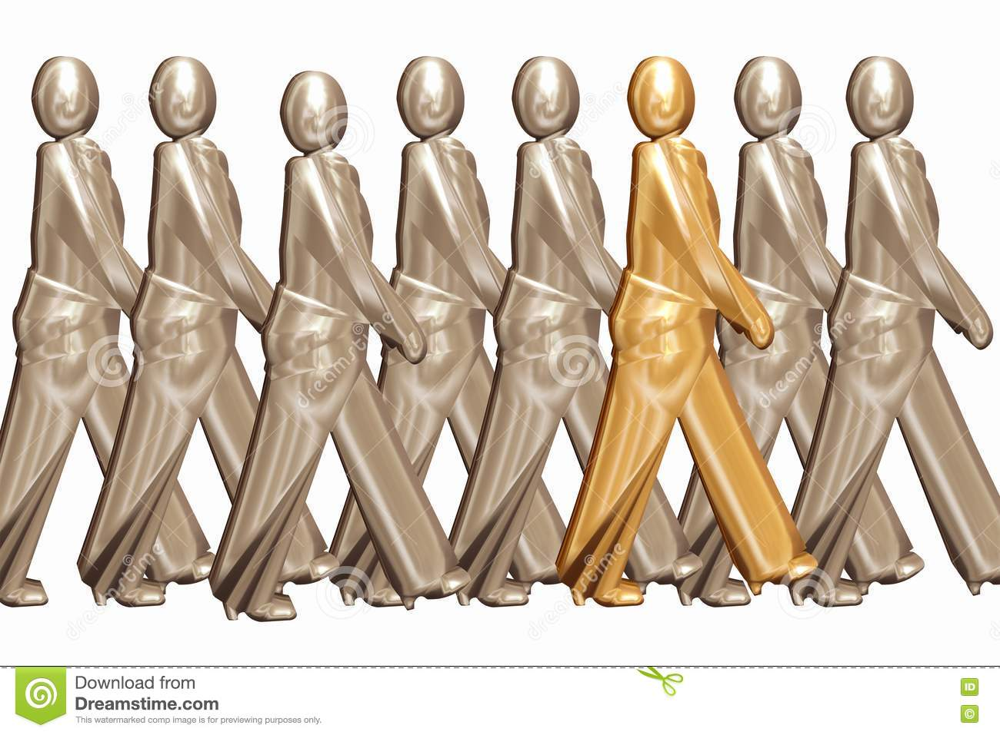
Bottom Line
We are leaders AND managers
We focus on accomplishing the mission
We use various styles of leadership
We apply resources
We make decisions
We inspire people to work
with dedication toward our
common objective

Slide 19
Check on Learning
Name the four functions of management.
What is your definition of leadership?
Put the description below in either the Leadership or Management column:
Plans detail
Passion
Breaks rules
Wants results
Sells

Slide 20
DELEGATION: AUTHORITY, RESPONSIBILITY, & ACCOUNTABILITY
C2. Describe how authority and responsibility work in a military setting.

Slide 21
Delegation: Authority, Responsibility, & Accountability
OBJECTIVES
Cadets who complete this section of the Leadership Roles Strand will be better prepared to work within the structure of the CACC Brigade and 10th Corps, to serve successfully in senior level leadership positions within the California Cadet Corps, and to contribute to the success of their program and activities through practice of leadership and management skills.
Plan of Action
Define authority, responsibility, and accountability; how they interact in the delegation process, and how leaders/managers delegate tasks to followers to accomplish a mission.
Essential Question: How do authority, responsibility, and accountability relate to delegation, and what part does delegation play in management?

Slide 22
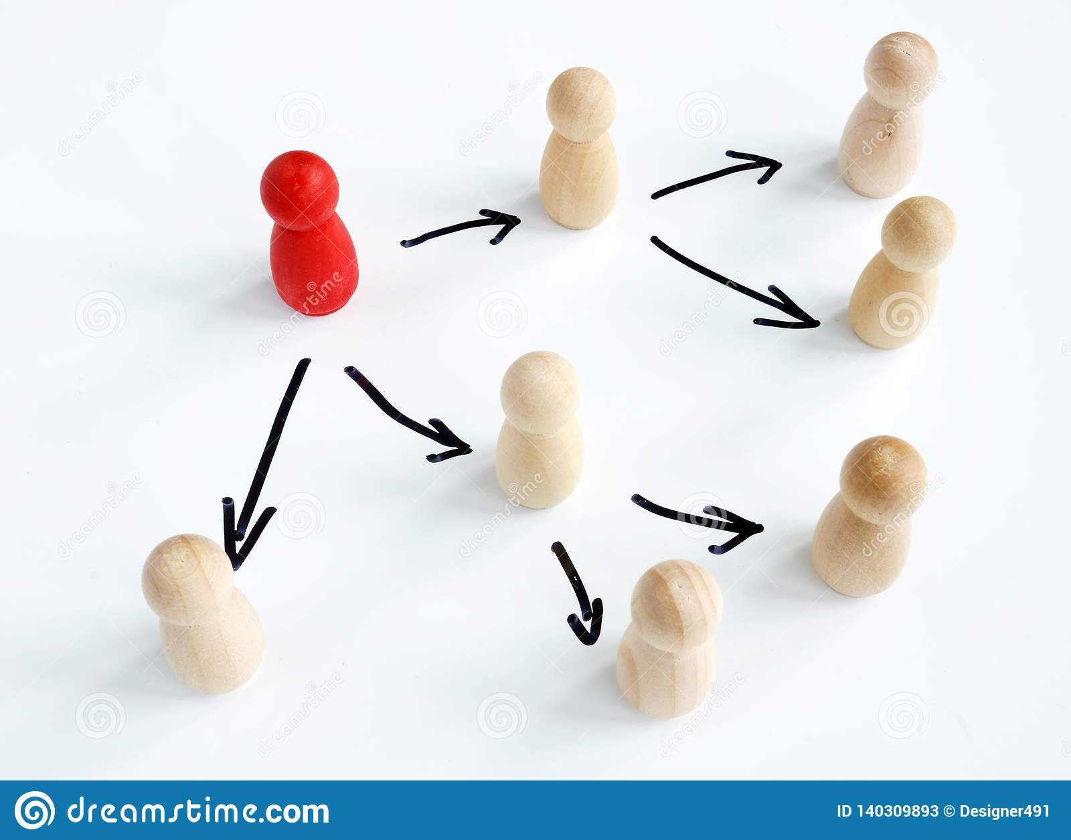
Definitions
Delegation:
The practice of turning over to a subordinate enough authority to do a specific task, and then holding that person accountable for the results.
(Gaurav Akrani)
Curt Lafond

Slide 23
Definitions
Authority:
Authority is the right or power assigned to an executive or a manager in order to achieve certain organizational objectives.
(Gaurav Akrani)

Slide 24
Authority
Tied to the organization
Formal or Personal
Formal from position
Personal from ability to influence others
Can be delegated – moves downward

Slide 25
Definitions
Responsibility:
An obligation to carry out a task or duty assigned by a superior.

Slide 26
Responsibility
From superior-subordinate relationship
Hard to have without authority
Moves upwards
Cannot be delegated

Slide 27
Definitions
Accountability
An obligation or willingness to accept responsibility or to account for one's actions

Slide 28
Authority = Power
Responsibility = Duty
Accountability = Consequences

Slide 29
Delegation - SMARTER
*Specific – communicated clearly
* Measurable – it will be clear whether the task has been accomplished
* Agreed – the subordinate understands the task
* Realistic – can be accomplished, is not impossible
* Time-bound – can be accomplished in a reasonable time period
* Ethical – is not illegal or immoral
* Recorded – written down and agreed to in writing by the leader and subordinate
whenever possible

Slide 30
10 Levels of Delegated Tasks Level 1
“Wait to be told" or "Do exactly what I say" or "Follow these instructions precisely. “
This is instruction. There is no delegated freedom at all.

Slide 31
10 Levels of Delegated Tasks Level 2
"Look into this and tell me the situation. I'll decide."
This is asking for investigation and analysis but no recommendation. The person delegating retains responsibility for assessing options prior to making the decision.

Slide 32
10 Levels of Delegated Tasks Level 3
“Look into this and tell me the situation. We'll decide together."
This has a subtle important difference to Level 2. This level of delegation encourages and enables the analysis and decision to be a shared process, which can be very helpful in coaching and development.

Slide 33
10 Levels of Delegated Tasks Level 4
“Tell me the situation and what help you need from me in assessing and handling it. Then we'll decide."
This opens the possibility of greater freedom for analysis and decision-making, subject to both people agreeing this is appropriate. Again, this level is helpful in growing and defining coaching and development relationships.

Slide 34
10 Levels of Delegated Tasks Level 5
“Give me your analysis of the situation (reasons, options, pros and cons) and recommendation. I'll let you know whether you can go ahead."
Asks for analysis and recommendation, but you will check the thinking before deciding.

Slide 35
10 Levels of Delegated Tasks Level 6
“Decide and let me know your decision, and wait for my go-ahead before proceeding."
The other person is trusted to assess the situation and options and is probably competent enough to decide and implement too, but for reasons of task importance, or competence, or perhaps externally changing factors, the boss prefers to keep control of timing. This level of delegation can be frustrating for people if used too often or for too long, and in any event the reason for keeping people waiting, after they've inevitably invested time and effort, needs to be explained.

Slide 36
10 Levels of Delegated Tasks Level 7
“Decide and let me know your decision, then go ahead unless I say not to."
Now the other person begins to control the action. The subtle increase in responsibility saves time. The default is now positive rather than negative. This is a very liberating change in delegated freedom, and incidentally one that can also be used very effectively when seeking responsibility from above or elsewhere in an organization, especially one which is strangled by indecision and bureaucracy. For example, "Here is my analysis and recommendation; I will proceed unless you tell me otherwise by (date)."

Slide 37
10 Levels of Delegated Tasks Level 8
“Decide and take action - let me know what you did (and what happened)."
This delegation level, as with each increase up the scale, saves even more time. This level of delegation also enables a degree of follow-up by the manager as to the effectiveness of the delegated responsibility, which is necessary when people are being managed from a greater distance, or more 'hands-off'. The level also allows and invites positive feedback by the manager, which is helpful in coaching and development of course.

Slide 38
10 Levels of Delegated Tasks Level 9
“Decide and take action. You need not check back with me."
The most freedom that you can give to another person when you still need to retain responsibility for the activity. A high level of confidence is necessary, and you would normally assess the quality of the activity after the event according to overall results, potentially weeks or months later. Feedback and review remain helpful and important, although the relationship is more likely one of mentoring, rather than coaching per se.

Slide 39
10 Levels of Delegated Tasks Level 10
“Decide where action needs to be taken and manage the situation accordingly. It's your area of responsibility now."
The most freedom that you can give to the other person, and not generally used without formal change of a person's job role. It's the delegation of a strategic responsibility. This gives the other person the responsibility for defining what changes projects, tasks, analysis and decisions are necessary for the management of a particular area of responsibility, as the task or project or change itself, and how the initiative or change is to be implemented and measured, etc. This amounts to delegating part of your job - not just a task or project. You’d use this utmost level of delegation (for example) when developing a successor, or as part of an intentional and agreed plan to devolve some of your job accountability in a formal sense.

Slide 40
Check on Learning
Which can be delegated, authority or responsibility?
Match up the following:
Consequences Authority
Power Responsibility
Duty Accountability
Choose: A Level 1 delegated tasking gives the subordinate more/less authority than a Level 8 tasking.

Slide 41
LEADERSHIP COUNSELING
C3. Describe the components of Leadership Counseling, how and when it is appropriate, and practice the skills learned.

Slide 42
Leadership Counseling
OBJECTIVES
Cadets who complete this section of the Leadership Roles Strand will be better prepared to work within the structure of the CACC Brigade and 10th Corps, to serve successfully in senior level leadership positions within the California Cadet Corps, and to contribute to the success of their program and activities through practice of leadership and management skills.
Plan of Action
Describe why Leadership Counseling is important, how and when it is appropriate, and practice the process presented.
Essential Question: When and how does a leader counsel subordinates, and what is one process you can use?

Slide 43
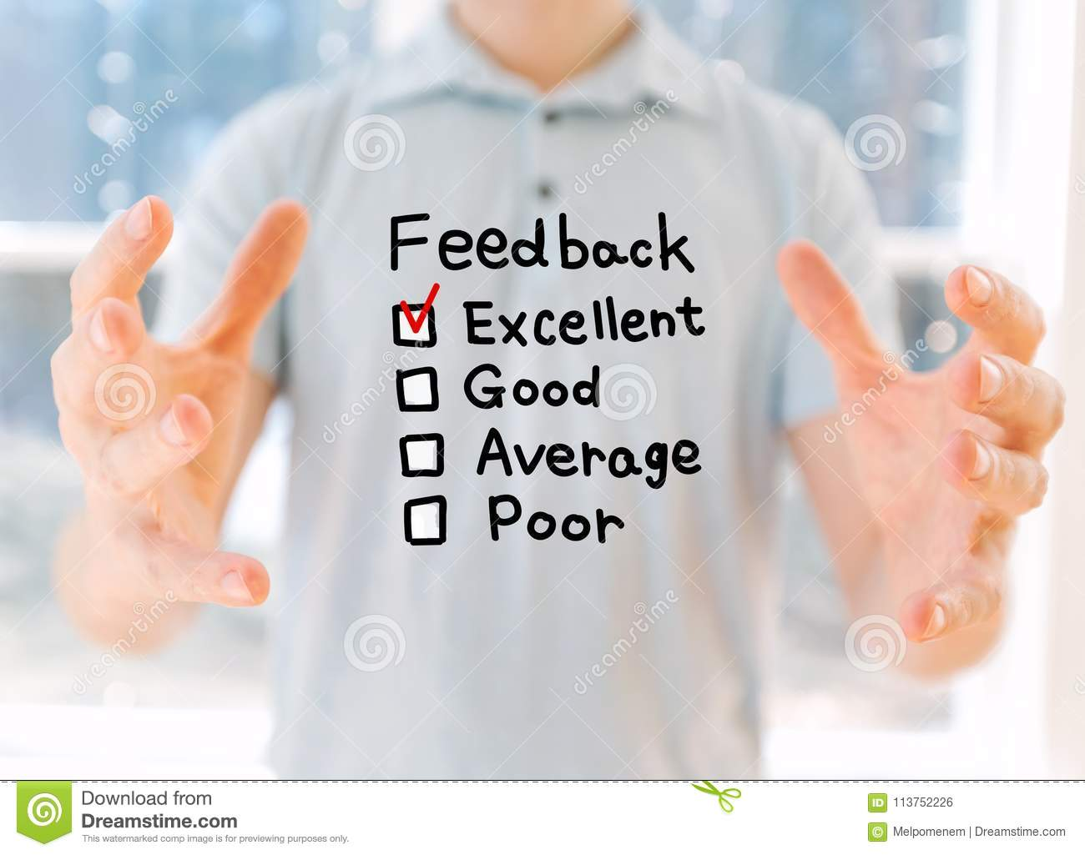
Leadership Counseling
Leadership Counseling
=
Feedback

Slide 44
Leader’s Job
Monitor performance
Teach
Coach
Mentor
Give Feedback

Slide 45
Counseling
Focuses on cadet’s performance
Discusses issues the cadet is having
Needs the active participation of both counselor and cadet
Should take place informally throughout the semester – not just when something happens
Identifies strengths and weaknesses
Discusses ways to improve

Slide 46
Performance Counseling
Sometimes you’ll have to deal with cadets:
Showing negative attitude
Misbehaving
Not performing well

Slide 47
Performance Counseling
Step 1: Examine the Situation
Step 2: Problem Solve
Step 3: Follow Through – Implement and
Evaluate
www.pixabay.com

Slide 48
Step 1: Examine the Situation
Find out from the cadet why the behavior is happening
Misbehavior is almost always caused by
Boredom
Lack of motivation
A need to get attention
A need for acceptance
Sometimes “external” factors cause the misbehavior
Maslow’s Hierarchy of Needs (See Lesson L4/A/6)

Slide 49
Step 1: Examine the Situation
Ask the cadet
Listen to the response
Restate the response
Ask clarifying questions if need be
Help cadet understand how misbehavior affects others
Try not to let the cadet get away with the answer “just because” or “I don’t know”
With enough examination, we all can come to understand why we do the things we do
Allow cadet to examine with you the alternatives to the misbehavior

Slide 50
Step 2: Problem Solve
Consider solutions to the misbehavior
Warning
Moving the cadet’s squad
A shared “signal” to let the cadet know the behavior is popping up again
Proximity of the leader – standing by the cadet can change the behavior
Making sure the cadet understands routines and practices them
Pairing up the cadet with a “model” cadet
A behavior contract
Other ideas?

Slide 51
Step 3: Implement & Evaluate
Implement the plan you have selected – consistently
The cadet needs to agree to the plan
Monitor progress
Evaluate the effectiveness of the plan
Ask the cadet if s/he thinks it is working
Share your thoughts with the cadet
Adapt or start over if necessary
Take mental notes about what worked and didn’t work so you have a frame of reference for next time.

Slide 52
Check on Learning
Which best sums up Leadership Counseling?
Chew Out Session
Feedback
Punishment
Evaluation
What are the three Steps to Performance Counseling?

