Slide 1
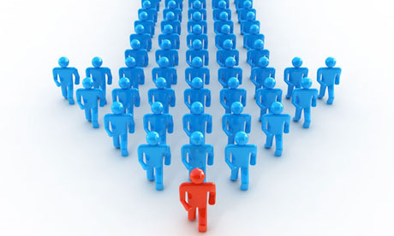
California Cadet Corps
Curriculum on Leadership
“Learn from Leaders who have forged the way before us.”
L6/B: Contemporary Leader Profiles

Slide 2
Contemporary Leadership Profiles Agenda
B1. Barack Obama
B2. Tony Blair
B3. Aung San Suu Kyi
B4. Angela Merkel
B5. Oprah Winfrey
B6. Indra Nooyi
B7. Elon Musk
B8. Jeff Bezos
B9. Jerry Brown
B10. Warren Buffett
B11. Sheryl Sandberg
B12. Kamala Harris
B13. Daniel “Chappie” James Jr.
B14. David Glasgow Farragut
B15. Eric Shinseki
B16. Ann Dunnwoody

Slide 3
Contemporary Leadership profiles Unit Objectives
The desired outcome of this unit is for cadets to learn about successful contemporary leaders, the reasons for their success, and what their experience added to the study of leadership.
Plan of Action:
Identify contemporary leaders, the basics of who they are and what they have done.
Explain the leadership lessons we learn from each of the contemporary leaders.
Compare the leadership of contemporary leaders to your own leadership skills, styles, and dynamics.

Slide 4
Barack obama
OBJECTIVES
DESIRED OUTCOME (Followership)
Cadets learn about Barack Obama, the reasons for his success, and what his experience adds to the study of leadership.
Plan of Action:
A1. Identify the basic facts about Barack Obama, and what he has accomplished.
A2. Explain what leadership lessons we can learn from familiarity with Barack Obama’s story.
A3. Compare the leadership of Barack Obama with your own leadership skills, styles, and dynamics.
Essential Question: What can we learn about our own leadership, how to build our traits and skills, based on the leadership of Barack Obama?

Slide 5
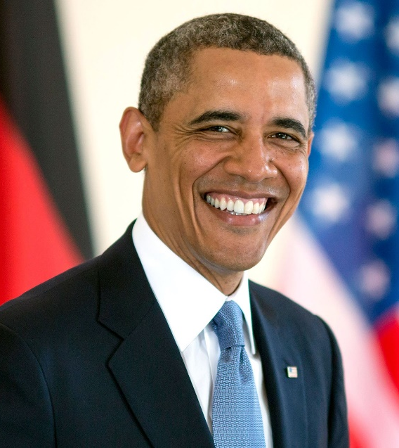
Barack Obama
1961-Present
Born in Hawaii
44th President of the US 2009-2017
Spent several years in Indonesia growing up
State Senator in Illinois
US Senator from Illinois
First African American US President

Slide 6
Barack Obama

Slide 7
Barack Obama

Slide 8
Leadership Lessons
“Yes, We can” mindset
Optimistic attitude about effecting change
Belief that all things are possible despite challenges
Be inclusive
Reached out to people from all backgrounds
Be clear about your vision
Communicate clearly, keep it simple, repeat
Speak from the heart to capture people’s support

Slide 9
Quotes
Americans… still believe in an America where anything’s possible – they just don’t think their leaders do.
Change will not come if we wait for some other person or some other time. We are the ones we’ve been waiting for. We are the change that we seek.
Focusing your life solely on making a buck shows a certain poverty of ambition. It asks too little of yourself. Because it’s only when you hitch your wagon to something larger than yourself that you realize your true potential.
I think when you spread the wealth around it’s good for everybody.
If you’re walking down the right path and you’re willing to keep walking, eventually you’ll make progress.
It took a lot of blood, sweat and tears to get to where we are today, but we have just begun. Today we begin in earnest the work of making sure that the world we leave our children is just a little bit better than the one we inhabit today.
Money is not the only answer, but it makes a difference.
There’s not a liberal America and a conservative America – there’s the United States of America.
This is the moment when we must come together to save this planet. Let us resolve that we will not leave our children a world where the oceans rise and famine spreads and terrible storms devastate our lands.
Tonight, we gather to affirm the greatness of our nation – not because of the height of our skyscrapers, or the power of our military, or the size of our economy. Our pride is based on a very simple premise, summed up in a declaration made over two hundred years ago.
We need to internalize this idea of excellence. Not many folks spend a lot of time trying to be excellent.
We need to steer clear of this poverty of ambition, where people want to drive fancy cars and wear nice clothes and live in nice apartments but don’t want to work hard to accomplish these things. Everyone should try to realize their full potential.

Slide 10
Check on Learning . . .
What did Barack Obama accomplish?
What leadership lessons can we take away?
What traits did he exhibit?
What do you admire about him?
Is there anything about Obama that you dislike and don’t want to emulate?
What did you learn that you can use to improve your own leadership?

Slide 11
Tony Blair
OBJECTIVES
DESIRED OUTCOME (Followership)
Cadets learn about Tony Blair, the reasons for his success, and what his experience adds to the study of leadership.
Plan of Action:
A1. Identify the basic facts about Tony Blair and what he has accomplished.
A2. Explain what leadership lessons we can learn from familiarity with Tony Blair’s story.
A3. Compare the leadership of Tony Blair to your own leadership skills, styles, and dynamics.
Essential Question: What can we learn about our own leadership, how to build our traits and skills, based on the leadership of Tony Blair?

Slide 12
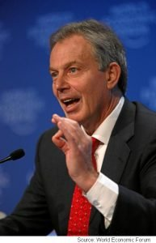
Tony Blair
1953-Present
Leader in the Labour Party
Prime Minister of the United Kingdom 1997-2007
Focused on domestic policies, 9/11 aftermath (UK worked closely with US in Afghanistan, Iraq, & anti- terrorism
Close ally of Pres George Bush
Middle East envoy during Israel-Palestinian conflicts
Popular corporate speaker

Slide 13
Tony Blair

Slide 14
Leadership Lessons
We cannot stand still
The speed of change is so fast, you have to embrace new ideas & innovation, & be prepared to adjust
Change is the hardest thing, and it is tough
Change is a disaster to some. It’s important to build support for the change if you are to succeed
Partnership and prejudice are mutually exclusive
People must learn to treat each other with respect
“All humanity is equal” is a key foundation for change
To succeed, there must be optimism
You can’t succeed if you’re afraid to fail

Slide 15
Quotes
It is not an arrogant government that chooses priorities, it’s an irresponsible government that fails to choose.
There is no meeting of minds, no point of understanding with such terror. Just a choice: Defeat it or be defeated by it. And defeat it we must.
This is not a battle between the United States of America and terrorism, but between the free and democratic world and terrorism.
I didn’t come into politics to change the Labour Party. I came into politics to change the country.
Power without principle is barren, but principle without power is futile. This is a party of government, and I will lead it as a party of government.
The art of leadership is saying no, not saying yes. It is very easy to say yes.

Slide 16
Check on Learning . . .
What did Tony Blair accomplish?
What leadership lessons can we take away?
What traits did he exhibit?
What do you admire about him?
Is there anything about Blair that you dislike and don’t want to emulate?
What did you learn that you can use to improve your own leadership?

Slide 17
Aung San Suu Kyi
OBJECTIVES
DESIRED OUTCOME (Followership)
Cadets learn about Aung San Suu Kyi, the reasons for her success, and what her experience adds to the study of leadership.
Plan of Action:
A1. Identify the basic facts about Aung San Suu Kyi, and what she has accomplished.
A2. Explain what leadership lessons we can learn from familiarity with Aung San Suu Kyi’s story.
A3. Compare the leadership of Aung San Suu Kyi with your own leadership skills, styles, and dynamics.
Essential Question: What can we learn about our own leadership, how to build our traits and skills, based on the leadership of Aung San Suu Kyi?

Slide 18
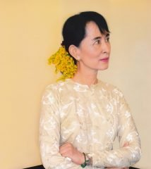
Aung San Suu Kyi
1945-Present
Daughter of the “Father of Modern Myanmar”
State Counsellor of Myanmar
Educated at Oxford, England
Under house arrest by ruling military junta for over 15 years
Refused to leave (abandon) the country
Supports nonviolent pro-democracy efforts in Myanmar
Nobel Peace Prize in 1991

Slide 19
Aung San Suu Kyi

Slide 20
Leadership Lessons
Be assertive
Stand up for what you believe in
Speak up against what you know is wrong
Stand by your convictions
Connections matter
Suu Kyi’s relationships with leaders & diplomats worldwide helped keep the international community on her side, putting great pressure on the government
Make the most out of a bad situation
Suu Kyi found ways to make her detention time productive – it prepared her for future success
Pressure from the international community was easier due to Suu Kyi’s detention

Slide 21
Quotes
You should never let your fears prevent you from doing what you know is right.
If you want to bring an end to long-standing conflict, you have to be prepared to compromise.
We will surely get to our destination if we join hands.
I don’t believe in people just hoping. We work for what we want. I always say that one has no right to hope without endeavor, so we work to try and bring about the situation that is necessary for the country, and we are confident that we will get to the negotiation table at one time or another.
My top priority is for people to understand that they have the power to change things themselves.
Fearlessness may be a gift but perhaps the more precious thing is the courage acquired through endeavor, courage that comes from cultivating the habit of refusing to let fear dictate one’s actions, courage that could be described as ‘grace under pressure’- grace which is renewed repeatedly in the face of harsh, unremitting pressure.

Slide 22
Check on Learning . . .
What did Aug San Suu Kyi accomplish?
What leadership lessons can we take away?
What traits did she exhibit?
What do you admire about her?
Is there anything about Aung San Suu Kyi that you dislike and don’t want to emulate?
What did you learn that you can use to improve your own leadership?

Slide 23
Angela Merkel
OBJECTIVES
DESIRED OUTCOME (Followership)
Cadets learn about Angela Merkel, the reasons for her success, and what her experience adds to the study of leadership.
Plan of Action:
A1. Identify the basic facts about Angela Merkel, and what she has accomplished.
A2. Explain what leadership lessons we can learn from familiarity Angela Merkel’s story.
A3. Compare the leadership of Angela Merkel with your own leadership skills, styles, and dynamics.
Essential Question: What can we learn about our own leadership, how to build our traits and skills, based on the leadership of Angela Merkel?

Slide 24
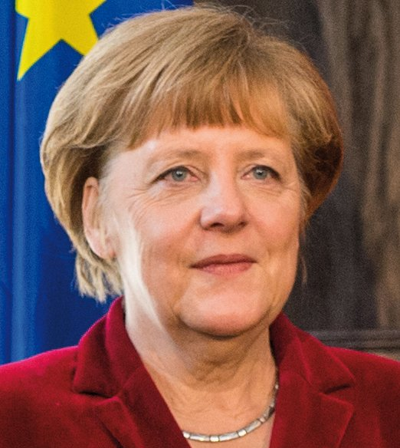
Angela Merkel
1954-Present
Born in Hamburg, Germany
Grew up in East Germany
Doctorate in Quantum Chemistry
Entered politics after the fall of the Berlin Wall
4 terms as Chancellor of Germany
Time Magazine Person of the Year for 2015

Slide 25
Angela Merkel

Slide 26
Leadership Lessons
Use your prior life experience to help you lead
Scientist: gathers information before deciding
Makes calculated decisions
Open to correcting if it seems right
Value cooperation and consensus
Governed with a coalition of parties
Values cooperation among the European Union
Don’t be afraid to make difficult decisions
Doesn’t shy away from difficult decisions
Moral courage to do what she thinks is right

Slide 27
Quotes
The willingness to learn new skills is very high.
Whoever decides to dedicate their life to politics knows that earning money isn’t the top priority.
Nobody in Europe will be abandoned. Nobody in Europe will be excluded. Europe only succeeds if we work together.
The markets want to force us to do certain things. That we won’t do. Politicians have to make sure that we’re unassailable, that we can make policy for the people.
Controversial disputes are a part of democratic culture.
For me, it is always important that I go through all the possible options for a decision.
It’s my duty and obligation to do everything possible for Europe to find a united path.
The majority of decisions in Europe are done by unanimity. That’s why it is important to be to have good relations with all parts.
You can much better have an influence on the debate when you sit at the bargaining table and you can give input.
I have a relatively sunny spirit, and I always had the expectation that my path through life would be relatively sunny, no matter what happened. I have never allowed myself to be bitter.
You could certainly say that I’ve never underestimated myself, there’s nothing wrong with being ambitious.

Slide 28
Check on Learning . . .
What did Angela Merkel accomplish?
What leadership lessons can we take away?
What traits did she exhibit?
What do you admire about her?
Is there anything about Merkel that you dislike and don’t want to emulate?
What did you learn that you can use to improve your own leadership?

Slide 29
Oprah Winfrey
OBJECTIVES
DESIRED OUTCOME (Followership)
Cadets learn about Oprah Winfrey, the reasons for her success, and what her experience adds to the study of leadership.
Plan of Action:
A1. Identify the basic facts about Oprah Winfrey, and what she has accomplished.
A2. Explain what leadership lessons we can learn from familiarity with Oprah Winfrey’s story.
A3. Compare the leadership of Oprah Winfrey with your own leadership skills, styles, and dynamics.
Essential Question: What can we learn about our own leadership, how to build our traits and skills, based on the leadership of Oprah Winfrey?

Slide 30
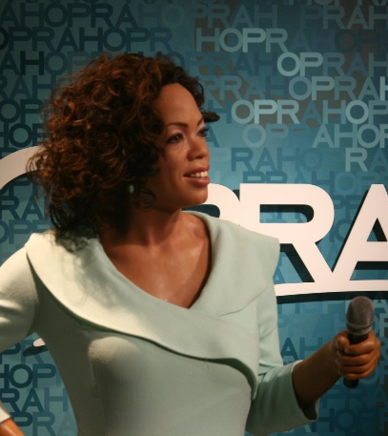
Oprah Winfrey
1964-Present
Host of the Oprah Winfrey Show
COO of Oprah Winfrey Network (OWN)
Philanthropist
Passionate about causes
Education
African American issues
One of the most influential women in the world
Awarded the Presidential Medal of Freedom in 2013

Slide 31
Oprah Winfrey

Slide 32
Leadership Lessons
Dream big
You’ll never reach your dream if you don’t have one – who knows how far you can go?!
Value people
Inspire them and reward them, and they will reward you with loyalty and support
People are the heart of what counts
Align your dreams with your values
Be your best self
If your dreams and values are aligned, you are able to be an authentic leader

Slide 33
Quotes
Do the one thing you think you cannot do. Fail at it. Try again. Do better the second time. The only people who never tumble are those who never mount the high wire. This is your moment. Own it.
Where there is no struggle, there is no strength.
Real integrity is doing the right thing, knowing that nobody’s going to know whether you did it or not.
Surround yourself with only people who are going to lift you higher.
Doing the best at this moment puts you in the best place for the next moment.
Passion is energy. Feel the power that comes from focusing on what excites you.
What I know is, is that if you do work that you love, and the work fulfills you, the rest will come.
Understand that the right to choose your own path is a sacred privilege. Use it. Dwell in possibility.
You know you are on the road to success if you would do your job and not be paid for it.
The big secret in life is that there is no big secret. Whatever your goal, you can get there if you’re willing to work.
The greatest discovery of all time is that a person can change his future by merely changing his attitude.
Books were my pass to personal freedom. I learned to read at age three, and soon discovered there was a whole world to conquer that went beyond our farm in Mississippi.
You get in life what you have the courage to ask for.
Challenges are gifts that force us to search for a new center of gravity. Don’t fight them. Just find a new way to stand.
Create the highest, grandest vision possible for your life because you become what you believe.

Slide 34
Check on Learning . . .
What did Oprah Winfrey accomplish?
What leadership lessons can we take away?
What traits did she exhibit?
What do you admire about her?
Is there anything about Oprah that you dislike and don’t want to emulate?
What did you learn that you can use to improve your own leadership?

Slide 35
Indira Nooyi
OBJECTIVES
DESIRED OUTCOME (Followership)
Cadets learn about Indra Nooyi, the reasons for her success, and what her experience adds to the study of leadership.
Plan of Action:
A1. Identify the basic facts about Indra Nooyi, and what she has accomplished.
A2. Explain what leadership lessons we can learn from familiarity with Indra Nooyi’s story.
A3. Compare the leadership of Indra Nooyi with your own leadership skills, styles, and dynamics.
Essential Question: What can we learn about our own leadership, how to build our traits and skills, based on the leadership of Indra Nooyi?

Slide 36
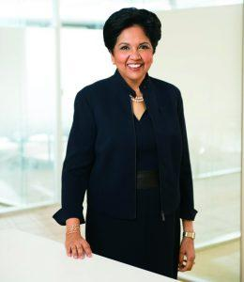
Indra Nooyi
1955-Present
Born in India
Graduated from Yale School of Management
First female CEO of PepsiCo
Innovator
PepsiCo CEO for 12 years (avg tenure is 5 years)
During her tenure at PepsiCo, company sales grew 80%
On Board of Directors of Amazon

Slide 37
Indra Nooyi

Slide 38
Indra Nooyi

Slide 39
Leadership Lessons
Communications is key
Critical for influencing others, articulating what’s needed to achieve goals
Set a standard for excellence
Perfection & Attention to Detail
Tough boss with exacting standards
It’s not just the big picture – small things are important too
Stay abreast of trends
Change with the times

Slide 40
Quotes
We ought to keep pushing the boundaries to get to flawless execution. Flawless is the ultimate goal.
I wouldn’t ask anyone to do anything I wouldn’t do myself.
I pick up the details that drive the organization insane. But sweating the details is more important than anything else.
Just because you are CEO, don’t think you have landed. You must continually increase your learning, the way you think, and the way you approach the organization. I’ve never forgotten that.
I’m very honest – brutally honest. I always look at things from their point of view as well as mine. And I know when to walk away.
The distance between number one and number two is always a constant. If you want to improve the organization, you have to improve yourself and the organization gets pulled up with you. That is a big lesson. I cannot just expect the organization to improve if I don’t improve myself and lift the organization, because that distance is a constant.

Slide 41
Check on Learning . . .
What did Indra Nooyi accomplish?
What leadership lessons can we take away?
What traits did she exhibit?
What do you admire about her?
Is there anything about Nooyi that you dislike and don’t want to emulate?
What did you learn that you can use to improve your own leadership?

Slide 42
Elon Musk
OBJECTIVES
DESIRED OUTCOME (Followership)
Cadets learn about Elon Musk, the reasons for his success, and what his experience adds to the study of leadership.
Plan of Action:
A1. Identify the basic facts about Elon Musk, and what he has accomplished.
A2. Explain what leadership lessons we can learn from familiarity with Elon Musk’s story.
A3. Compare the leadership of Elon Musk with your own leadership skills, styles, and dynamics.
Essential Question: What can we learn about our own leadership, how to build our traits and skills, based on the leadership of Elon Musk?

Slide 43
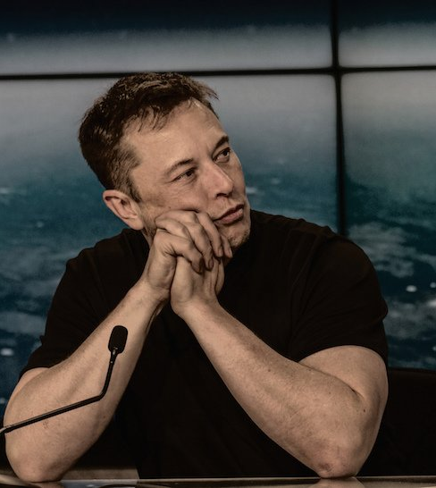
Elon Musk
1971-Present
Born in South Africa
Bullied as a child
Interested in computer programming
Moved to Canada, then US
Entrepreneur
Founded companies:
Zip2 (sold to Compaq)
X.com (merged to become PayPal, eventually sold to eBay)
SpaceX
Tesla Motors
Considered one of the most revolutionary & visionary entrepreneurs of his generation

Slide 44
Elon Musk

Slide 45
Leadership Lessons
Let your vision guide you
Musk’s decisions align with his vision
Inspire like-minded people to work with you
Set the standard in your industry
If you’re going to be, be the best
He’s not content with what others are doing, he wants to lead the way, go farther
Use a feedback loop constructively
Constantly look at what you’ve done and how you could be doing it better and questioning yourself
Get input from others – less bias than yourself

Slide 46
Quotes
When something is important enough, you do it even if the odds are not in your favor.
Failure is an option here. If things are not failing, you are not innovating enough.
If you want to grow a giant redwood, you need to make sure the seeds are ok, nurture the sapling, and work out what might potentially stop it from growing all the way along. Anything that breaks it at any point stops that growth.
Talent is extremely important. It’s like a sports team, the team that has the best individual player will often win, but then there’s a multiplier from how those players work together and the strategy they employ.
Work like hell. I mean you just have to put in 80 to 100-hour weeks every week. [This] improves the odds of success. People work better when they know what the goal is and why. It is important that people look forward to coming to work in the morning and enjoy working.
The problem is that at a lot of big companies, process becomes a substitute for thinking. You’re encouraged to behave like a little gear in a complex machine.
Some people don’t like change, but you need to embrace change if the alternative is disaster.
Really pay attention to negative feedback and solicit it, particularly from friends. … Hardly anyone does that, and it’s incredibly helpful.
If you’re co-founder or CEO, you have to do all kinds of tasks you might not want to do… If you don’t do your chores, the company won’t succeed… No task is too menial.
People should pursue what they’re passionate about. That will make them happier than pretty much anything else.
I always have optimism, but I’m realistic. It was not with the expectation of great success that I started Tesla or SpaceX… It’s just that I thought they were important enough to do anyway.

Slide 47
Check on Learning . . .
What did Elon Musk accomplish?
What leadership lessons can we take away?
What traits did he exhibit?
What do you admire about him?
Is there anything about Elon Musk that you dislike and don’t want to emulate?
What did you learn that you can use to improve your own leadership?

Slide 48
Jeff Bezos
OBJECTIVES
DESIRED OUTCOME (Followership)
Cadets learn about Jeff Bezos, the reasons for his success, and what his experience adds to the study of leadership.
Plan of Action:
A1. Identify the basic facts about Jeff Bezos, and what he has accomplished.
A2. Explain what leadership lessons we can learn from familiarity with Jeff Bezos’ story.
A3. Compare the leadership of Jeff Bezos with your own leadership skills, styles, and dynamics.
Essential Question: What can we learn about our own leadership, how to build our traits and skills, based on the leadership of Jeff Bezos?

Slide 49
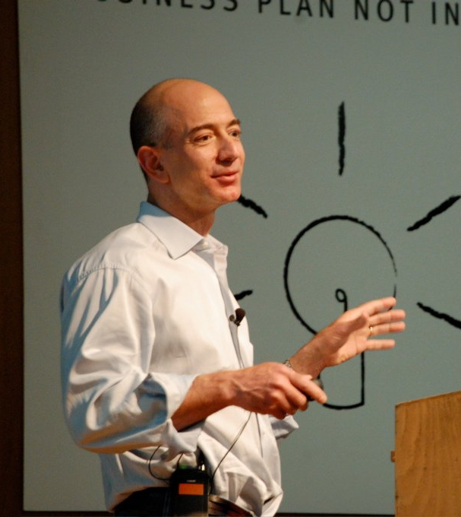
Jeff Bezos
1964-Present
CEO of Amazon
Did well in school; graduated from Princeton University
Started Amazon as an e-commerce store to sell books
Diversified its product offerings
Ranked 2nd best CEO in the world after Steve Jobs (Harvard Business Review)
Also founded Blue Origin – a company developing space travel
Time Magazine’s Person of the Year in 1999
Richest person in the US

Slide 50
Jeff Bezos

Slide 51
Leadership Lessons
Focus on the customer
Customer is more important than competitors
You can innovate with customers – you react to competitors
Provide hassle-free services
Think long-term
Ensure long-term relevance in an increasingly competitive marketplace
Be stubborn and flexible
Stubborn on vision, Flexible on details
Focus on the end state, not the path to it

Slide 52
Quotes
You have to be willing to be misunderstood if you're going to innovate.
When it's tough, will you give up, or will you be relentless?
If you never want to be criticized, for goodness' sake don't do anything new.
In the end, we are our choices. Build yourself a great story.
Failure and invention are inseparable twins.
One of the only ways to get out of a tight box is to invent your way out.
Part of company culture is path-dependent -- it's the lessons you learn along the way.
A company shouldn't get addicted to being shiny, because shiny doesn't last.
Cleverness is a gift; kindness is a choice. Gifts are easy -- they're given after all. Choices can be hard
Life's too short to hang out with people who aren't resourceful.

Slide 53
Check on Learning . . .
What did Jeff Bezos accomplish?
What leadership lessons can we take away?
What traits did he exhibit?
What do you admire about him?
Is there anything about Bezos that you dislike and don’t want to emulate?
What did you learn that you can use to improve your own leadership?

Slide 54
Jerry Brown
OBJECTIVES
DESIRED OUTCOME (Followership)
Cadets learn about Jerry Brown, the reasons for his success, and what his experience adds to the study of leadership.
Plan of Action:
A1. Identify the basic facts about Jerry Brown, and what he has accomplished.
A2. Explain what leadership lessons we can learn from familiarity with Jerry Brown’s story.
A3. Compare the leadership of Jerry Brown with your own leadership skills, styles, and dynamics.
Essential Question: What can we learn about our own leadership, how to build our traits and skills, based on the leadership of Jerry Brown?

Slide 55
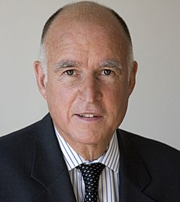
Jerry Brown
1938-Present
WAS A CADET IN CA CADET CORPS in high school in 1950’s!!
Attended Jesuit Seminary
Graduated from UC Berkeley
Graduated Yale Law School
Law Clerk
CA Secretary of State 1970-1974
34th Governor of California 1975-1982
Ran for President 3 times
Ran for Senate & lost
Mayor of Oakland 1999-2006
Founded Oakland Military Institute (OMI)
CA Attorney General 2007-2011
39th Governor of California 2011-2018
President of Board of Directors at OMI

Slide 56
Jerry Brown

Slide 57
Leadership Lessons
Communication leads to persuasion
Brown was effective at communicating his vision, persuading people to share it, and shaping the dynamics of political systems to accomplish it
Build your leadership capital
Accomplished vision of fiscal solvency – built trust
Able to accomplish further goals in environmental, fiscal, & education reform based on initial success
Never quit
Always worked toward his goals
After leaving office, he resumed one of his passions: helping Oakland Military Institute regain its footing as a successful CACC school in Oakland

Slide 58
Quotes
So we are being systematically trained to fear this false ‘rising crime' tide. This is all part of a system to lock up more people and impose more control and surveillance.
I'd shrink government in a minute, if I could shrink GM, Bank of America, and all these immoral corporations that operate by an undemocratic code, with no soul and no conscience.
The great danger of humane punishment is that people will come to accept state murder as something sanitary. I don't think bureaucracy should ever be entrusted with that kind of power.
We have to be realistic about what the state can afford and put an end to abuses of the system that cost millions.
Multinational corporations do control. They control the politicians. They control the media. They control the pattern of consumption, entertainment, thinking. They're destroying the planet and laying the foundation for violent outbursts and racial division.
The Democrats are a big tent with many different points of view. Having said all of that, I think there will be a tendency to passing too many laws and spend too much money. And I would say that the [new] governor is going to have to correct that. But he wouldn’t be able to correct it all because in order to govern he’s got to please some of these groups enough of the time to still be viable as a political leader.

Slide 59
Check on Learning . . .
What did Jerry Brown accomplish?
What leadership lessons can we take away?
What traits did he exhibit?
What do you admire about him?
Is there anything about Brown that you dislike and don’t want to emulate?
What did you learn that you can use to improve your own leadership?

Slide 60
Warren Buffett
OBJECTIVES
DESIRED OUTCOME (Followership)
Cadets learn about Warren Buffett, the reasons for his success, and what his experience adds to the study of leadership.
Plan of Action:
A1. Identify the basic facts about Warren Buffett, and what he has accomplished.
A2. Explain what leadership lessons we can learn from familiarity with Warren Buffett’s story.
A3. Compare the leadership of Warren Buffett with your own leadership skills, styles, and dynamics.
Essential Question: What can we learn about our own leadership, how to build our traits and skills, based on the leadership of Warren Buffett?

Slide 61
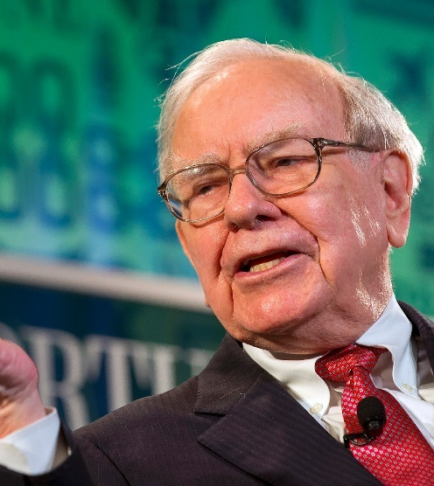
Warren Buffett
1930-Present
Chairman & CEO of Berkshire Hathaway
One of the richest people in the world
Philanthropist – pledged to donate 99% of his wealth to charity
Entrepreneur as a child
Extremely successful investor
Purchased many companies as investments – making him a billionaire
One of the most influential financial thinkers of our time
Nice guy

Slide 62
Warren Buffett

Slide 63
Leadership Lessons
Stick to fundamental values
Live simply
Frugal spender
Objective is to accumulate wealth, not squander it
Give back
Wealth is a means to effect positive change
Communicate openly & effectively
Pick your allies wisely
Be prepared for any risks

Slide 64
Quotes
We simply attempt to be fearful when others are greedy and to be greedy only when others are fearful.
It takes 20 years to build a reputation and five minutes to ruin it. If you think about that, you'll do things differently.
Price is what you pay. Value is what you get.
Someone's sitting in the shade today because someone planted a tree a long time ago.
Rule No.1: Never lose money. Rule No.2: Never forget rule No.1.
Risk comes from not knowing what you're doing.
It's only when the tide goes out that you discover who's been swimming naked.
It's far better to buy a wonderful company at a fair price than a fair company at a wonderful price.
Our favorite holding period is forever.
It's better to hang out with people better than you. Pick out associates whose behavior is better than yours and you'll drift in that direction.

Slide 65
Check on Learning . . .
What did Warren Buffett accomplish?
What leadership lessons can we take away?
What traits did he exhibit?
What do you admire about him?
Is there anything about Buffett that you dislike and don’t want to emulate?
What did you learn that you can use to improve your own leadership?

Slide 66
Sheryl Sandberg
OBJECTIVES
DESIRED OUTCOME (Followership)
Cadets learn about Sheryl Sandberg, the reasons for her success, and what her experience adds to the study of leadership.
Plan of Action:
A1. Identify the basic facts about Sheryl Sandberg, and what she has accomplished.
A2. Explain what leadership lessons we can learn from familiarity with Sheryl Sandberg’s story.
A3. Compare the leadership of Sheryl Sandberg with your own leadership skills, styles, and dynamics.
Essential Question: What can we learn about our own leadership, how to build our traits and skills, based on the leadership of Sheryl Sandberg?

Slide 67
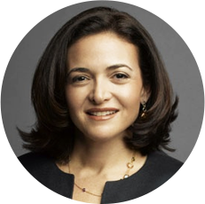
Sheryl Sandberg
1969-Present
Chief Operating Officer of Facebook
One of the top women leaders in the tech industry
Excellent student
Graduated top of her Harvard class in Economics. Harvard MBA in Business
Worked for the Secretary of the Treasury
VP at Google
Facebook COO in 2008
Facebook Board of Directors in 2012 (first female board member)
One of the 172 female billionaires in the world (as of 2020)
Repeatedly named one of the most powerful or influential women in business

Slide 68
Sheryl Sandberg

Slide 69
Sheryl Sandberg

Slide 70
Leadership Lessons
Be open to opportunities
Sandberg didn’t plot her career in tech – she just took the opportunities when they happened
Desire to have a positive impact on the world
Use your power to highlight important issues
Ability to deal with criticism
Accused of elitism and being out of touch with the average woman
Acknowledges her privilege
Still tries to make a difference

Slide 71
Quotes
The traditional metaphor for careers is a ladder, but I no longer think that metaphor holds. It doesn’t make sense in a less hierarchical world. … Build your skills, not your resume. Evaluate what you can do, not the title they’re going to give you. Do real work.
All of us, and especially leaders, need to speak and hear the truth. The workplace is an especially difficult place for anyone to tell the truth, because no matter how flat we want our organizations to be, all organizations have some form of hierarchy. What that means is that one person’s performance is assessed by someone else’s perception. This is not a setup for honesty.
Your life’s course will not be determined by doing the things that you are certain you can do. Those are the easy things. It will be determined by whether you try the things that are hard.
Leadership is not bullying, and leadership is not aggression. Leadership is the expectation that you can use your voice for good. That you can make the world a better place.
Work hard, stick with what you like, and don’t let go.
So, if you find yourself on one path but you long for something else, keep trying. And if that path isn’t right, try again. Keep trying and trying until you find something that stirs your passion, a job that matters to you and others. It is a luxury to combine passion and contribution, and it is also the clearest path to happiness.
I believe that if more women lean in, we can change the power structure of our world and expand opportunities for all. More female leadership will lead to fairer treatment for all women.
Every woman I know, particularly the senior ones, has been called too aggressive at work. We know in gender blind studies that men are more aggressive in their offices than women. We know that. Yet we’re busy telling all the women that they’re too aggressive. That’s the issue.

Slide 72
Check on Learning . . .
What did Sheryl Sandberg accomplish?
What leadership lessons can we take away?
What traits did she exhibit?
What do you admire about her?
Is there anything about Sandberg that you dislike and don’t want to emulate?
What did you learn that you can use to improve your own leadership?

Slide 73
Kamala Harris
OBJECTIVES
DESIRED OUTCOME (Followership)
Cadets learn about Kamala Harris, the reasons for her success, and what her experience adds to the study of leadership.
Plan of Action:
A1. Identify the basic facts about Kamala Harris, and what she has accomplished.
A2. Explain what leadership lessons we can learn from familiarity with Kamala Harris’ story.
A3. Compare the leadership of Kamala Harris with your own leadership skills, styles, and dynamics.
Essential Question: What can we learn about our own leadership, how to build our traits and skills, based on the leadership of Kamala Harris?

Slide 74
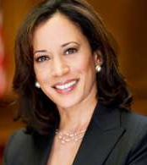
Kamala Harris
1964-Present
California politician on 2020 presidential ticket
2nd black female senator, and first Indian American (Asian) senator, first black woman on a major party’s national ticket; first Indian American and Asian on a presidential ticket
As a senator, advocated for healthcare reform, making cannabis legal (federally), a path to citizenship for undocumented immigrants, the DREAM Act, banning assault weapons, and progressive tax reform. She’s considered a moderate Democrat
California’s Attorney General before running for the US Senate – major victories in fraud suits against the mortgage industry, environmental issues, collection of DNA from adults in felony arrests, human trafficking

Slide 75
Kamala Harris

Slide 76
Leadership Lessons
Sweat the small stuff
Believes a leader needs to pay attention to detail that will actually accomplish a big vision
Master the art of communication
Known for her ‘prosecutorial’ style
Get to the point
Set the tone in communication
Display a collegial style
Open to group-wide mediation efforts and consensus-building to manage crisis
Cultivates relationships
Able to work with diverse types of people

Slide 77
Quotes
I believe that a child going without an education is a crime.
Doing nothing while the middle class is hurting. That's not leadership. Loose regulations and lax enforcement. That's not leadership. That's abandoning our middle class.
The American dream belongs to all of us.
I want to use my position of leadership to help move along at a faster pace what I believe and know the Obama administration wants to do around the urgency of climate change.
I was raised to be an independent woman, not the victim of anything.
What's important for my daughter to know is that... if you are fortunate to have opportunity, it is your duty to make sure other people have those opportunities as well.
My mother had a saying: 'Kamala, you may be the first to do many things, but make sure you're not the last.
I love being in a courtroom.
What we all want is public safety. We don't want rhetoric that's framed through ideology.
My mother was and will always remain my greatest hero.
I remember when my mother, Shyamala Harris, bought our first home. I was thirteen. She was so proud, and my sister and I were so excited. Millions of Americans know that feeling of walking through the front door of their own home for the first time - the feeling of reaching for opportunity and finding it.
I believe in that old adage that 'as goes California, so goes the country.’

Slide 78
Check on Learning . . .
What did Kamala Harris accomplish?
What leadership lessons can we take away?
What traits did she exhibit?
What do you admire about her?
Is there anything about Harris that you dislike and don’t want to emulate?
What did you learn that you can use to improve your own leadership?

Slide 79
Daniel “Chappie” James Jr.
OBJECTIVES
DESIRED OUTCOME (Followership)
Cadets learn about Chappie James, the reasons for his success, and what his experience adds to the study of leadership.
Plan of Action:
A1. Identify the basic facts about Chappie James, and what he accomplished.
A2. Explain what leadership lessons we can learn from familiarity with Chappie James’ story.
A3. Compare the leadership of Chappie James with your own leadership skills, styles, and dynamics.
Essential Question: What can we learn about our own leadership, how to build our traits and skills, based on the leadership of Chappie James?

Slide 80
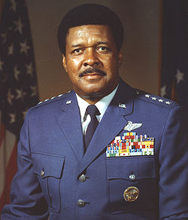
Chappie James
1920-1978
First African American to achieve 4-star rank. Promoted to General in the Air Force in 1975
Tuskegee Airman during World War II
Flew fighters in Korea & Vietnam Wars
Opposed Affirmative Action

Slide 81
Chappie James

Slide 82
Leadership Lessons
Be a patriot
Loved the USA
Served in the military for 35 years
Be a communicator
Found further success, in addition to flying, as a Public Affairs Officer at the Pentagon
Preparation and Persistence
“I shall not quit”
Believed in being ready when opportunity knocks – prepare yourself for the opportunities, and when you get them, work hard and never quit

Slide 83
Quotes
The power of excellence is overwhelming. It is always in demand, and nobody cares about its color.
The Marines don’t have any race problems. They treat everybody like they’re black.
I'm not disgusted. I'm a citizen of the United States of America and I'm no second-class citizen either and no man here is, unless he thinks like one and reasons like one and performs like one. This is my country and I believe in her, and I will serve her, and I'll contribute to her welfare whenever and however I can. If she has any ills, I'll stand by her until in God's given time, through her wisdom and her consideration for the welfare of the entire nation, she will put them right.

Slide 84
Check on Learning . . .
What did Chappie James accomplish?
What leadership lessons can we take away?
What traits did he exhibit?
What do you admire about him?
Is there anything about Chappie James that you dislike and don’t want to emulate?
What did you learn that you can use to improve your own leadership?

Slide 85
David Glasgow Farragut
OBJECTIVES
DESIRED OUTCOME (Followership)
Cadets learn about David Glasgow Farragut, the reasons for his success, and what his experience added to the study of leadership.
Plan of Action:
A1. Identify the basic facts about David Glasgow Farragut, and what he accomplished.
A2. Explain what leadership lessons we can learn from familiarity with David Glasgow Farragut’s story.
A3. Compare the leadership of David Glasgow Farragut with your own leadership skills, styles, and dynamics.
Essential Question: What can we learn about our own leadership, how to build our traits and skills, based on the leadership of David Glasgow Farragut?

Slide 86
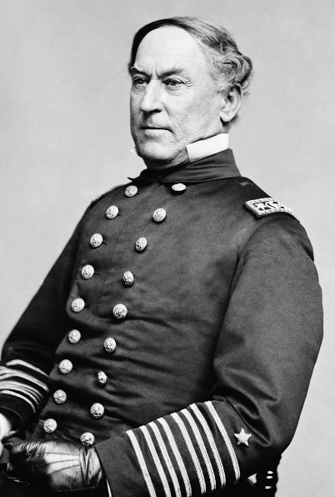
David Glasgow Farragut
1801-1869
First Hispanic Admiral (first Admiral)
His father was Spanish
Served in the US Navy 1810-1869
Appointed as a Midshipman at the age of 9, commanded his first ship at 22
Though a Southerner, declared his allegiance to the Union and served the Union Navy during the Civil War
During the Battle of Mobile Bay, declared “Damn the torpedoes, full speed ahead!” (that’s paraphrased, not his actual words)

Slide 87
David Glasgow Farragut

Slide 88
Leadership Lessons
First be sure you’re right, then go ahead
Known for straight thinking & determined action
During the Battle of Mobile Bay, he knew his ships could avoid the mines, and he accomplished a brilliant victory
A tolerant disposition is not incompatible with inflexibility in discipline or greatness as a warrior
Known to be a kind man – showed great love for friends and family
Character & honor were important to him
Still maintained a disciplined command climate on ships

Slide 89
Quotes
Damn the torpedoes! Full speed ahead! (this is a paraphrase of his actual words)
The best defense is a well-directed fire from your own guns.
Conquer or be conquered.

Slide 90
Check on Learning . . .
What did David Farragut accomplish?
What leadership lessons can we take away?
What traits did he exhibit?
What do you admire about him?
Is there anything about Farragut that you dislike and don’t want to emulate?
What did you learn that you can use to improve your own leadership?

Slide 91
Eric Shinseki
OBJECTIVES
DESIRED OUTCOME (Followership)
Cadets learn about Eric Shinseki, the reasons for his success, and what his experience adds to the study of leadership.
Plan of Action:
A1. Identify the basic facts about Eric Shinseki, and what he has accomplished.
A2. Explain what leadership lessons we can learn from familiarity with Eric Shinseki’s story.
A3. Compare the leadership of Eric Shinseki with your own leadership skills, styles, and dynamics.
Essential Question: What can we learn about our own leadership, how to build our traits and skills, based on the leadership of Eric Shinseki?

Slide 92
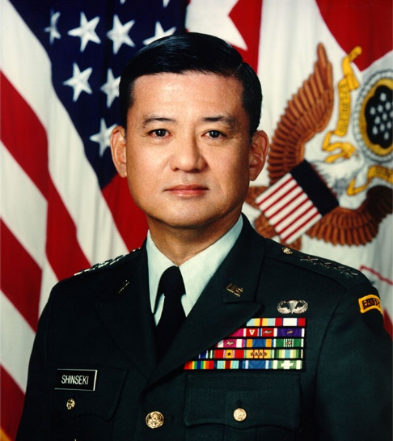
Eric Shinseki
1942-Present
First Asian American to achieve 4-star military rank
Promoted to General in the Army in 1997
Served as Army Chief of Staff 1999-2003
Served as Secretary of Veterans Affairs 2009-2014

Slide 93
Eric Shinseki

Slide 94
Leadership Lessons
Integrity
Well known for his integrity
Publicly disagreed with Secretary of Defense Rumsfeld about the size of the force needed to invade and hold Iraq
Had the moral courage to state his opinion, and lost his position over it (turned out he was right)
There are positive and negative effects of low-key, behind-the-scenes leadership
Shinseki is a low-key, quiet leader; an introvert
Very successful throughout his Army career
This didn’t work well for him at the VA – he didn’t have the traits needed in the political realm in Washington DC

Slide 95
Quotes
It’s tough never being right.
Well, let’s assume the world is linear. If we required a certain amount of troops per 25,000 population in the Balkans, if the world is not radically different, something of the same extent is going to be needed in Iraq.
An army that fought and won a war decisively finds it even more difficult to undergo change
The magnificent army that fought in Desert Storm is a great army, and it still is a magnificent army today. But it was one we designed for the Cold War, and the Cold War has been over for ten years now.
In the army, we do two things every day. We train our soldiers, and then we grow them into leaders, because frankly, we don’t hire out. We grow our own leaders.
I have spent a lifetime watching kids make mistakes because they were not trained or well led or properly motivated to do well. I never faulted the kids; rather, I saw opportunity to train, to motivate, to improve leadership – not to punish the individual.
You don’t get many do-overs in life.
If you are going to make a change, make it big and bold. Walk up to the biggest guy on the block, stand in his face and get it started. Then go around, brigade by brigade, making it make sense.
It’s important in any organization that if visions have any reality at all, it’s because the organization believes that the vision is right and that they share in it. Otherwise, it becomes the good idea of one person, and that even more importantly contributes to the sense that it will not survive the departure of that individual.
You must love those you lead before you can be an effective leader.
Without leadership, command is a hollow experience, a vacuum often filled with mistrust and arrogance.

Slide 96
Check on Learning . . .
What did Eric Shinseki accomplish?
What leadership lessons can we take away?
What traits did he exhibit?
What do you admire about him?
Is there anything about Shinseki that you dislike and don’t want to emulate?
What did you learn that you can use to improve your own leadership?

Slide 97
Ann Dunwoody
OBJECTIVES
DESIRED OUTCOME (Followership)
Cadets learn about Ann Dunwoody, the reasons for her success, and what her experience adds to the study of leadership.
Plan of Action:
A1. Identify the basic facts about Ann Dunwoody, and what she has accomplished.
A2. Explain what leadership lessons we can learn from familiarity with Ann Dunwoody’s story.
A3. Compare the leadership of Ann Dunwoody with your own leadership skills, styles, and dynamics.
Essential Question: What can we learn about our own leadership, how to build our traits and skills, based on the leadership of Ann Dunwoody?

Slide 98
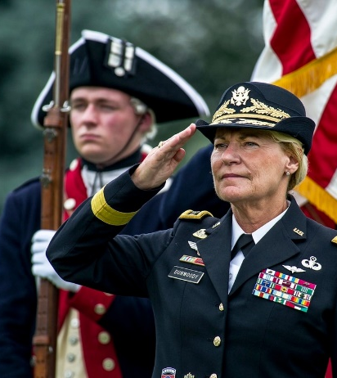
Ann Dunwoody
1953-Present
First woman to achieve 4-star military rank
Promoted to General in 2008
Served in the Army as a logistician

Slide 99
Ann Dunwoody

Slide 100
Leadership Lessons
Never walk by a mistake
If you walk by a mistake, you just set a new lower standard
Make every person on your team count
Everybody has something to contribute
Reward good behavior
Correct poor performance
Hold yourself to a higher standard
All good leaders strive for excellence, and encourage their subordinates to do the same

Slide 101
Quotes
If you don't know where you're going, any road will take you there.
I have to laugh when people ask, "How's retired life?" I'm as busy as I've ever been, except now I make my own schedule.
If you compromise your integrity and principles on minor issues, it gets easier to make bad choices on the big issues.

Slide 102
Check on Learning . . .
What did Ann Dunwoody accomplish?
What leadership lessons can we take away?
What traits did she exhibit?
What do you admire about her?
Is there anything about Dunwoody that you dislike and don’t want to emulate?
What did you learn that you can use to improve your own leadership?

