Slide 1
California Cadet Corps
Curriculum on Leadership
“Learn from Leaders who have forged the way before us.”
L6/C: Contemporary Leader Profiles

Slide 2
Leaders Who Inspire You Agenda
Profiling a Leader Who Inspires You:
Step 1: Familiarize yourself with the Leadership Profile format
Step 2: Select a Leader to profile
Step 3: Research your Leader
Step 4: Write your Leader Profile
Step 5: Present your Leader Profile
Check on Learning

Slide 3
Contemporary Leadership profiles Unit Objectives
The desired outcome of this unit is for cadets to learn how to profile leaders who inspire them; determine the reasons for their success, and what their experience added to the study of leadership.
Plan of Action:
Identify a leader who inspires you for their leadership or what they accomplished.
Develop a leadership profile in the general format provided, including
Biographical information
Leadership Lessons
Quotes from the Leader
Related books, if any
Related videos, if any
Related links
Compare the leadership of the inspirational leader to your own leadership skills, styles, and dynamics, and to what you’ve learned about leadership in your CACC experience.

Slide 4
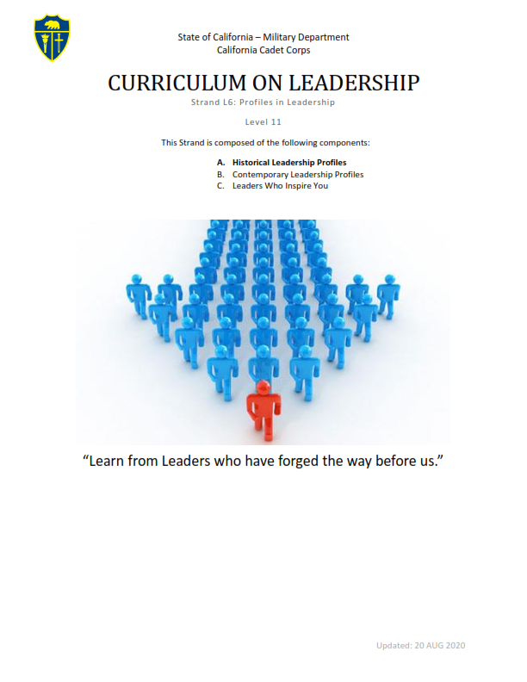
Step 1
Familiarize yourself with the Leadership Profile format
Take a look at some leadership profiles in L6A and L6B
Note the format
Note the type of information included
Note the types of references used

Slide 5
Step 2
Select a Leader to profile
Should be a public figure (historical or contemporary)
Should be someone you find inspiring in some way
For what they accomplished
For how they lead
Shouldn’t be one of the leaders profiled in L6A or L6B
Shouldn’t be from www.LeadershipGeeks.com
Commandants shouldn’t assign leaders
Part of the process is thinking about leadership and making your own selection
May be a leader from any venue (politics, military, business, entertainment, sports)
Not just someone famous, but a LEADER
Alternately, you may profile a local leader – someone you have access to and can interview
Select a Leader, not a Hero

Slide 6
Step 2, continued
For your inspirational leader, try to answer these questions:
What has the leader accomplished? What is their vision?
Can you identify the style of leadership used? This is sometimes hard because people don’t just fit into one category – they act differently in different situations.
What leadership lessons can we take away?
What traits does he/she exhibit?
What do you admire about him/her?
Is there anything about the leader that you dislike and don’t want to emulate?
Is there controversy about the leader and what he/she did or believed?
What did you learn that you can use to improve your own leadership?

Slide 7
Step 3
Research your Leader
Gather information
Seek out websites, books, magazines or information available in your world through interviews
Interview the leader and anybody who can provide more insight into their leadership (their followers, boss, peers)
What kind of information would people in these roles have that the leader may not even know?

Slide 8
Step 4
Write your Leader Profile
Organized using the given format
Helps the reader understand the Leader’s accomplishments, style, and/or lessons about leadership
If there are no books or videos on the leader, you may skip those sections
Include references from your research

Slide 9
Step 5
Present your Leader Profile
If desired, present your Leader Profile to your Cadet Corps class
Use slides or videos
Better conveys information
Gives a better ‘picture’ of the leader
Focus most on the ‘lessons learned’ about leadership from studying this leader

Slide 10
Check on Learning
What should you look for in selecting a leader to profile?
What’s the most important part of the profile?
What’s the difference in research between profiling an historical leader and profiling someone you have access to (not in the public eye)?

