Slide 1
California Cadet Corps Curriculum on Military Courtesy
“Everyday Cadet Courtesies”

Slide 2
Daily Cadet Courtesies Agenda
A1. Introduction to Military Courtesy
A2. Rank
A3. Addressing People (Title/Sir)
A4. Saluting
A5. What to Salute:
A6. Reporting
A7. Position of Attention
A9. Cadet Corps Traditions
A10. Every Day Courtesies
A11. Cadet Corps Taboos
A12. Grooming
A13. Helping Others
A14. Chain of Command

Slide 3
Introduction to military courtesy
A1. Describe what military courtesy is and why it’s important in the Cadet Corps.

Slide 4
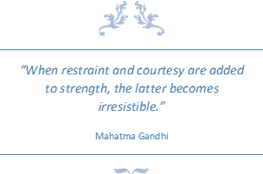
Introduction to Courtesy
Military Courtesy:
A required set of rules that govern how members of the military (or Cadet Corps) address and treat each other.
Found in:
Tradition
Regulation
Unit Pride
The courtesy you learn and practice here in the Cadet Corps will also prepare you for success in any occupation you choose, not just the military.

Slide 5
Check on Learning
T / F Military Courtesy is a one-way street.
What do you think is the most important reason to practice courtesy?
It’s Required and in the Regulations
It will prepare you for your future
Order and Discipline of the unit
A good way to treat people, and be treated
What do you think is different about military courtesy?

Slide 6
rank
A2. Identify all Cadet Corps and US Army ranks. Be familiar with the military history of rank. Understand the purpose of each rank.

Slide 7
History of Rank
CACC Adapted its rank from the US Army (1911)
US Army adapted its rank from the British (1780s)
British rank developed out of
Aristocracy
That’s why we have Officers, Commissions, and Warrants
Medieval Europe
That’s why we have French and Spanish words (lieutenant, colonel, etc)
Rank has been in use since ancient times (at least 500 b.c.)
In thousands of years, only a few militaries (Communist) have attempted to eliminate rank…only to return to them because of no command and control.

Slide 8
Fun Facts About Rank
"Lieutenant" comes from the French "lieu" meaning "place" and "tenant" meaning "holding." Literally, lieutenants are placeholders.
The British originally corrupted the French pronunciation, pronouncing the word, "lieuftenant."
While majors outrank lieutenants, lieutenant generals outrank major generals.
Gold is worth more than silver, but silver outranks gold.
Colonel is pronounced "kernal" because the British adopted the French spelling "colonel" but the Spanish pronunciation was "coronel" which became more popular.
While rank insignia is important, sometimes it isn't smart to wear them. When the rifled musket made its appearance in the Civil War, sharpshooters looked for officers. Officers soon learned to take off their rank insignia as they approached the battle line.

Slide 9
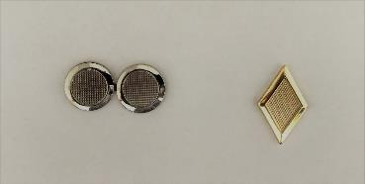
Cadet Corps Ranks
Rank determines who gets to tell whom what to do.
Higher rank = more authority and responsibility
CACC rank categories:
Field Grade Officers outrank…
Company Grade Officers outrank…
Warrant Officers outrank…
Senior Sergeants outrank…
Sergeants outrank…
Entry Level Cadets
CPT
MAJ
With each rank comes new leadership lessons.

Slide 10
Cadet Corps Ranks
Recruit
Cadet
Cadet First Class
Corporal
Sergeant
Staff Sergeant
Sergeant First Class
Master Sergeant
First Sergeant
Sergeant Major
Command Sergeant Major
Officers
Second Lieutenant
First Lieutenant
Captain
Major
Lieutenant Colonel
Colonel

Slide 11
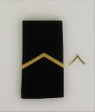
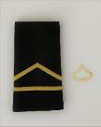
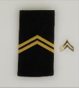
Cadets (Entry level)
Recruits wear the uniform without any rank.
RCT - Cadet Recruit
(Addressed as "Cadet")
Lowest rank: a “Recruit” who’s in their first semester of CACC. Primary role is to carry out orders issued to them to the best of his/her ability.
Squad member.
CDT - Cadet
(Addressed as "Cadet")
RCTs are advanced to this level after one semester of CACC (or earlier) and passing their PTA. Carries out orders issued to them to the best of his/her ability.
Squad member.
CFC - Cadet First Class
(Addressed as "Cadet")
CDTs are advanced to this level after their second semester of CACC (or earlier) and passing their PTA. Carries out orders issued to them to the best of his/her ability.
Squad member.
C/CPL - Cadet Corporal
(Addressed as "Corporal")
CFCs are advanced to this level after their third semester of CACC (or earlier) and passing their PTA. Carries out orders issued to them to the best of his/her ability.
Squad member. However, now as a non-commissioned officer may have to fill in for the squad leader or may be tasked to lead small work details.

Slide 12
Sergeants
C/SGT - Cadet Sergeant
(Addressed as "Sergeant")
CPLs are promoted to this level after taking the C/SGT exam and passing their PTA. Often in this rank cadets experience their first official leadership position, Squad Leader. Considered to have the greatest impact on Cadets because SGTs oversee them in their daily tasks. SGTs set an example and the standard for Entry-Level Cadets to look up to, and live up to.
Assistant Squad Leader (5-11 Cadets).
C/SSG - Cadet Staff Sergeant
(Addressed as "Sergeant")
SGTs are promoted to this level after taking the C/SSG exam and passing their PTA. Also, commands a squad (9 to 10 Cadets). Often has one or more SGTs under their leadership.
Squad Leader (5-11 cadets), Company Clerk/Guidon Bearer, Battalion Staff NCO

Slide 13
Senior Sergeants
C/SFC - Cadet Sergeant First Class
(Addressed as "Sergeant")
SSGs are promoted to this level after passing a promotion board and completing their PTA. Often SFCs serve as platoon Sergeant and advise the platoon leader as well as mentor squad leaders. SFCs are key to staff function.
Company Supply Sergeant, Battalion Staff NCO, Regimental Staff NCO
C/MSG - Cadet Master Sergeant
(Addressed as "Sergeant")
SFCs are promoted to this level after passing a promotion board and completing their PTA. Principal NCO at the Battalion, and all staff levels.
Platoon Sergeant, Battalion/Regimental/Brigade/10th Corps Staff NCO

Slide 14
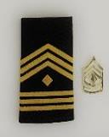
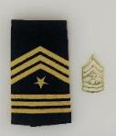
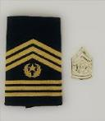
Senior Sergeants
C/1SG - Cadet First Sergeant
(Addressed as "First Sergeant")
SFCs or MSGs are promoted to this level after passing a promotion board and completing the MSG PTA and being assigned to the First Sergeant Position. Principal NCO and life-blood of the company: the trainer, tutor, and wise counselor. Instructs other SGTs, advises the Commander and helps train Cadets.
Company First Sergeant, HHC First Sergeant
C/SGM - Cadet Sergeant Major
(Addressed as " Sergeant Major ")
1SGs or MSGs are promoted to this level after passing a promotion board. SGMs experience and abilities are equal to that of the CSM, but the sphere of influence regarding leadership is generally limited to those directly under his charge.
Battalion Operations NCO, Regimental/Brigade/10th Corps Staff NCO
C/CSM - Cadet Command Sergeant Major
(Addressed as "Command Sergeant Major")
SGMs are promoted to this level after passing a promotion board. CSMs normally serve at the Brigade level and above.
Battalion/Regiment/Brigade/10th Corps Command Sergeant Major

Slide 15
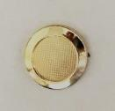
Company Grade Officers
C/2LT - Cadet Second Lieutenant
(Addressed as "Lieutenant")
SSGs and above are promoted to this entry-level officer rank after completing OCS, Promotion Board, and Officer PTAs . Leads platoon-size elements consisting of the platoon SGT and two or more squads (Commands at least 14 Cadets).
Platoon Leader, Company Staff Officer
C/1LT - Cadet First Lieutenant
(Addressed as "Lieutenant")
2LTs are promoted to the senior lieutenant rank after completing a promotion board and 1LT PTAs. 1LTs are often assigned as the Company XO.
Company Executive Officer, Battalion Staff Officer
C/CPT - Cadet Captain
(Addressed as "Captain")
1LTs are promoted to this rank after completing a promotion board and Captain PTAs. Captains command companies (at least 32 cadets) and are primary staff officers at the Battalion
Company Commander, Battalion Staff Officer

Slide 16
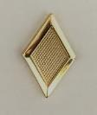
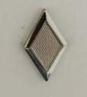
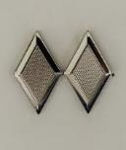
Field Grade Officers
C/MAJ - Cadet Major
(Addressed as "Major")
CPTs are promoted to this rank after completing a promotion board and Major PTAs. Majors are primarily staff officers.
Battalion Executive Officer, Regimental/Brigade/10th Corps Staff Officer
C/LTC - Cadet Lieutenant Colonel
(Addressed as "Colonel")
MAJs are promoted to this rank after completing a promotion board and LTC PTAs. Lieutenant Colonels command battalions and regiments.
Battalion/Regimental Commander, Brigade Deputy/XO, 10th Corps Staff Officer
C/COL - Cadet Colonel
(Addressed as "Colonel")
LTCs are promoted to this rank after completing a promotion board and COL PTAs. Colonels command brigades and the 10th Corps (Several thousand cadets)
Brigade Commander, !0th Corps Command Element

Slide 17
Miscellaneous Ranks
C/CW1 – Warrant Officer 1*
(Addressed as “Mr.” or “Ms.”)
C/CW2 – Warrant Officer 2*
(Addressed as “Mr.” or “Ms.”)
C/OC – Officer Candidate
(Addressed as “Candidate”)
CR 1-5 in 2017 removed Cadet Warrant Officer ranks from our system. There will be Cadet Warrant Officers around in dwindling numbers for a short time.

Slide 18
Check on Learning
Write down each Rank (abbreviations OK)
1 2 3 4 5 6 7 8 9 10 11
12 13 14 15 16 17

Slide 19
US Army Enlisted Soldiers
PRIVATE (PVT/PV2)
(Addressed as "Private") Lowest rank: a trainee who’s starting Basic Combat Training (BCT). Primary role is to carry out orders issued to them to the best of his/her ability. (PVT does not have an insignia)
PRIVATE FIRST CLASS (PFC)
(Addressed as "Private") PV2s are promoted to this level after one year—or earlier by request of supervisor. Individual can begin BCT at this level with experience or prior military training. Carries out orders issued to them to the best of his/her ability.
SPECIALIST (SPC)
(Addressed as "Specialist") Can manage other enlisted Soldiers of lower rank. Has served a minimum of two years and attended a specific training class to earn this promotion. People enlisting with a four-year college degree can enter BCT as a Specialist.

Slide 20
US Army NCOs
CORPORAL (CPL)
(Addressed as "Corporal") The base of the Non-Commissioned Officer (NCO) ranks, CPLs serve as team leader, the smallest Army units. Like SGTs, they are responsible for individual training, personal appearance and cleanliness of Soldiers.
SERGEANT (SGT)
(Addressed as "Sergeant") Typically commands a squad (9 to 10 Soldiers). Considered to have the greatest impact on Soldiers because SGTs oversee them in their daily tasks. In short, SGTs set an example and the standard for Privates to look up to, and live up to.
STAFF SERGEANT (SSG)
(Addressed as "Sergeant") Also commands a squad (9 to 10 Soldiers). Often has one or more SGTs under their leadership. Responsible for developing, maintaining and utilizing the full range of his Soldiers' potential.
SERGEANT FIRST CLASS (SFC)
(Addressed as "Sergeant") Key assistant and advisor to the platoon leader. Generally, has 15 to 18 years of Army experience and puts it to use by making quick, accurate decisions in the best interests of the Soldiers and the country.
MASTER SERGEANT (MSG)
(Addressed as "Sergeant") Principal NCO at the battalion level, and often higher. Not charged with all the leadership responsibilities of a 1SG, but expected to dispatch leadership and other duties with the same professionalism.

Slide 21
US Army Senior NCOs
FIRST SERGEANT (1SG)
(Addressed as "First Sergeant") Principal NCO and life-blood of the company: the provider, disciplinarian and wise counselor. Instructs other SGTs, advises the Commander and helps train all enlisted Soldiers. Assists Officers at the company level (62 to 190 Soldiers).
SERGEANT MAJOR (SGM)
(Addressed as "Sergeant Major") SGMs experience and abilities are equal to that of the CSM, but the sphere of influence regarding leadership is generally limited to those directly under his charge. Assists Officers at the battalion level (300 to 1,000 Soldiers).
COMMAND SERGEANT MAJOR (CSM)
(Addressed as " Command Sergeant Major") Functioning without supervision, a CSM’s counsel is expected to be calm, settled and accurate—with unflagging enthusiasm. Supplies recommendations to the commander and staff, and carries out policies and standards on the performance, training, appearance and conduct of enlisted personnel. Assists Officers at the brigade level (3,000 to 5,000 Soldiers).
SERGEANT MAJOR OF THE ARMY
There’s only one Sergeant Major of the Army. This rank is the epitome of what it means to be a Sergeant and oversees all Non-Commissioned Officers. Serves as the senior enlisted advisor and consultant to the Chief of Staff of the Army (a four-star General).

Slide 22
US Army Warrant Officers
WARRANT OFFICER 1 (WO1)
Appointed by warrant from the Secretary of the Army. WO1s are technically and tactically focused officers who perform the primary duties of technical leader, trainer, operator, manager, maintainer, sustainer, and advisor.
CHIEF WARRANT OFFICER 2 (CW2)
Chief Warrant Officers become commissioned officers as provided by the President of the United States. CW2s are intermediate level technical and tactical experts who perform increased duties and responsibilities at the detachment through battalion levels.
CHIEF WARRANT OFFICER 3 (CW3)
Advanced-level experts who perform the primary duties that of a technical and tactical leader. They provide direction, guidance, resources, assistance, and supervision necessary for subordinates to perform their duties. CW3s primarily support operations levels from team or detachment through brigade.
CHIEF WARRANT OFFICER 4 (CW4)
Senior-level experts in their chosen field. They primarily support battalion, brigade, division, corps, and echelons above corps operations. CW4s typically have special mentorship responsibilities for other WOs and provide essential advice to commanders on WO issues.
CHIEF WARRANT OFFICER 5 (CW5)
Master-level technical and tactical experts that support brigade, division, corps, echelons above corps, and major command operations. They provide leader development, mentorship, advice, and counsel to WOs and branch officers.

Slide 23
US Army Officers
SECOND LIEUTENANT (2LT)
(Addressed as "Lieutenant") Typically the entry-level rank for most Commissioned Officers. Leads platoon-size elements consisting of the platoon sergeant and two or more squads (16 to 44 Soldiers).
FIRST LIEUTENANT (1LT)
(Addressed as "Lieutenant") A seasoned lieutenant with 18 to 24 months’ service. Leads more specialized weapons platoons and indirect fire computation centers. As a senior Lieutenant, they are often selected to be the Executive Officer of a company-sized unit (110 to 140 personnel).
CAPTAIN (CPT)
(Addressed as "Captain") Commands and controls company-sized units (62 to 190 Soldiers), together with a principal NCO assistant. Instructs skills at service schools and The United States Army combat training centers and is often a Staff Officer at the battalion level.
MAJOR (MAJ)
(Addressed as "Major") Serves as primary Staff Officer for brigade and task force command regarding personnel, logistical and operational missions.
LIEUTENANT COLONEL (LTC)
(Addressed as "Lieutenant Colonel " or "Colonel") Typically commands battalion-sized units (300 to 1,000 Soldiers), with a CSM as principal NCO assistant. May also be selected for brigade and task force Executive Officer.
COLONEL (COL)
(Addressed as "Colonel") Typically commands brigade-sized units (3,000 to 5,000 Soldiers), with a CSM as principal NCO assistant. Also, found as the chief of divisional-level staff agencies.

Slide 24
US Army General Officers
BRIGADIER GENERAL (BG)
(Addressed as "General") Serves as Deputy Commander to the commanding general for Army divisions. Assists in overseeing the staff's planning and coordination of a mission.
MAJOR GENERAL (MG)
(Addressed as "General") Typically commands division-sized units (10,000 to 15,000 Soldiers).
LIEUTENANT GENERAL (LTG)
(Addressed as "General") Typically commands corps-sized units (20,000 to 45,000 Soldiers).
GENERAL (GEN)
(Addressed as "General") The senior level of Commissioned Officer typically has over 30 years of experience and service. Commands all operations that fall within their geographical area. The Chief of Staff of the Army is a four-star General.
GENERAL OF THE ARMY (GOA)
This is only used in time of War where the Commanding Officer must be equal or of higher rank than those commanding armies from other nations. The last officers to hold this rank served during and immediately following WWII.

Slide 25
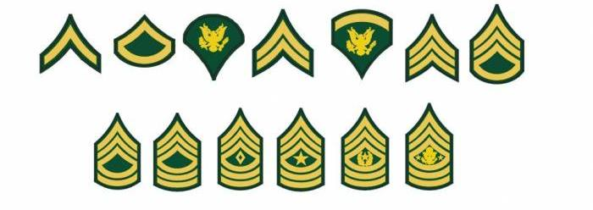
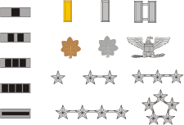
Check on Learning
Write down each Rank (abbreviations OK)
1 2 3 4 E.C. 5 6
7 8 9 10 11 12
13 14 15
25
26
16 17 18
27
19 20 21
28
24
22 23
29

Slide 26
How to address people
A3. Properly address other cadets, cadet officers, and adult members of all ranks using titles or rank. Know when to use “Sir” and “Ma’am”.

Slide 27
Use of Titles
One military courtesy is the use of titles to show respect.
When you are talking to someone in the Cadet Corps or the military, address that person by his or her rank.
This form of a courtesy is not only a standard greeting, but it shows respect for the responsibility that person has earned.

Slide 28
Addressing Rank
All Generals: “General”
Colonels and Lieutenant Colonels: “Colonel”
Majors: “Major”
Captains: “Captain”
Lieutenants: “Lieutenant”
Officer Candidate: “Candidate”
Warrant Officers: “Mister” or “Miss”
Sergeants Major: “Sergeant Major”
First Sergeants: “First Sergeant”
All other Sergeants: “Sergeant”
Corporals: “Corporal”
All Specialists: “Specialist”
Recruits, Cadets and Cadets First Class: “Cadet”
Privates and Privates First Class: “Private”
Example1: A C/SSG asks a CFC “Do you understand, Cadet?” The CFC answers “Yes, Sergeant!”
Example2: A C/CSM greets a C/LTC with “Good morning, Colonel” and the C/LTC responds with “Good morning, Sergeant Major”

Slide 29
“Sir” and “Ma’am”
Use when addressing an Officer (Cadet or Adult)
Greetings, e.g. “Good Morning, Sir”
Responses, e.g. “Yes Ma’am”, “No excuse, Sir”
Statements, e.g. “Ma’am, all cadets are present”
Not used when addressing ‘enlisted’ ranks (even CSM)
Also may be appropriate to use with civilian leaders, teachers, parents, etc.

Slide 30
Check on Learning
T / F Addressing an Officer with “Sir” or “Ma’am” is optional.
T / F A Major General is addressed as “Major General”
T / F A male C/CSM asks a male C/RCT if he is OK. The C/RCT should respond with a “Yes Sir”
T / F It’s appropriate to use “Ma’am” or “Sir” to your principal

Slide 31
saluting
A4. Describe the process of saluting. Give the correct verbal greeting for each time of day.

Slide 32
Military Salute History
Knights in armor raised visors with the right hand when meeting a comrade.
This practice gradually became a way of showing respect and, in early American history, sometimes involved removing the hat. By 1820, the motion was modified to touching the hat, and since then it has become the hand salute used today.
You salute to show respect toward an officer, flag, or our country.

Slide 33
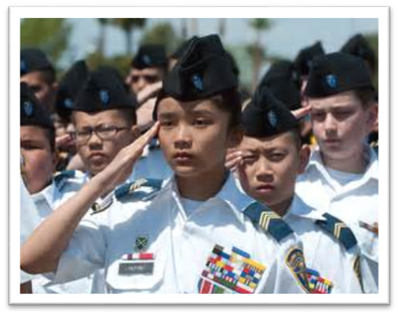
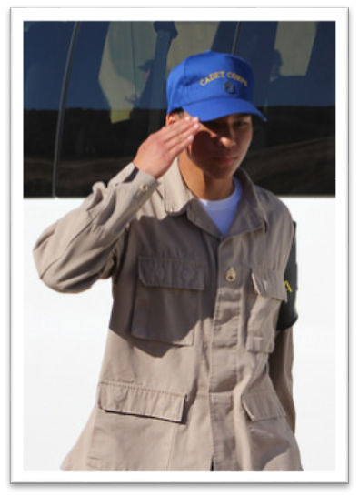
How to Salute
Face the person/flag you’re saluting
Your fingers are together, straight, and your thumb snug along the hand in line with the fingers, and not across your palm.
Raise your flat right hand until the tip of your forefinger touches the outer edge of your right eyebrow (just above and to the right of your right eye).
When wearing headgear with a visor, the forefinger touches the right front corner of the visor.
Your hand, wrist, and forearm are straight, forming a straight line from your elbow to your fingertips. Your upper arm (elbow to shoulder) is horizontal to the ground.

Slide 34
How to Salute (Cont)
Hold salute until returned, dropping the salute, bring your hand directly down to its natural position at your side, without slapping your leg or moving your hand out to the side.
The junior person salutes first and drops their salute last.
Greet with a salute and the CACC Standard Greeting
CACC Standard Greeting
Time of Day | Greeting
0000-1159:59 | “Good Morning Sir/Ma’am/Sergeant”
1200-1659:59 | “Good Afternoon Sir/Ma’am/Sergeant”
1700-2359:59 | “Good Evening Sir/Ma’am/Sergeant”

Slide 35
Check on Learning
T / F If you salute, then you don’t have to verbally greet someone.
T / F When saluting, your right upper arm should be parallel to the ground.
T / F When saluting while wearing a brimmed hat, you should touch your finger to your eyebrow.
T / F Saluting an Officer is optional
At 1659, the standard greeting is “Good__________, sir/ma’am”

Slide 36
Rules of saluting
A4. Give the correct response to each situation in the Rules for Saluting. Identify what receives a salute (both rank and flag).

Slide 37
Saluting Rules, OUTDOORS
Dress | Situation | Correct Response
Uniform | US flag is raised or lowered *Note: Accompanied by Reveille or Retreat or National Anthem being played | Stop, stand at attention, face the flag and salute until flag is finished being raised or lowered or last note of music is played.
Uniform | US Flag passes by | Stop, stand at attention and salute until flag is 6 paces away
Uniform | Pass by an officer | Salute and greet him/her 6 paces away, continue walking without stopping
Uniform | Pass an officer from behind | Salute and greet with “By your leave, Sir/Ma’am” and continue walking without stopping
Uniform | Reporting to an officer | Salute and say “Sir/Ma’am, Cadet (include your rank and name) reporting as ordered.”
Uniform | Reporting to an NCO | Stand at Parade Rest and say “Sergeant (or First Sergeant or Sergeant Major), Cadet (include your rank and name) reporting as ordered.”
Uniform | Reciting the Pledge of Allegiance | Salute and recite the pledge
Civilian | US flag is raised or lowered *Note: Accompanied by Reveille or Retreat or National Anthem being played | Stop, stand at attention, put your hand over your heart, and face the flag until it is finished being raised or lowered or last note of music is played .
Civilian | US Flag passes by | Stop, stand at attention until flag is 6 paces away
Civilian | Pass by an officer | Greet him/her 6 paces away, continue walking
Civilian | Pass an officer from behind | Greet with “By your leave, Sir/Ma’am” and continue walking without stopping
Civilian | Reporting to an officer | Stand at attention and say “Sir/Ma’am, Cadet (include your rank and name) reporting as ordered.”
Civilian | Reporting to an NCO | Stand at parade rest and say “Sergeant (or First Sergeant or Sergeant Major), Cadet (include your rank and name) reporting as ordered.”

Slide 38
Saluting Rules, IN FORMATION (IN-PLACE OR MARCHING)
Dress | Situation | Correct Response
Civilian | Reciting the Pledge of Allegiance | Place your hand over your heart and recite the pledge
Uniform | US flag is raised or lowered | Entire Formation Salutes at “Present, Arms” Command
Uniform | An officer passes by | Formation’s leader salutes on behalf of the unit, continues marching without stopping. If at Parade Rest or At Ease, the formation is called to Attention.
Civilian | US flag is raised or lowered | Entire formation stands at attention and salutes
Civilian | An officer passes by | Formation’s leader greets officer on behalf of the unit, continues marching without stopping. If at Parade Rest or At Ease, the formation is called to Attention

Slide 39
Saluting Rules, IN DOORS
Dress | Situation | Correct Response
Uniform or Civilian | Reciting the Pledge of Allegiance | Stand at attention, place your hand over your heart and recite the Pledge
Uniform or Civilian | Reporting to an officer | Salute and say “Sir/Ma’am, Cadet (include your rank and name) reporting as ordered.”
Uniform or Civilian | Reporting for a Board | Salute the Board President and say “Sir/Ma’am/Sergeant Cadet (include your rank and name) reporting for board.”
Uniform or Civilian | Reporting to an NCO | Stand at parade rest and say “Sergeant (or First Sergeant or Sergeant Major), Cadet (include your rank and name) reporting as ordered.”
Uniform or Civilian | Pass by an officer or passing from behind | Greet officer
Uniform or Civilian | US Flag passes by; National anthem is Sung | Stand at attention and place your hand over your heart (If in civilian clothes)

Slide 40
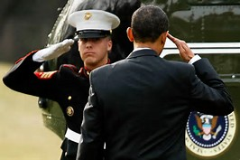
What to Salute
Flag of the United States:
As it’s being raised or lowered
As it’s passing by in a parade
As you are passing by it in a parade
As you are pledging allegiance outdoors (CACC-only)
Commander in Chief:
President of the United States
Governor of the State of California
Officers in the CACC:
Warrant Officers
Company Grade Officers (2LT-CPT)
Field Grade Officers (MAJ-COL)

Slide 41
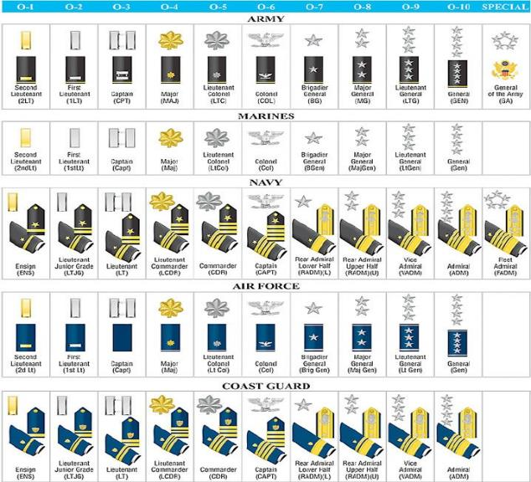
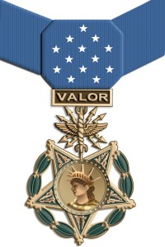
What to Salute Cont.
Officers in the military:
Army, Navy, Air Force, Marines, Coast Guard
California State Military Forces
Officers of Foreign countries (If you recognize them)
Medal of Honor Winners
All Ranks

Slide 42
What If…
My hands are full
Do a verbal greeting such as “Good morning sir.”
The other person’s hands are full
Salute the senior officer even though the salute can’t be returned
I’m at a sporting event, theater, church, or on public transportation
No salute required, though a verbal greeting is appropriate
I’m not sure if I should salute
Salute if in doubt
If you can’t salute, you should still attempt to render a respectful verbal greeting.

Slide 43
Check on Learning
Salute or Not? (In uniform, outdoors, and you’re a RCT)
Pass a Cadet CSM
National Anthem is being played
In formation (not leading) and an Officer passes by
You’re carrying a big box and pass an adult Commandant who is a Major
You’re a spectator at a parade and the US flag passes by.
You’re reporting in to a C/MSG on a promotion board

Slide 44
Reporting
A6. Report to an officer or NCO correctly in an office or outside.

Slide 45
Reporting
When reporting to an officer Indoors or in an office:
Cadet removes headgear, knocks twice, and enters when told to do so.
Cadet approaches within three steps of the officer's desk, halts, salutes, and reports, "Sir (Ma'am), Recruit Jones reporting as ordered."
The salute is held until the report-in is completed and the salute has been returned by the officer.
When the business is completed, the cadet salutes, holds the salute until it has been returned, executes an about face, and departs.
Reporting Outdoors
When reporting outdoors, the Cadet moves rapidly (double time) toward the officer, halts approximately three steps from the officer, salutes, and reports (as when indoors).
When the Cadet is dismissed by the officer, salutes are again exchanged.
Tip: When reporting to a Non-Commissioned Officer the salute is not rendered and the “Sir/Ma’am” is replaced with rank.

Slide 46
Check on Learning
T / F When reporting in, you may drop your salute when your report is complete.
T / F If outdoors you should walk to an Officer when told to report.
T / F You should salute an NCO when reporting in.
When reporting indoors, knock ____ times on the Officer’s door.

Slide 47
Position of Attention
A7. Properly call a room to Attention, or a group or formation outside, upon the approach of an officer.

Slide 48
Attention, At-Ease, or Nothing
When talking with an Officer who outranks you, stand at:
Attention. Maintain until relieved with an “at ease”, “as you were”, “at rest” or similar statement.
When talking with a senior NCO, stand:
At Ease.
When an Officer walks in to a room, call:
“Room, Attention”-if you are the first person to see him or her. If there is already an officer in the room, only call it to attention if the new officer out-ranks the officer already in the room. Remain at attention until relieved with an “at ease”, “as you were”, “at rest”, “carry on” or similar statement.
“Room, At Ease”- When an NCO of superior rank enters the room, the first cadet to recognize the NCO calls the room to "At ease." Remain at ease until relieved.
When an Officer walks into a class that is already in session
Continue Working
The officer should be greeted by the person in charge.
When an Officer walks into a class that is just beginning
Commandants may establish local policies on calling the room to attention
Dining facility, do:
During Mess, the command “At Ease” may be given, however you should remain seated, stay silent, and continue eating. Leaders, under normal circumstances, do not want to interrupt limited meal time.

Slide 49
Check on Learning
You are in a room (not class) with an adult Major, and an adult Captain walks in. Do you call the room to attention out of respect for the Captain?
You are a C/LTC and you walk into a room that gets called to attention for you. What do you say to get the room back to what they were doing?
If class is in session do you normally call the room to attention when an officer walks in?

Slide 50
The Senior’s Position of Honor
A8. Describe the position of honor for junior and senior personnel walking, posted, or entering a vehicle together.

Slide 51
The Right Way
A long-held military tradition dictates that you should always walk on the left side of senior ranking individuals.
For hundreds of years men fought with swords and shields. Most warriors carried the sword in their right and the shield in their left hand. Individuals and units who were proud of their fighting ability and desire to go offensive requested the right side of the battle line as a post of honor.
Thus, the right became the honored side.
When you permit a senior ranking individual to sit or walk on your right, you’re showing them respect by allowing them to symbolically fill the post of honor.
In-Ranks Inspection Exception
Senior inspector is to the left and as a result has the best vantage point from which to conduct the inspection.
Transportation Etiquette
When entering a car, the junior ranking person enters first.
The senior person enters last.
When leaving the car, the senior officer goes first.
The senior person sits on the right.

Slide 52
Check on Learning
You are walking with your Commandant to class. On what side do you walk?
Is the highest ranking person the first person to go into a car or the last person?
What side is the position of honor?

Slide 53
Every Day Courtesies
A10. Identify the basic courtesies cadets should use at all times.

Slide 54
Every Day Courtesies
“Please”
expresses both respect and consideration
“Thank You / You’re Welcome”
Gifts, favors, awards, courtesies
“Excuse Me”
Interruptions, Requests, Acknowledging an error, Departing, Getting someone’s attention
“I’m Sorry”
Apologizing, Expressing sorrow or regret

Slide 55
Check on Learning
What are the best words to repair mistakes?
What words express gratitude?
What one word best express respect?
What words are best used when you have to interrupt someone?

Slide 56
Cadet Corps Traditions
A9. Identify examples of Cadet Corps Customs/Traditions.

Slide 57
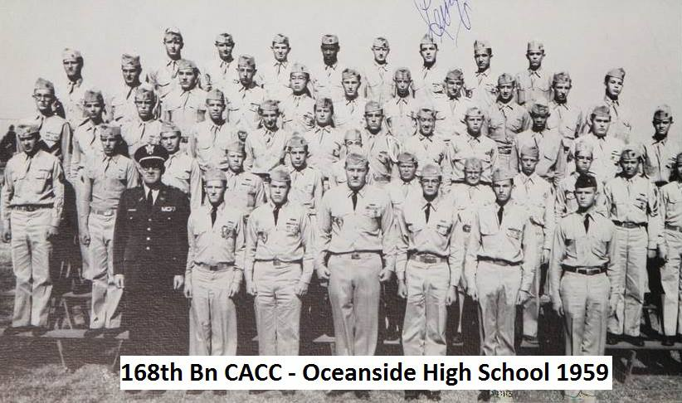
Customs / Traditions
The California Cadet Corps has a long, proud tradition going back to its formation in 1911. The Cadet Program has changed over the years, but we still carry out a basic mission – to make our cadets better citizens of the United States of America.

Slide 58
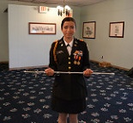
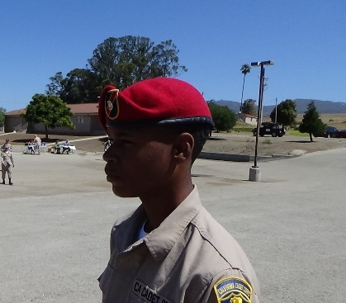
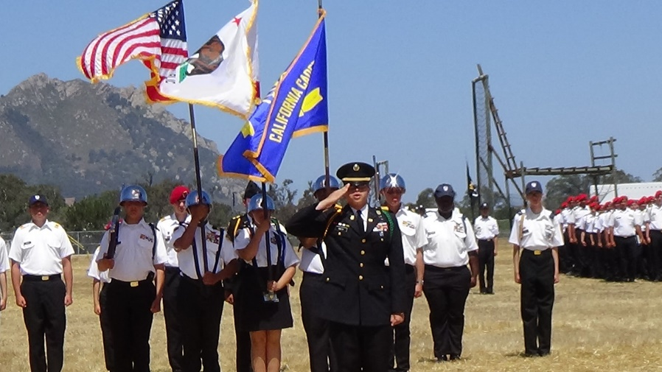
Some CACC Traditions
Stillwell Saber
Red Beret for Survival
Summer Camp
Cadet Battalion & Brigade
Numbers and Names

Slide 59
Check on Learning
Name two Cadet Corps traditions.
Is the salute a custom/tradition or a courtesy?

Slide 60
Cadet Corps Taboos
A11. Identify, from a list Taboos, things that members of the Cadet Corps will not do.

Slide 61
Taboos
Never criticize the Cadet Corps or a leader in public. (this includes Social Media)
Never go "over the heads" of superiors - don't jump the chain of command.
Never offer excuses, unless asked to explain.
Never "wear" a superior's rank by saying something like, "the First Sergeant wants this done now," when in fact the First Sergeant said no such thing. Speak with your own voice.
Never turn and walk away to avoid giving the hand salute.

Slide 62
Taboos
Never go indoors or pretend you don't hear to avoid standing reveille or retreat. Proudly respect the flag!
If you don't know the answer to a superior's question, you will never go wrong with the response, "I don't know sir, but I'll find out."
Never chew gum while in uniform
Never spread gossip or rumors
Never use profanity or vulgar words
Never walk or stand with your hands in your pockets

Slide 63
Check on Learning
Identify which of the examples below are taboos.
Never arrive at class late
Never offer an excuse unless asked to explain
Never stand with your hands in your pockets
Never use the chain of command to solve a problem

Slide 64
Grooming
A12. Identify how good grooming shows respect and courtesy for those around you.

Slide 65
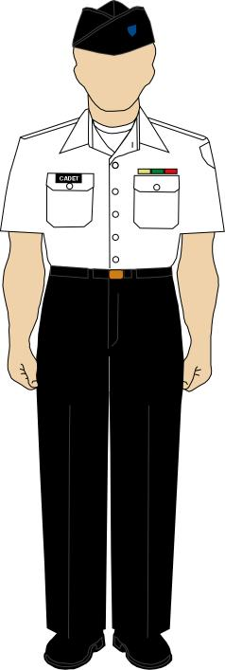
Grooming
Good Haircut = good attitude
Uniform worn properly =
I care
Clean, neat and tidy – ready to do my job and be a leader
Hair, hands/nails
Breath, body odor
Clean clothes
Pressed uniform
Insignia worn correctly
Shoes shined
How you present yourself

Slide 66
Check on Learning
T / F Grooming is only important in uniform.
T / F It’s okay to put on your make-up in the back of the classroom.
T / F Your Class B shirt should have military creases down the back and front.

Slide 67
Chain of Command
A14. List in order the positions of the chain of command from Cadet through the Governor. Describe the three chains of command that exist within the Cadet Corps structure.

Slide 68
A Chain of Command
Governor
His Boss
Her Boss
His Boss
Flow of Information
Her Boss
Flow of Information
His Boss
His Boss
Her Boss
Your Boss
YOU

Slide 69
Governor
The Adjutant General
CDR YCPTF
Executive Officer
Brigade Advisor
Regimental Advisor
Commandant
Ast Commandant
Cadet
Governor
Superintendant of Public Education
Superintendant
District Administrator
Principal
Commandant
Cadet
CACC Chain
School Chain
Cadet Chain
10th Corps Commander
Brigade Commander
Regimental Commander
Battalion Commander
Company Commander
Platoon Leader
Squad Leader
Squad Member

Slide 70
Other Chains
10th Corps: S1, S2, S3, S4, S5 & Asstants & NCOs
Corps CSM
Bde Cmd Sgt Major
Brigade: S1, S2, S3, S4, S5 & Asstants & NCOs
Bn Cmd Sgt Major
Battalion: S1, S2, S3, S4, S5 & Asstants & NCOs
First Sergeant
Platoon Sergeant
Company: Clerk, Supply,
Admin, Training NCOs
Squad Leader
YOU
YOU
NCO SUPPORT CHANNEL
STAFF SUPPORT CHANNEL

Slide 71
Check on Learning
Fill in the blanks:
10th Corps Cdr
Governor
Battalion Commander
Cdr, YCPTF
Executive Officer
Platoon Leader
Commandant
YOU
YOU

